Slide 1

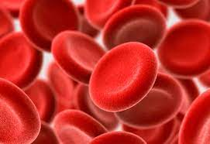
MDS diagnosis and risk stratification:
Getting a facelift
Amy E. DeZern, MD, MHS
Associate Professor of Oncology and Medicine
Division of Hematologic Malignancies
Sidney Kimmel Comprehensive Cancer Center at Johns Hopkins
Notes:
• 15–17-minute presentation of your talk with no more than 18 to 20 slides
• One-minute summary of your talk
• 15–20-minute Q&A session with one of the chairs
The presentation will be on the topic of:

Slide 2
Objectives
Describe standard MDS diagnosis
  History
  Recent updates 2022
Reexamine MDS risk stratification
  History
  Recent updates 2022

Slide 3
Goals for MDS patients in the beginning
Accurately diagnose
  Ruling out other causes of cytopenia
Understand biology as feasible in current era
Risk stratify for an individual patient based on known data
Make appropriate therapeutic recommendations

Slide 4
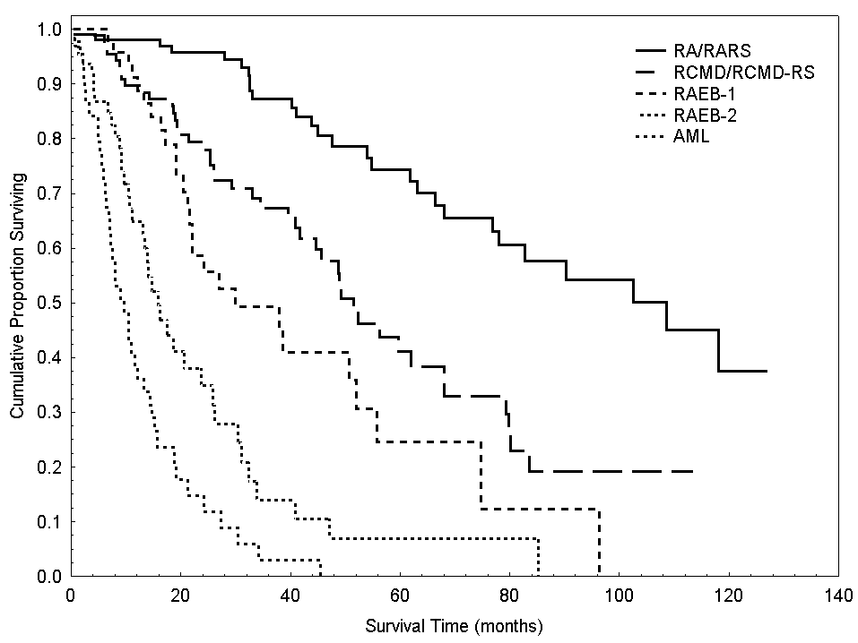
The Clinical Biology of MDS Can Vary Widely
Indolent conditions lasting years
Aggressive forms approaching AML
Malcovati et al. J Clin Oncol. 2005 Oct 20;23(30):7594-603
Notes:
Since the FAB classification in 1982, the extreme heterogeneity of MDS is a well-established notion. This notion was reinforced in 2001 by the first WHO classification of MDS. When we applied this classification systematically, we found that these disorders included indolent conditions lasting years, mainly characterized by isolated erythroid dysplasia, as well as aggressive forms approaching AML, mainly characterized by excess blasts. A risk-adapted treatment strategy is mandatory for such heterogeneous disorders.

Slide 5
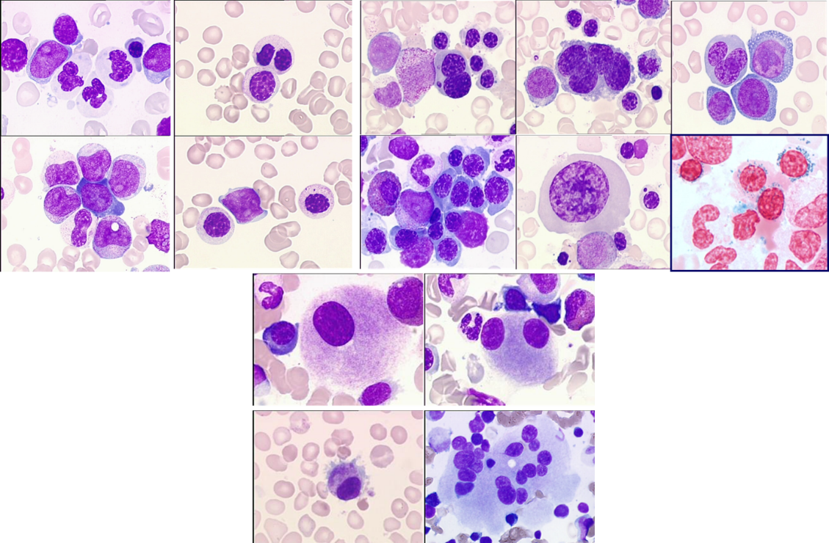
MDS Minimal Diagnostic Criteria
MDS major criteria
    Dysplasia of ≥10% of cells in 1 or more major BM lineage(s) (erythroid, neutrophilic, megakaryocytic) or an increase in RS of ≥15% (or ≥5% in the presence of a SF3B1 mutation)
    An increase in myeloblasts of 5%-19% in dysplastic BM smears or 2%-19% myeloblasts in peripheral blood smears
    An MDS-related (5q-, -7, complex…) karyotype
Prerequisite criteria: both 1 and 2 must be fulfilled
1. Persistent cytopenia(s)
  Hb <10 g/dL, or
  ANC <1800/μL, or
  Platelets <100 x 10⁹/L
2. EXCLUDE other causes of cytopenias and morphological changes:
  Vitamin B12/folate deficiency
  HIV or other viral infection
  Copper deficiency
  Alcohol abuse
  Medications (esp. methotrexate, azathioprine, recent chemotherapy)
  Autoimmune conditions (ITP, Felty syndrome, SLE, etc.)
  Hereditary BMF syndromes (Fanconi anemia, etc)
  Other hematological disorders (aplastic anemia, LGL disorders, MPN, etc)
At least 1 of these major MDS criteria has to be met (together with prerequisite criteria) to arrive at the diagnosis of MDS
Valent. Oncotarget. 2017;8:73483. NCCN Guidelines in Oncology: Myelodysplastic Syndromes. V3.2022.
Notes:
ANC, absolute neutrophil count; BM, bone marrow; BMF, bone marrow failure; ITP, immune thrombocytopenia; LGL, large granular lymphocyte; MDS, myelodysplastic syndrome; MPN, myeloproliferative neoplasm; RS, ring sideroblasts; SLE, systemic lupus erythematosus

Slide 6
Evolution in MDS
Currently Approved Therapies in MDS→AML
2022: IPSS-M
WHO 2022
ICC 2022
2005: Lenalidomide
for 5q Minus Syndrome
FAB 1982
NGS 2011
WHO 2016
IPSS 1997
Cytogenetics 1970;
Chromosomes Leukemia 1979
2006: Decitabine
IPSS-R 2012
*Erythropoeisis-stimulating agents approved in Europe and widely used in US
WPSS 2007
1970…1980… 2000 2003 2005 2007 2009 2011 2013 2015 2017 2018 2020 2022
FPSS 2011
2020
--Luspatercept for MDS-RS
--Decitabine/
Cedazurine
2004: Azacitidine
Diagnostic System
Prognostic System
Treatment
2008
--WHO 2008
--MDS-LR
--MDAS
Notes:
However, in many myeloid diseases that are biologically- related to MDS - there are a number of truly targeted agents–
and a timeline like this shows the progress that can be made when we understand the genetics of a disease like CML or AML. And then target those mutations.
CLICK

Slide 7
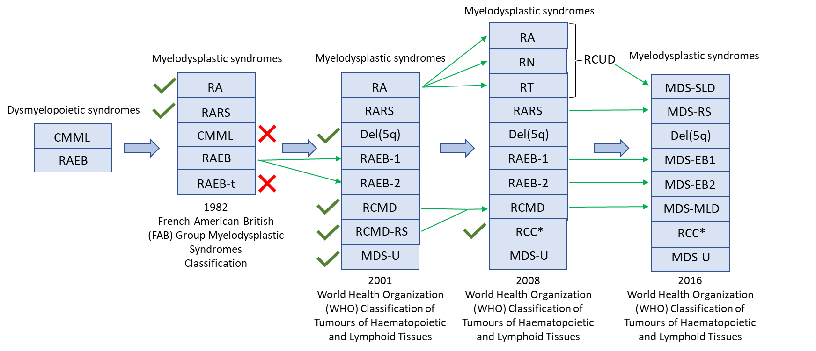
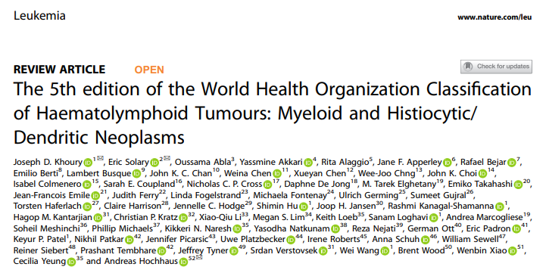
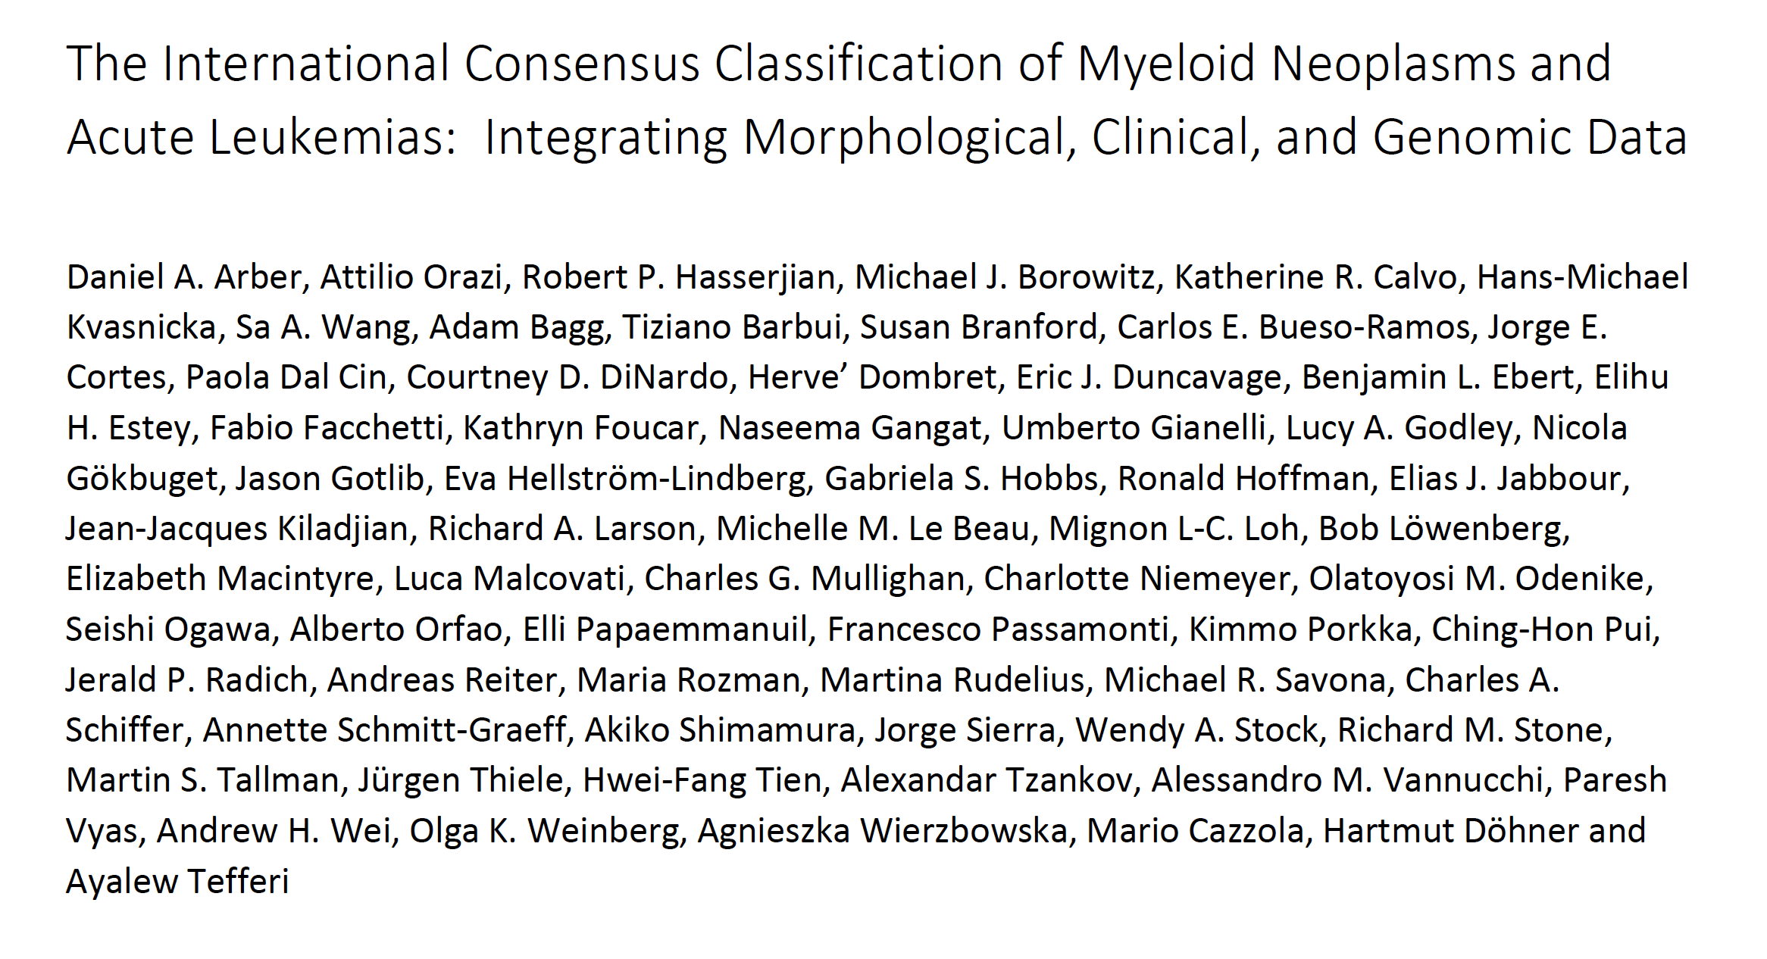
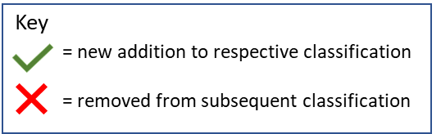
MDS classification has evolved over time
WHO 2022
ICC 2022
Zeidan A et al, Blood Reviews, 2019; Khoury J et al, Leukemia; Arber D et al, Blood 2022

Slide 8
Comparison of the 2022 WHO and ICC for MDS
MORPHOLOGY |  | WHO 2016 | WHO 2022 | ICC 2022
Ring Sideroblasts | RS ≥15% | MDS with ring sideroblasts and single lineage dysplasia (MDS-RS-SLD) and multi-lineage dysplasia (MDS-RS-MLD) | MDS with ring sideroblasts (MDS-RS): Low blast, SF3B1 wild-type | No RS specific category
Number of Dysplastic Lineages | 1 vs. >1 | MDS with single lineage dysplasia (MDS-SLD) and multi-lineage dysplasia (MDS-MLD) | Dysplastic lineages are removed MDS with low blasts (MDS-LB): <5% BM and <2% PB | MDS, not otherwise specified with single lineage dysplasia (MDS, NOS-SLD) and multi-lineage dysplasia (MDS, NOS-MLD)
Blasts | 5-9% | MDS with excess blasts-1 (MDS-EB1): 5-9% BM blasts | MDS with increased blasts-1 (MDS-IB1): 5-9% BM and/or 2-4% PB blasts | MDS with excess blasts (MDS-EB; 5-9% BM and/or 2-9% PB blasts or Auer rods)
 | 10-19% | MDS excess blasts-2 (MDS-EB2): 10-19% BM or PB blasts or Auer rods | MDS with increased blasts-2 (MDS-IB2): 10-19% BM or 5-19% PB blasts or Auer rods | MDS/AML (10-19% BM or PB blasts)
Added Subgroup | WHO | Not included | MDS, hypoplastic (MDS-h): Hypocellular marrow (age-adjusted) | Not included
 |  | Not included | MDS with fibrosis (MDS-f): BM blasts 5-19%, PB blasts 2-19%; BM Fibrosis- grade ≥ 2 | Not included
Removed |  | MDS unclassifiable | Not included | Not included
Arber et al. Blood. 2016; Khoury et al. Leukemia. 2022; Arber et al. Blood. 2022.

Slide 9
Comparison of the 2022 WHO and ICC for MDS
GENETICS |  | WHO 2016 | WHO 2022 | ICC 2022
Genetically Defined Subgroups | SF3B1 | No specific category | MDS-SF3B1: MDS with low blasts (BM <5%, PB <2%) and SF3B1 mutation No del 5q, -7, complex karyotype No TP53, RUNX1, EZH2, or NPM1 mutations | MDS-SF3B1: MDS with low blasts (BM <5%, PB <2%) and SF3B1 mutation SF3B1 VAF ≥10% No del 5q, -7, complex karyotype - No multi-hit TP53 or RUNX1 mutations
 | 5q | MDS with isolated del(5q) | MDS-5q: MDS with low blasts and isolated del 5q | MDS del(5q): MDS with isolated Del 5q or with 1 other cytogenetic abnormality except -7/del(7)
 | TP53 mutation (supersedes all other MDS categories) | Not included | MDS-biTP53: MDS with biallelic TP53 inactivation - ≥2 TP53 mutations, or 1 mutation with evidence of TP53 copy number loss or cnLOH | MDS with mutated TP53 MDS/AML with mutated TP53 - MDS (blast <10%): Criteria same as WHO or, 1 TP53 mutation plus complex karyotype - MDS/AML (blast 10-19%): Any TP53 mutation (VAF ≥10%)
Other genetic Subgroups | MDS-related gene mutations and cytogenetic abnormalities | Not included | MDS with low or excess blasts with other defined gene alterations | MDS/AML with myelodysplasia related gene mutations MDS/AML with myelodysplasia related cytogenetic abnormalities
Arber et al. Blood. 2016; Khoury et al. Leukemia. 2022; Arber et al. Blood. 2022.

Slide 10
WHO 2016
ICC 2022
WHO 2022
Increased BM fibrosis
MDS with fibrosis
MDS or MDS/AML-TP53
MDS-TP53
biTP53mut
MDS-EB1
5-9% BM / 2-4% PB
MDS-EB
5-9% BM / 2-9% PB
MDS-IB1
5-9% BM / 2- 4% PB
MDS-EB2
5-9% BM / 5-9% PB
MDS-IB2
10-19% BM / 5-19% PB
MDS-EB2
10-19% BM / 10-19% PB
MDS/AML
10-19% BM / 10-19% PB
AML
≥20% BM / PB
AML
≥20% BM / PB
AML-defining genetics
AML
≥10% BM / PB
AML-defining genetics
AML
Any BM / PB blasts
AML-defining genetics
Courtesy of Rob Hasserjian, MD

Slide 11
SF3B1-mutant MDS as a new molecular entity
International Consensus Classification of Myeloid Neoplasms
Persistent cytopenia
No excess blasts
SF3B1 mutation (VAF ≥10%)
No concomitant mutation in RUNX1
Absence of TP53 multi-hit state
Arber et al. Blood. 2022 Sep 15;140(11):1200-1228
Notes:
The International Consensus Classification of Myeloid Neoplasms includes SF3B1-mutant MDS as a new molecular entity, characterized by Persistent cytopenia, No excess blasts, SF3B1 mutation (VAF ≥10%), No concomitant mutation in RUNX1, and Absence of TP53 multi-hit state

Slide 12
MDS with mutated TP53 as a new molecular entity
International Consensus Classification of Myeloid Neoplasms
Persistent cytopenia
Less than 10% blasts
TP53 multi-hit state (VAF ≥10%)
Or TP53 mutation (VAF ≥10%) plus complex karyotype
Arber et al. Blood. 2022 Sep 15;140(11):1200-1228
Notes:
The International Consensus Classification of Myeloid Neoplasms includes MDS with mutated TP53 as a new molecular entity, characterized by persistent cytopenia, less than 10% blasts, TP53 multi-hit state (VAF ≥10%), or TP53 mutation (VAF ≥10%) plus complex karyotype.

Slide 13
MDS morphologic and molecular classifications and their implications
WHO 2022 over ICC
Potential for MDS-IB2 patients to be eligible for AML-type as well as MDS treatment.
More consistency
Concern that lowering the blast threshold for AML diagnosis from 20% to 10% could arbitrarily diminish the ability to analyze and manage pts,→ ?risk of over-treatment
Notes:
need for persisting understanding of the transitional nature of MDS, with its important features for discerning biologic mechanisms causing the evolutionary potential of relative indolent to aggressive stages of myeloid diseases, more recognition of the mutational impact on the disease and its treatment.

Slide 14
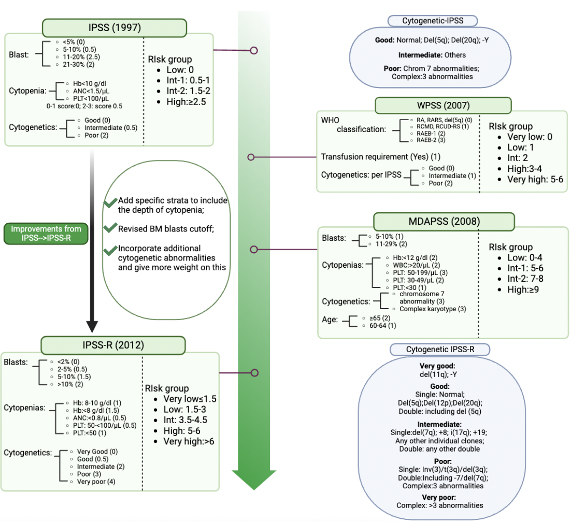
Evolution of Prognostic Scoring Systems
Xie Z et al, Blood Reviews, 2022

Slide 15
Evolution of Prognostic Scoring Systems
 | Blasts | Cyto | HGB | Plts | ANC | Txn | Age | PS
1. IPSS
2. WPSS(time dependent)
3. MDS-LR (lower risk only)
4. MDAS (more variables)
5. FPSS (higher risk + AZA)
6. IPSS-R
** none with molecular to date
1. Blood. 1997; 89(6):2079–88. [PubMed: 9058730], 2. ASCO. 2007; 25(23):3503–10. [PubMed: 17687155]; 3. Leukemia. 2008; 22(3):538–43. [PubMed: 18079733]; 4. Cancer. 2008; 113(6):1351–61. [PubMed: 18618511]; 5. Blood. 2011; 117(2): 403–11. [PubMed: 20940414]; 6. Blood. 2012; 120(12):2454–65. [PubMed: 22740453]

Slide 16
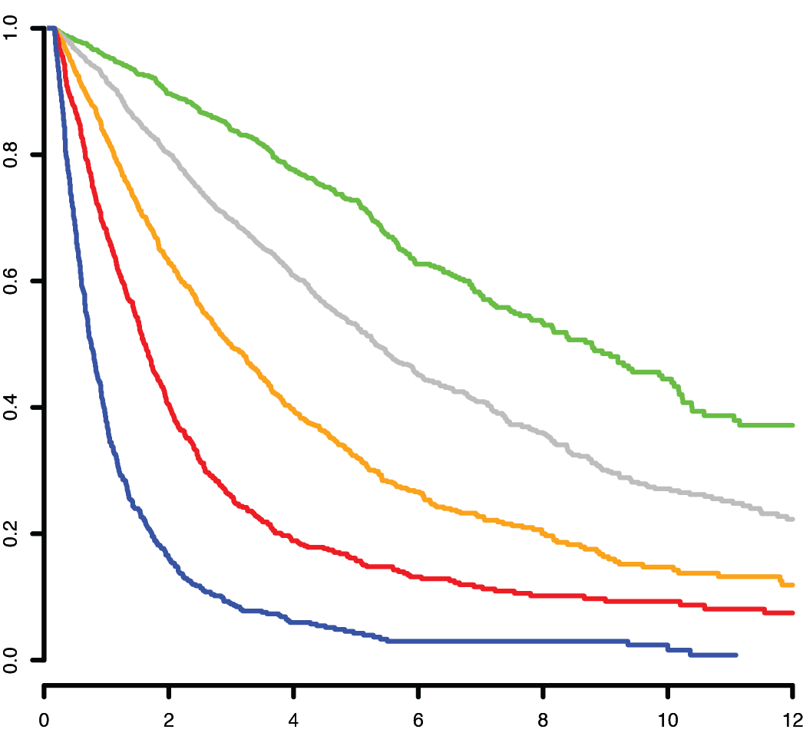
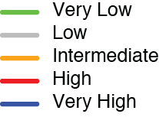
Prognosis by the Revised IPSS (IPSS-R)
Prognostic Variable | 0 | 0.5 | 1 | 1.5 | 2 | 3 | 4
Cytogenetics | Very Good |  | Good |  | INT | Poor | Very Poor
BM blast % | < 2 |  | >2 <5 |  | 5 -10 | >10
Hemoglobin | > 10 |  | 8 - <10 | < 8
Platelets | > 100 | 50–<100 | < 50
ANC | > 0.8 | < 0.8
Risk Category
Very Low | < 1.5
Low | > 1.5 - 3
Intermediate | > 3 – 4.5
High | > 4.5 - 6
Very High | >6
IPSS: Int-1, median OS: 42 months
IPSS-R score 3.5 (INT), median OS: 36 months
Greenberg et al. 2012. Blood 120:2454

Slide 17
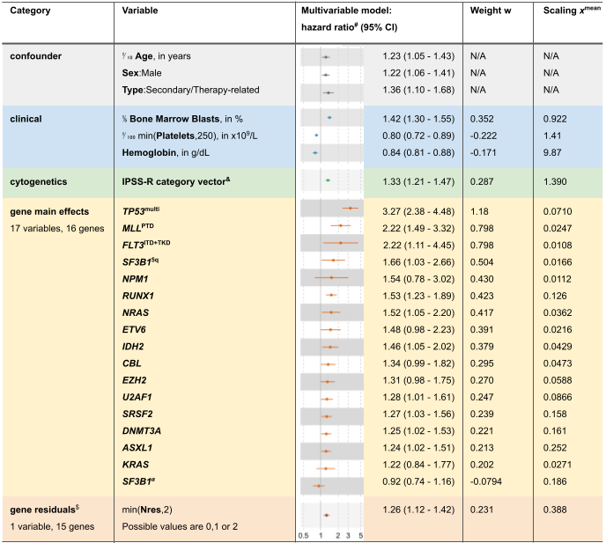
Building the IPSS-M Model
Model fit with a robust Cox multivariable regression adjusted for confounder variables
Adjusted for confounder variables
Age, sex, MDS type (primary, therapy-related)
Included in the fit but not in the score
Continuous clinical parameters
Marrow blasts, platelets, hemoglobin – NOT ANC!
IPSS-R cytogenetic categories
Unchanged in the IPSS-M
17 genetic variables from 16 main effect genes
Individual weights attributed to each variable
1 genetic variable from 15 residual genes
Number of mutated genes (0, 1 or 2)

Slide 18
Residual Genes – Accounting for Additional Risk

Slide 19
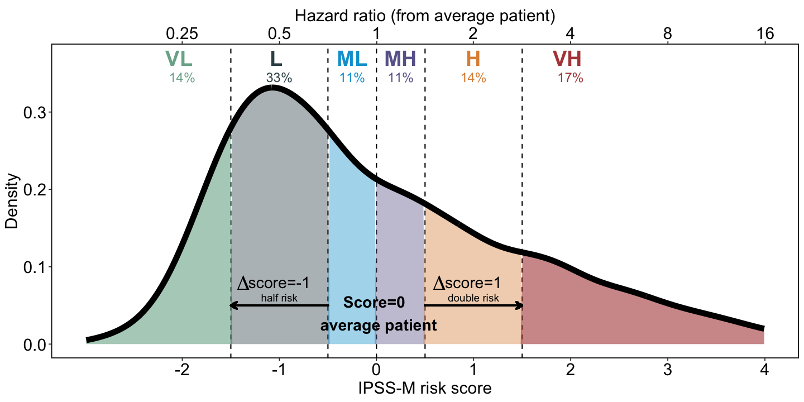
The IPSS-M Risk Score
A six-category risk schema
Very Low | Low | Moderate Low | Moderate High | High | Very High
LOWER RISK
HIGHER RISK

Slide 20
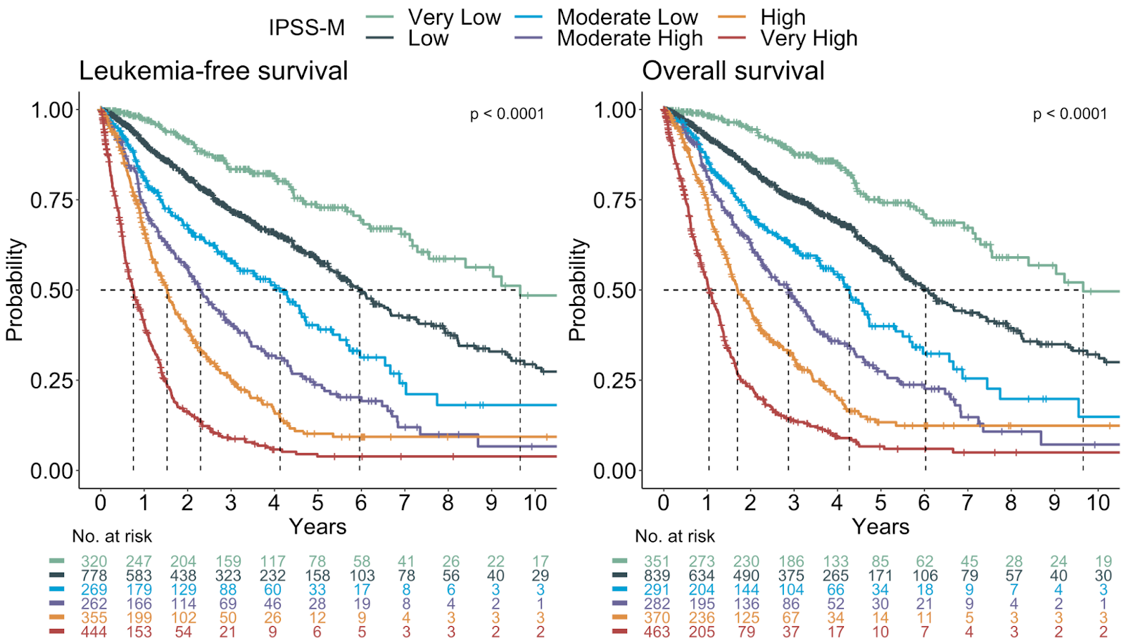
The IPSS-M Risk Categories
A six-category risk schema
Very Low | Low | Moderate Low | Moderate High | High | Very High
Prognostic separation of the IPSS-M risk categories

Slide 21
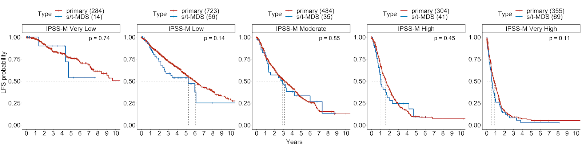
Utility in Clinical Settings
Across sex, in low-blast-count AML (n=125), and in therapy-related MDS (n=234)
Similar outcomes between primary and t-MDS within each IPSS-M category

Slide 22
IPSS M Summary
Retains the cytogenetic risk groups from the IPSS-R
Clinical variables are encoded continuously for greater accuracy
17 main genetic features and 15 residual aggregate features
A score of 0 is median risk and +1 point is double the LFS-risk
Valid with t-MDS, low blast AML, and in treated MDS patients
The IPSS-M Improves Risk Stratification over the IPSS-R!
https://mds-risk-model.com/

Slide 23
Independent validation of the IPSS-M
626 de novo MDS pts 2005-2020
Median follow-up 9.5 years
Distribution of 6 IPSS-M risk categories comparable
  15% VL
  41% L
  11% ML
  7% MH
  12% H
  14% VH
worse discrimination of the MH risk
Baer et al. Leukemia. 2023 Feb 1.

Slide 24
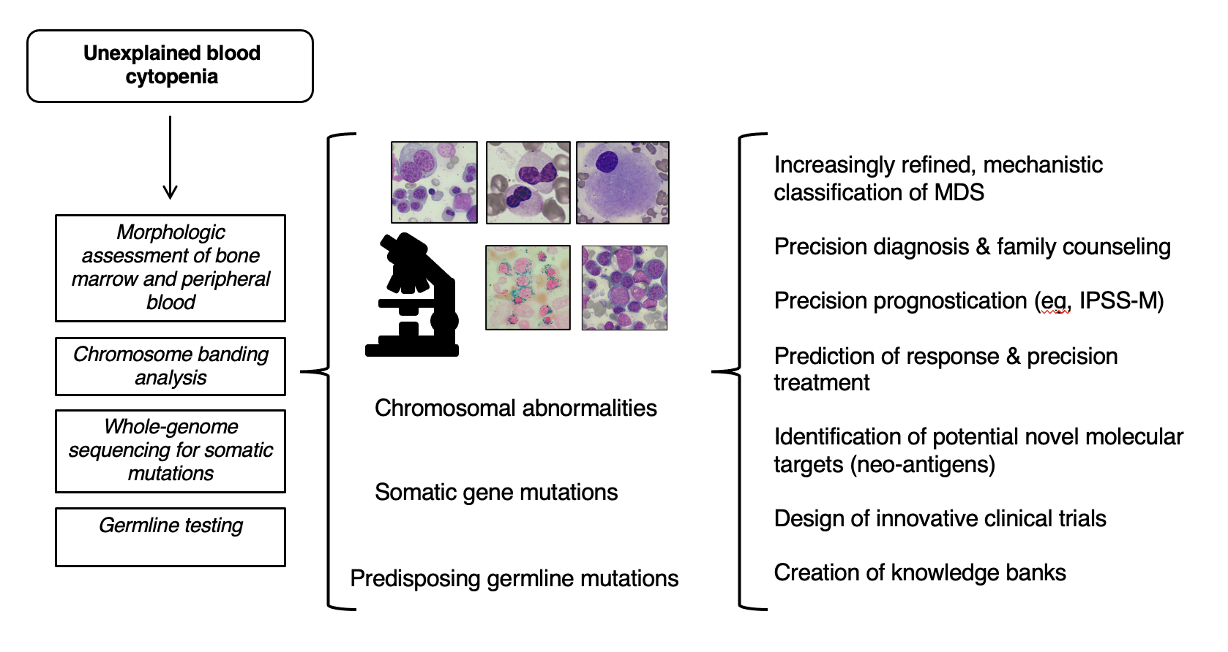
Appropriate diagnosis and risk stratification in MDS:
The Future will be therapies for patients
Duncavage et al. Blood. 2022 Nov 24;140(21):2228-2247
Notes:
This is my final, visionary slide. In a number of years, reference centers will routinely use morphology, chromosome banding analysis, whole-genome sequencing for somatic mutations, and germline testing for the diagnosis and risk stratification of MDS. To make this feasible ad hoc infrastructures should be built in our health systems

Slide 25
Accurate diagnosis and prognosis influences
treatment and outlook for MDS patients
MDS is a complex group of bone marrow malignancies causing marrow failure
  Challenging to diagnosis– biology is key
  Marrow testing critical to obtain information
    Morphology, cytogenetics, molecular profiles
Important to understand the disease prognosis and implications for therapy
    IPSS-M – 2023 starting point for risk stratification
      Predictive and prognostic significance
      Targetable mutations possible
Notes:
Accurate diagnosis influences treatment and outlook
Avoids inappropriate therapies
Too aggressive or too conservative?
Helps patients and family manage expectations
Is this a larger familial predisposition?
Clonal hematopoiesis is associated with increased overall mortality
Increased risk of hematologic malignancy (monitoring for us)
Increased risk of therapyrelated malignancy (Monitoring for solid oncologists)
Increased risk of cardiovascular disease (MI, CVA)
Systematic diagnostic algorithms allow for efficient clinical care and facilitateeducation and research

Slide 26
Thank you!!
Happy for questions.

