Slide 1


Allogeneic HCT in MDS: How to cure more patients
Bart Scott, MD
Member, FHCRC
Professor, UWMC

Slide 2
Disclosures
Novartis: consultant, research funding
Celgene/BMS: consultant, advisory board
Incyte: consultant, honorarium
Agios: consultant
Alexion: advisory Board
Taiho Oncology: consultant

Slide 3
Synopsis
Why HCT?
Just say no!
  Age
  Comorbidities
  No donor
  Bad Disease
  Socioeconomic Issues

Slide 4
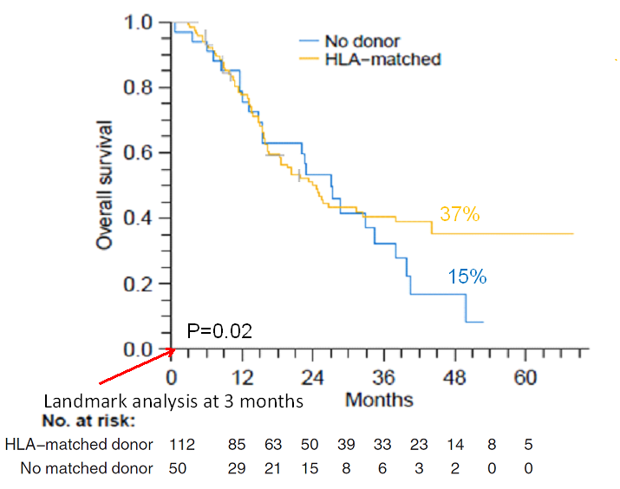
OS Donor vs. No Donor
N=50 HMA 88%, IC 24% no RX 8%;med age 61
N=112 (54 MRD, 58 MUD 10/10);med age 60
Eligibility: 50-70 years MDS/AML/CMML
Int-2/High or Int-1 with low plts
HCT upfront if BM blasts <10%
> 10% IC (n=40) or Aza (n=117)
RIC HCT Flu/BU2/rATG w/in 6 mos (med 8)
PBSC grafts (no cord, no haplo)
31 w/ donor no HCT
16 excess BM blasts
9 comorbidities
4 early death
2 other (refusal and social)
11 w/ no donor received HCT
Marginal Structural Model
> 2 years HR 0.024 (0.003-0.22) P=0.0009
Robin, M. et al. Leukemia 2015;29:1496-1501
Notes:
Prospective donor vs no donor comparison from the GFM group

Slide 5
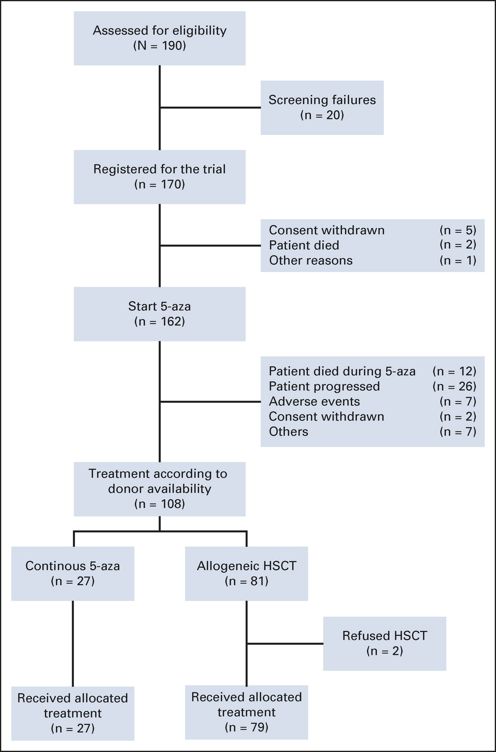
VidazaAllo Study
Eligibility: 55-70 MDS/CMML FAB criteria
4-6 cycles of Aza followed by RIC PBSCT or continued Aza
Int-2/High or int-1 with high risk cyto by IPSS
Donor group 10/10 HLA-matched URD or MRD
Primary endpoint 3 yr OS
80% power to detect 20% difference in 3-year OS. Trial was stopped early due to poor accrual. The anticipated 3-year OS was 50% in HCT group and 30% in aza group. The anticipated HCT group was 66 and the aza group was 44. the study was not powered to see a difference in OS.
Med age 63
FLAMSA or Flu/Bu2
Med age 65
Kröger et al. Jnl Clin Oncol. 2021;39:3318-3327

Slide 6
VidazaAllo Study
7% died due to infectious complications while Rx with Aza
16% progressed on Rx with Aza
Kröger et al. Jnl Clin Oncol. 2021;39:3318-3327

Slide 7
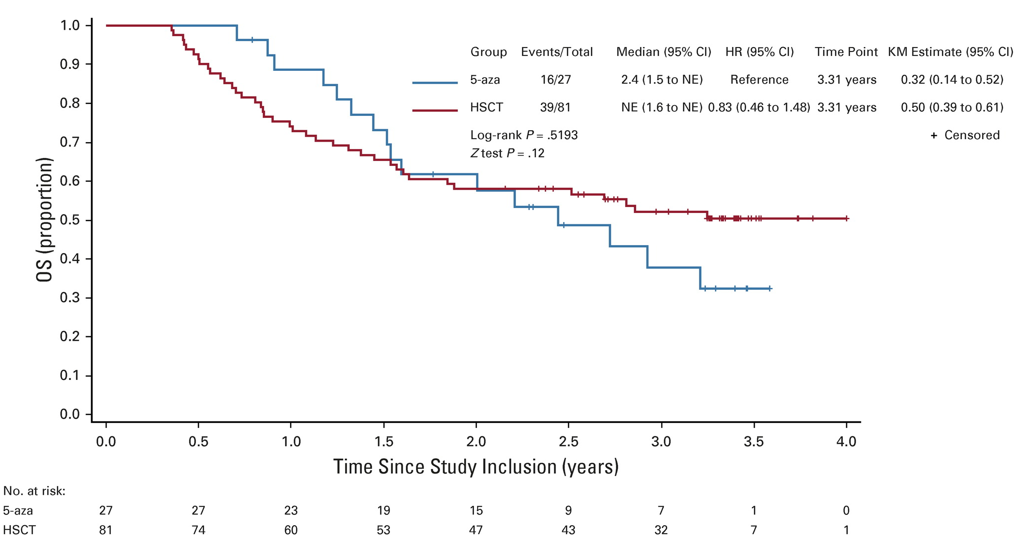
VidazaAllo Study
14 patients in the continued Aza arm received alt donor HCT after progression
Kröger et al. Jnl Clin Oncol. 2021;39:3318-3327

Slide 8
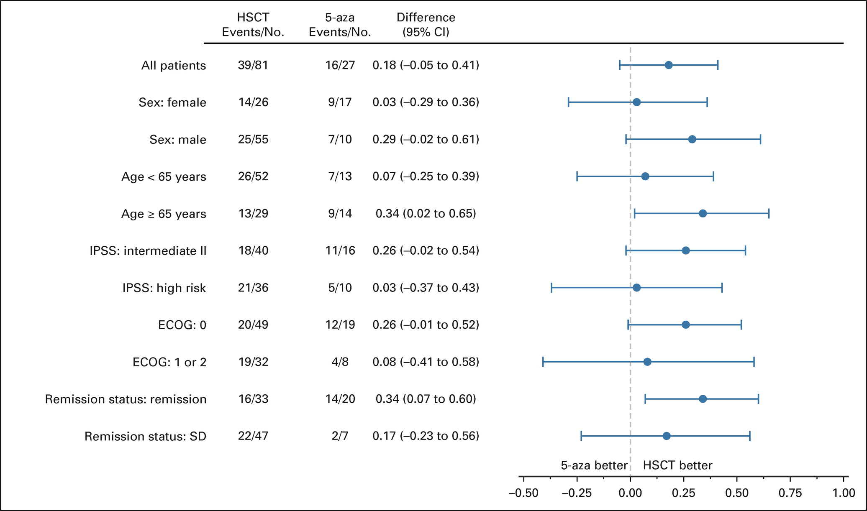
VidazaAllo Study
Kröger et al. Jnl Clin Oncol. 2021;39:3318-3327

Slide 9
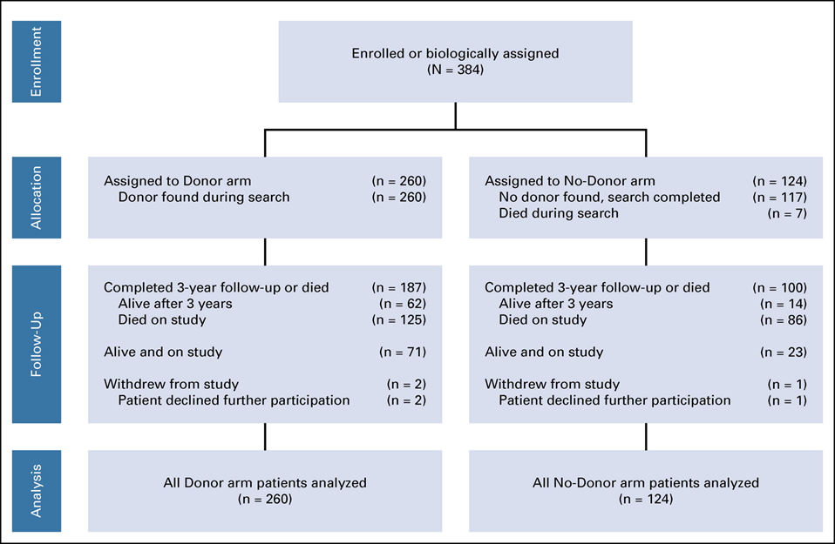
BMT CTN 1102
Eligibility: 50-75 denovo MDS
Int-2/High IPSS
Donor group 8/8 HLA-matched URD or MRD
90 day search window
RIC HCT within 6 mos
Prior or ongoing HMA therapy allowed
No prior URD search
80% power to detect 15% difference in 3-yr OS
Med age 66
Med age 67
Did not undergo HCT n=44
Progression to AML n=18
Patient preference n=16
Underwent HCT n= 26 MAC
Nakamura et al. Jnl Clin Oncol 2021;39:3328-3339

Slide 10
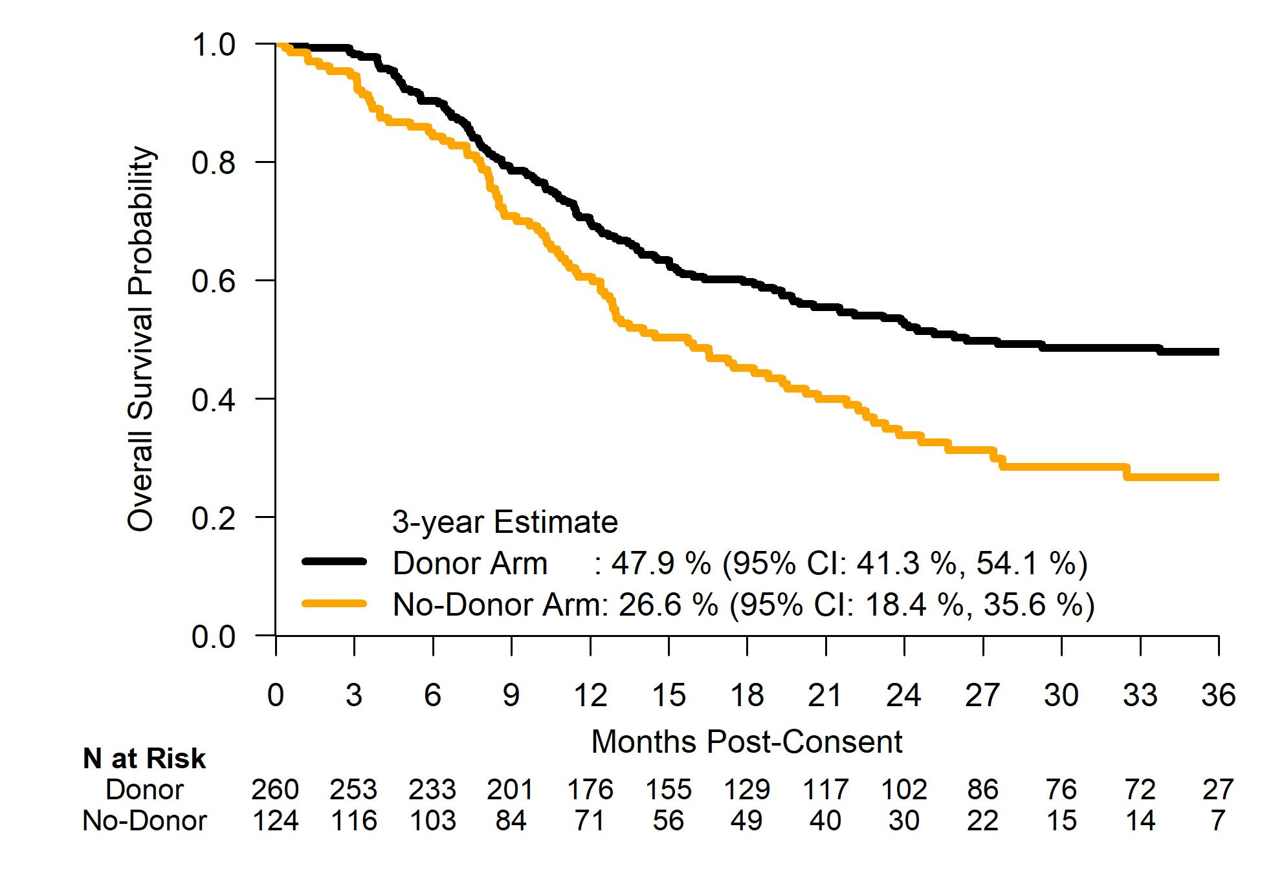
BMT CTN 1102
Absolute Improvement
21.3%, p=0.0001
Nakamura et al. Jnl Clin Oncol 2021;39:3328-3339

Slide 11
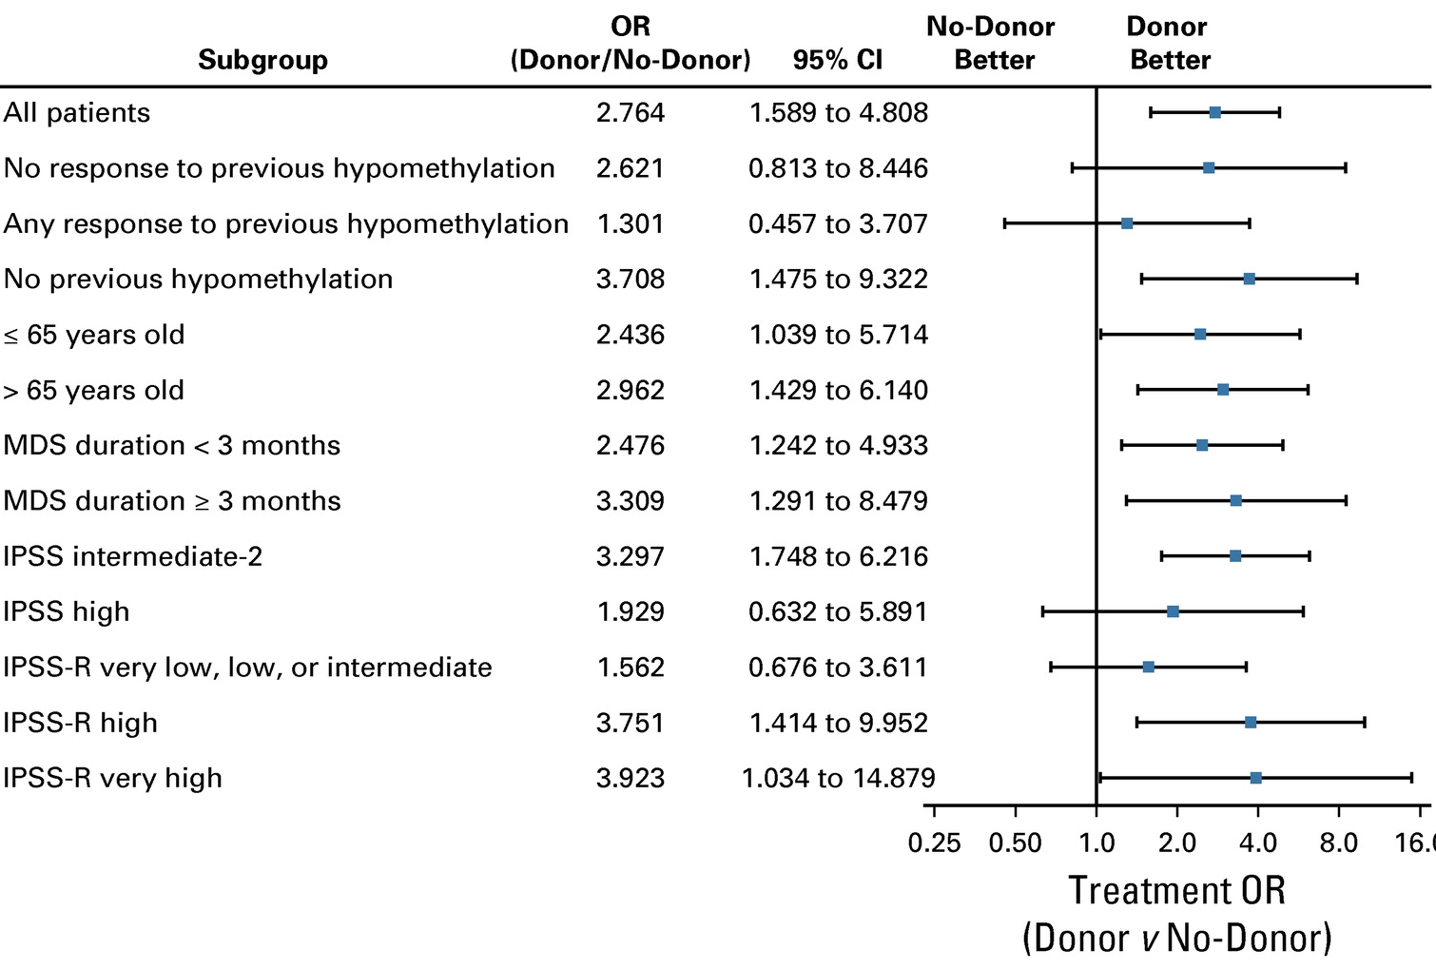
BMT CTN 1102
Nakamura et al. Jnl Clin Oncol 2021;39:3328-3339

Slide 12
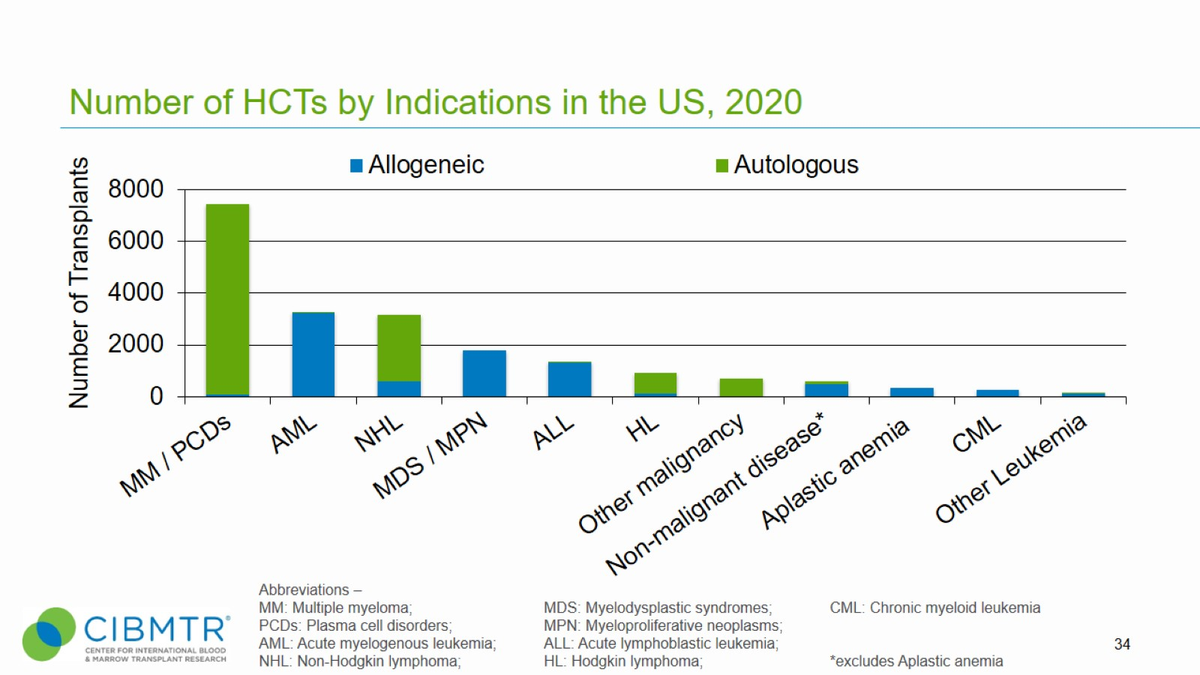
Number of HCTs by Indications in the US, 2020
Notes:
Slide 34: The most common indications for HCT in the US in 2020 were multiple myeloma and lymphoma (NHL and HL) accounting for 58% of all HCTs. Acute leukemias (AML, ALL) and MDS (combined with MPN) are the most common indications for allogeneic transplants accounting for 76% of allogeneic HCTs. MDS/MPN transplants have increased after the availability of Centers for Medicare and Medicaid Services (CMS)-approved Coverage with Evidence Development studies allowing allogeneic HCT in Medicare-insured patients for MDS (since 2010) and myelofibrosis (since 2017).
Non-malignant disease includes Inherited abnormalities erythrocyte differentiation or function (n=206), Severe combined immunodeficiency (SCID) and other immune system disorders (n=175), Inherited abnormalities of platelets (n=5), Inherited disorders of metabolism (n=54), Histiocytic disorders (n=51), and Autoimmune Diseases (n=5).

Slide 13
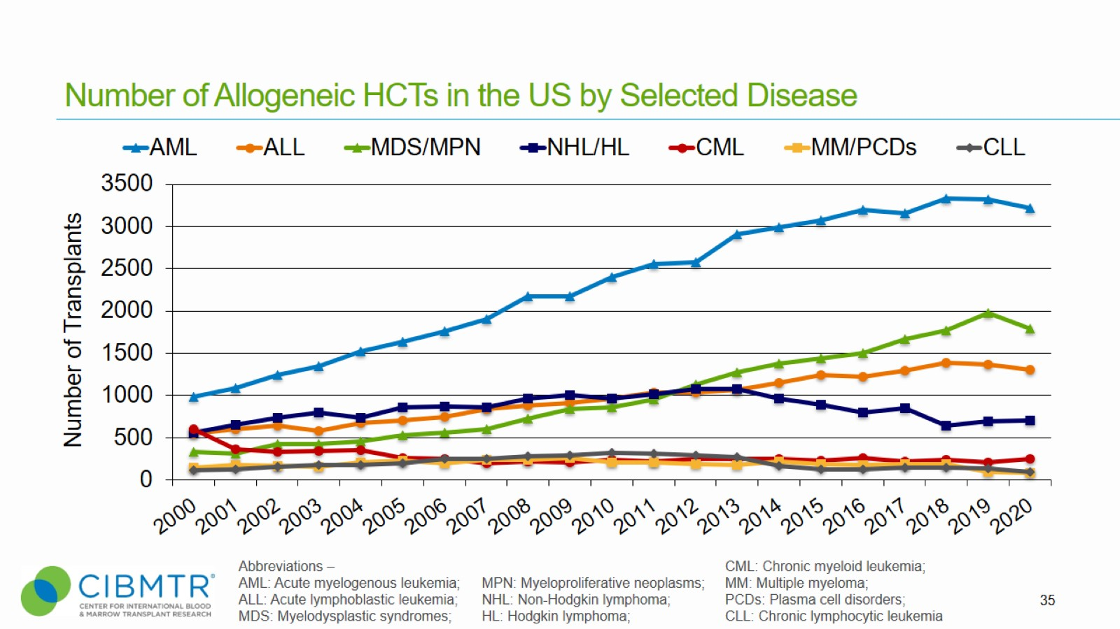
Number of Allogeneic HCTs in the US by Selected Disease
Notes:
Slide 35

Slide 14
Synopsis
Why HCT?
Just say no!
  Age
  Comorbidities
  No donor
  Bad Disease
  Socioeconomic Issues

Slide 15
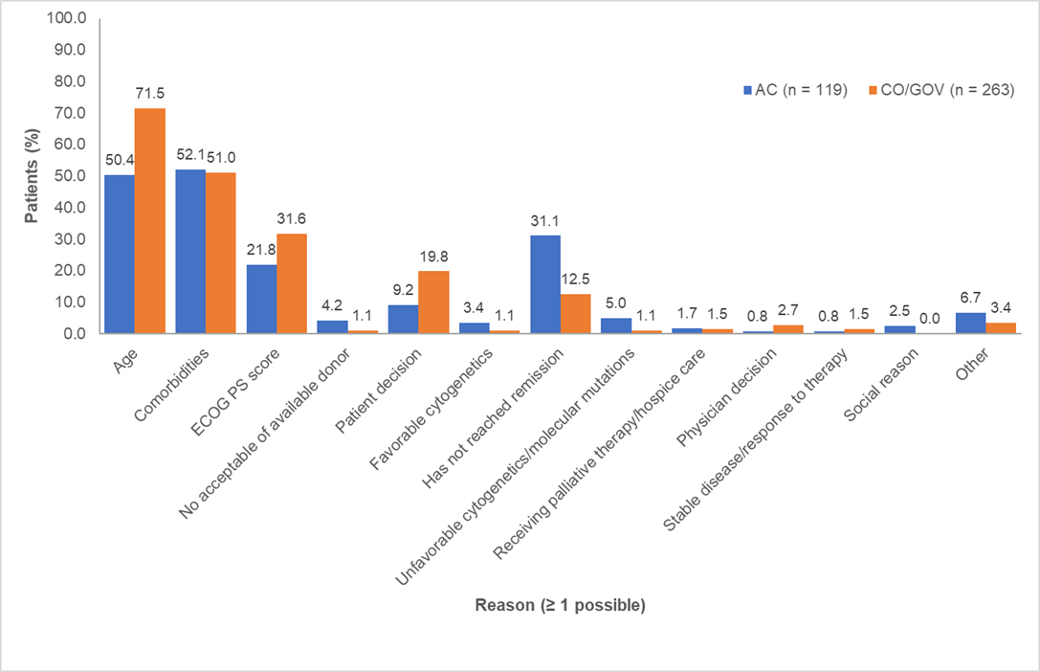
Connect Registry: Reasons not Considered for HCT
Age, median (range), yrs | 72 (19–97)
Diagnosis, n (%)
HR-MDS | 341 (43.8)
IR-AML | 252 (32.4)
AR-AML | 185 (23.8)
Tomlinson et al. TCT 2019

Slide 16
CONNECT Registry: Reasons not Eligible for HCT
Reason not eligible for transplant, n (%) (> 1 answer possible) | AC sites (n = 262) | CO/GOV sites (n = 516) | All sites (N = 778)
Patients not undergoing transplant | n = 73 | n = 79 | n = 152
Age | 3 (4.1) | 4 (5.1) | 7 (4.6)
Comorbidities | 2 (2.7) | 12 (15.2) | 14 (9.2)
Performance status | 4 (5.5) | 2 (2.5) | 6 (3.9)
No available or acceptable donor | 14 (19.2) | 11 (13.9) | 25 (16.4)
Patient decision | 11 (15.1) | 17 (21.5) | 28 (18.4)
Favorable cytogenetics | 1 (1.4) | 5 (6.3) | 6 (3.9)
Has not reached remission | 28 (38.4) | 23 (29.1) | 51 (33.6)
In transplant process | 9 (12.3) | 12 (15.2) | 21 (13.8)
Insurance | 3 (4.1) | 1 (1.3) | 4 (2.6)
Receiving treatment first | 5 (6.8) | 12 (15.2) | 17 (11.2)
HLA typing pending | 5 (6.8) | 3 (3.8) | 8 (5.3)
Other | 16 (21.9) | 31 (39.2) | 47 (30.9)
Tomlinson et al. TCT 2019

Slide 17
Synopsis
Why HCT?
Just say no!
  Age
  Comorbidities
  No donor
  Bad Disease
  Socioeconomic Issues

Slide 18
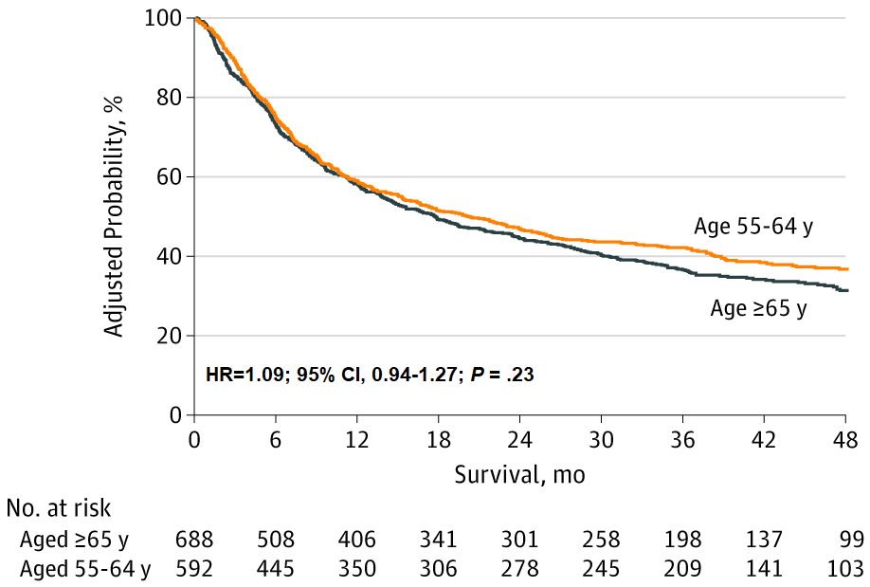
OS by Age Following AlloHCT
Med age 61
Med age 68 (65-79)
MAC 29%; RIC 71%
MAC 49%; RIC 51%
Atallah E, JAMA Oncol 6:486-493, 2020

Slide 19
Synopsis
Why HCT?
Just say no!
  Age
  Comorbidities
  No donor
  Bad Disease
  Socioeconomic Issues

Slide 20
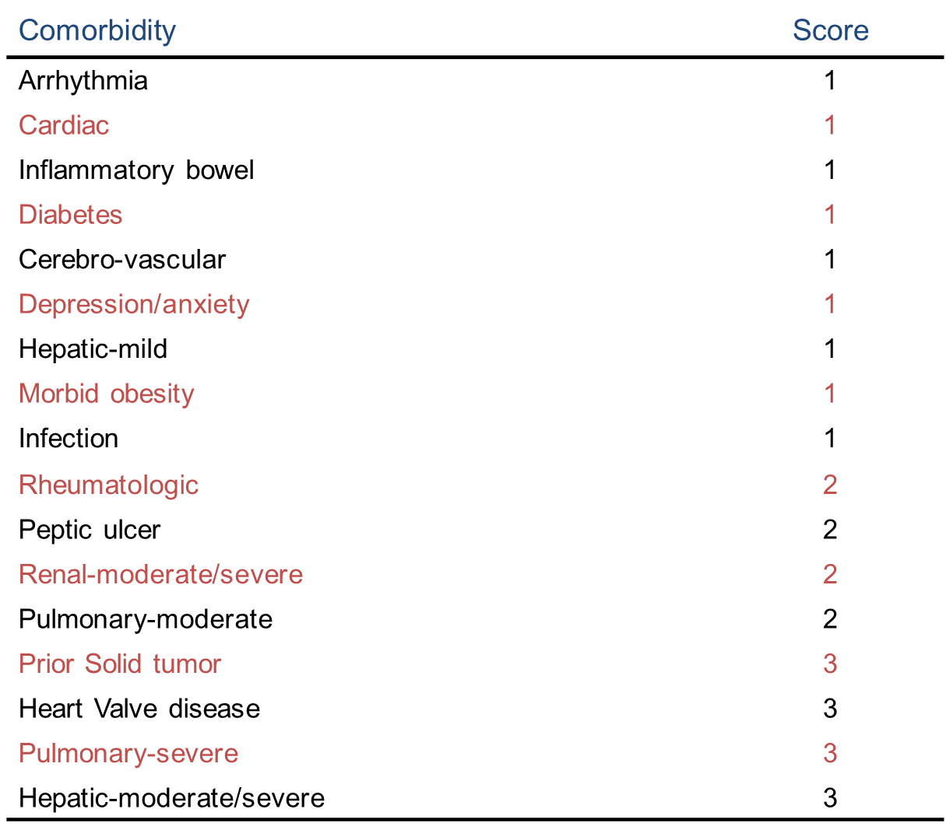
http://hctci.org/Home/Calculator

Slide 21
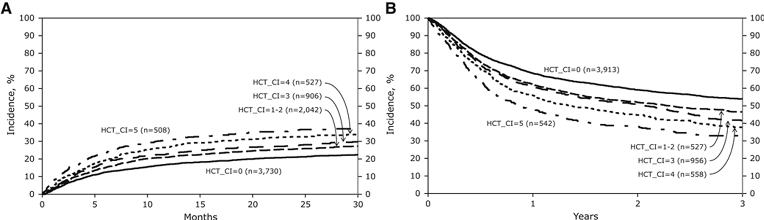
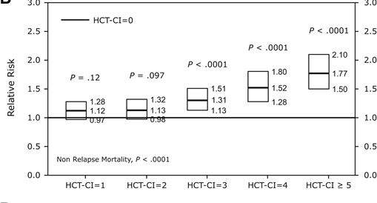
HCT-CI impact on post-HCT outcomes
NRM
OS
8,115 allo HCT malignant diseases
5,460 MAC; 2,655 RIC/NMA
3,317 AML
1,362 ALL
944 MDS
Sorror et al. BBMT 2015;21:1479-1487

Slide 22
Synopsis
Why HCT?
Just say no!
  Age
  Comorbidities
  No donor
  Bad Disease
  Socioeconomic Issues

Slide 23
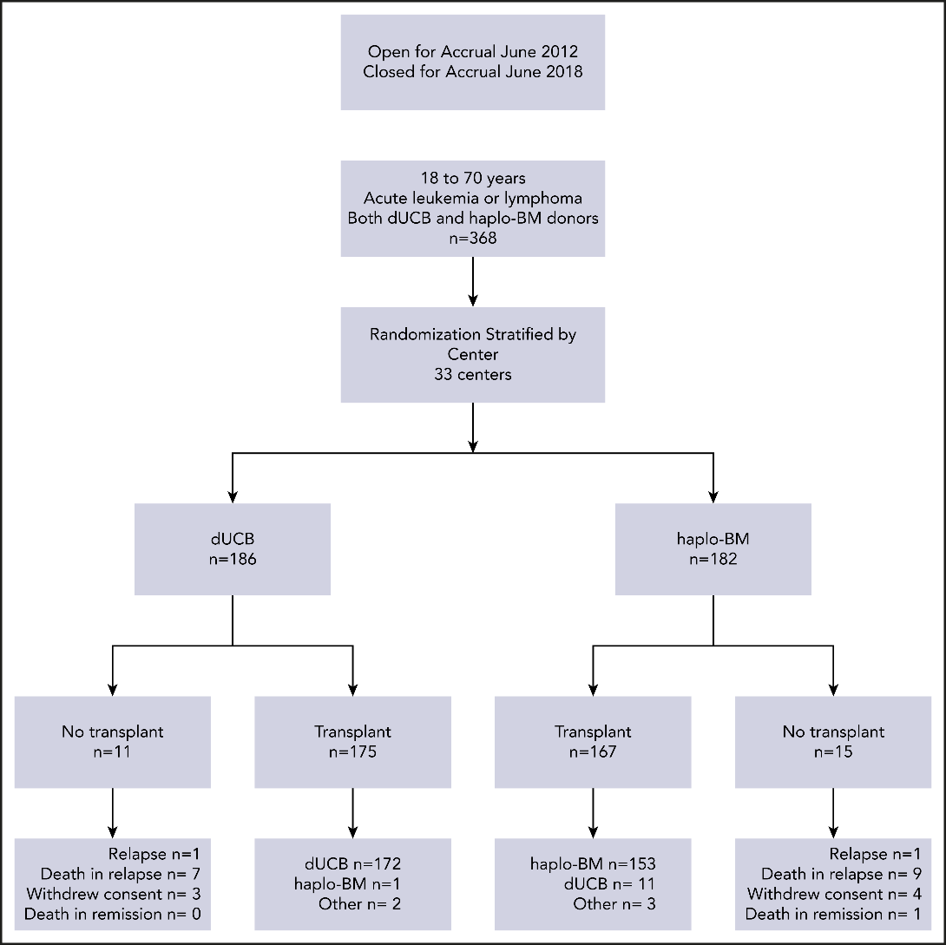
BMT CTN 1101: DCB vs Haplo
18-70 years
Acute leukemia or lymphoma
Both dUCB and haplo BM donors
N=368
Accrual plan was over 3 years
Closed after enrolling 368 patients:
90% of projected accrual. Closed early due to poor accrual.
AL n=134
Lymphoma n=52
AL n=133
Lymphoma n=44
Fuchs et alt. Blood (2021) 137 (3): 420–428.

Slide 24
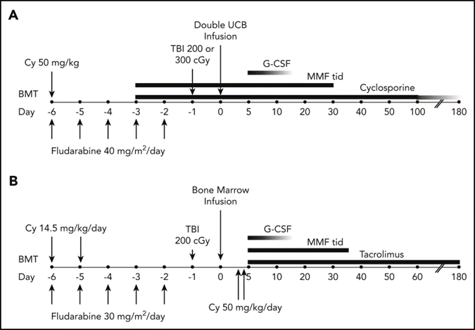
BMT CTN 1101: DCB vs Haplo
Fuchs et alt. Blood (2021) 137 (3): 420–428.

Slide 25
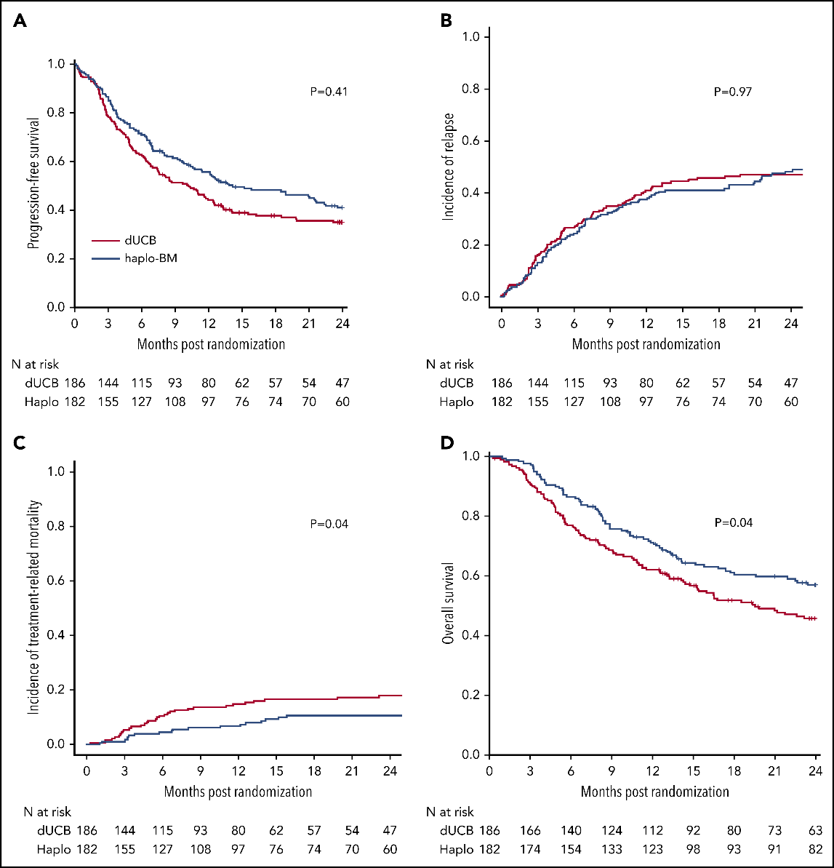
BMT CTN 1101: DCB vs Haplo
Fuchs et al. Blood (2021) 137 (3): 420–428.

Slide 26
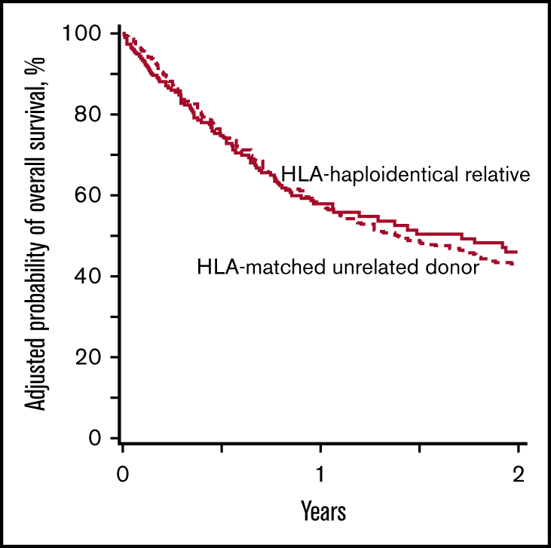
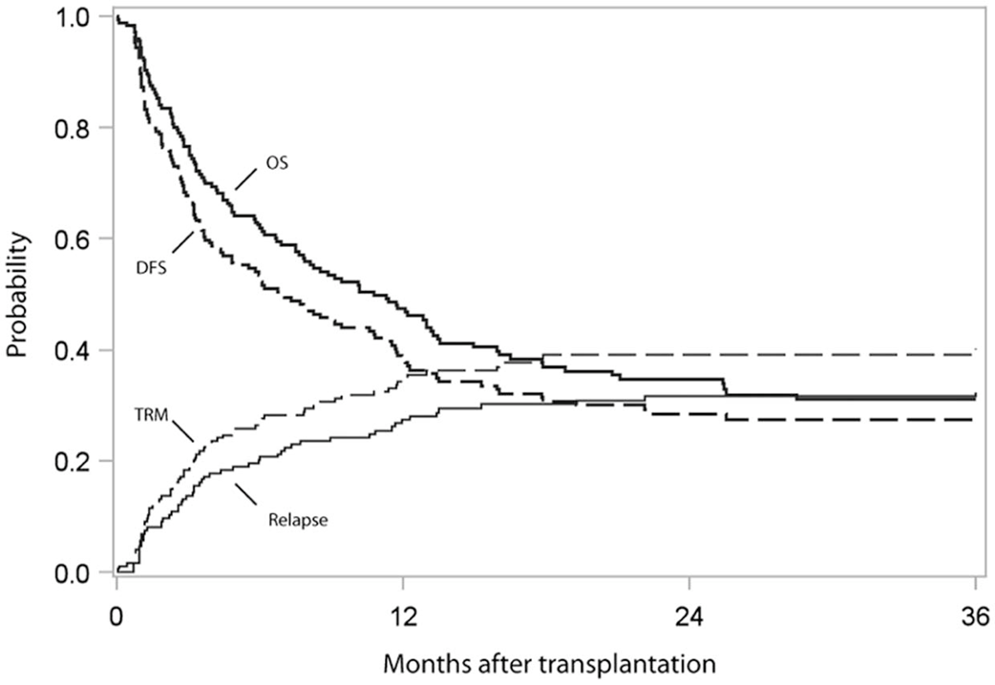
Outcomes with Alt. donors in MDS
CBT
N=176
N=176
N=427
Grunwald et al. TCT 2021;5:975-983
Gerds et al. BBMT 2017;23: 971-979

Slide 27
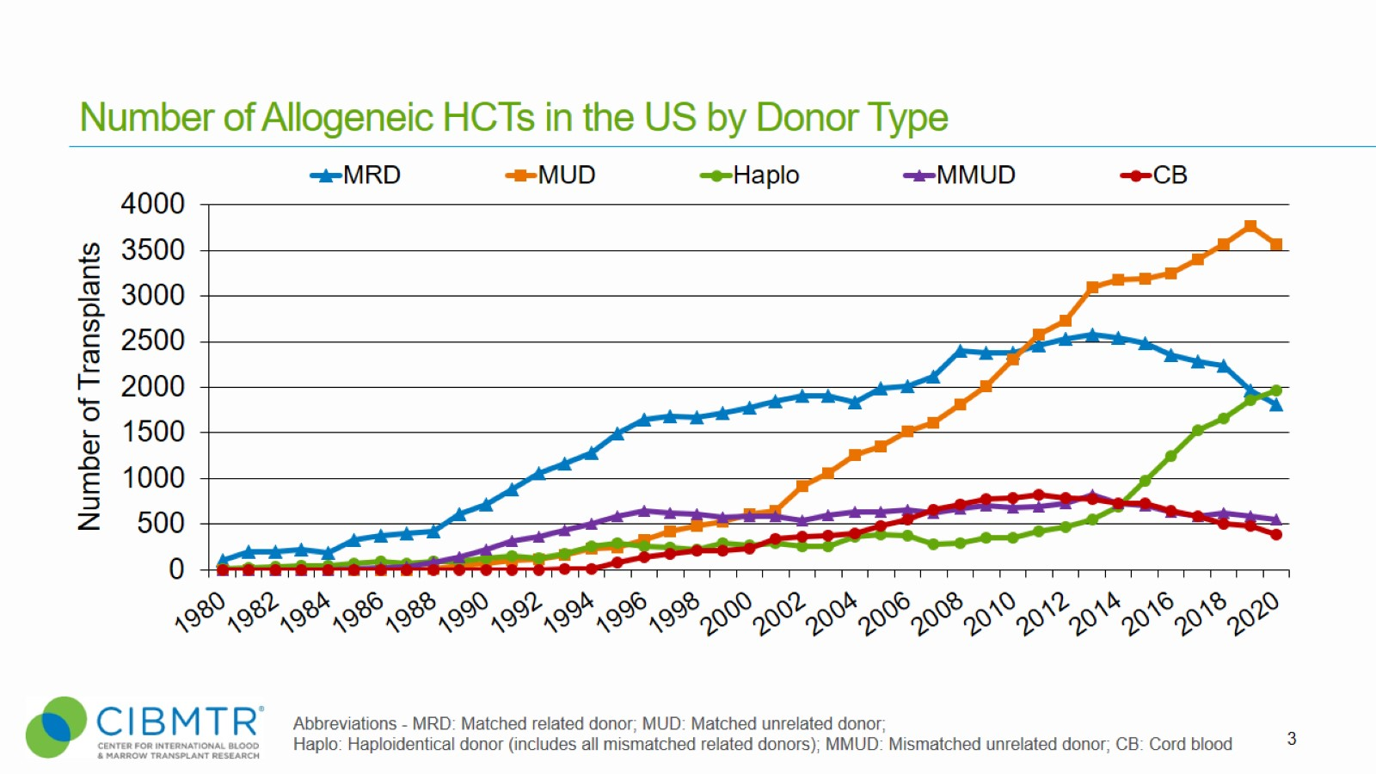
Number of Allogeneic HCTs in the US by Donor Type
Notes:
Slide 3: Upon further stratifying the number of allogeneic transplants in the US by donor type, matched related donor (MRD) transplants represent the largest group before 2010. After then, matched unrelated donor (MUD) transplants represent the largest group. After 2013, the number of MRD transplants has shown a downward trend in absolute numbers. MUD transplants plateaued from 2013-2016 but began rising again after 2016.
There is a steady increase in the number of haplo-identical donor (Haplo) transplants, while those performed using a mismatched unrelated donor (MMUD) or cord blood (CB) show a slight decline.

Slide 28
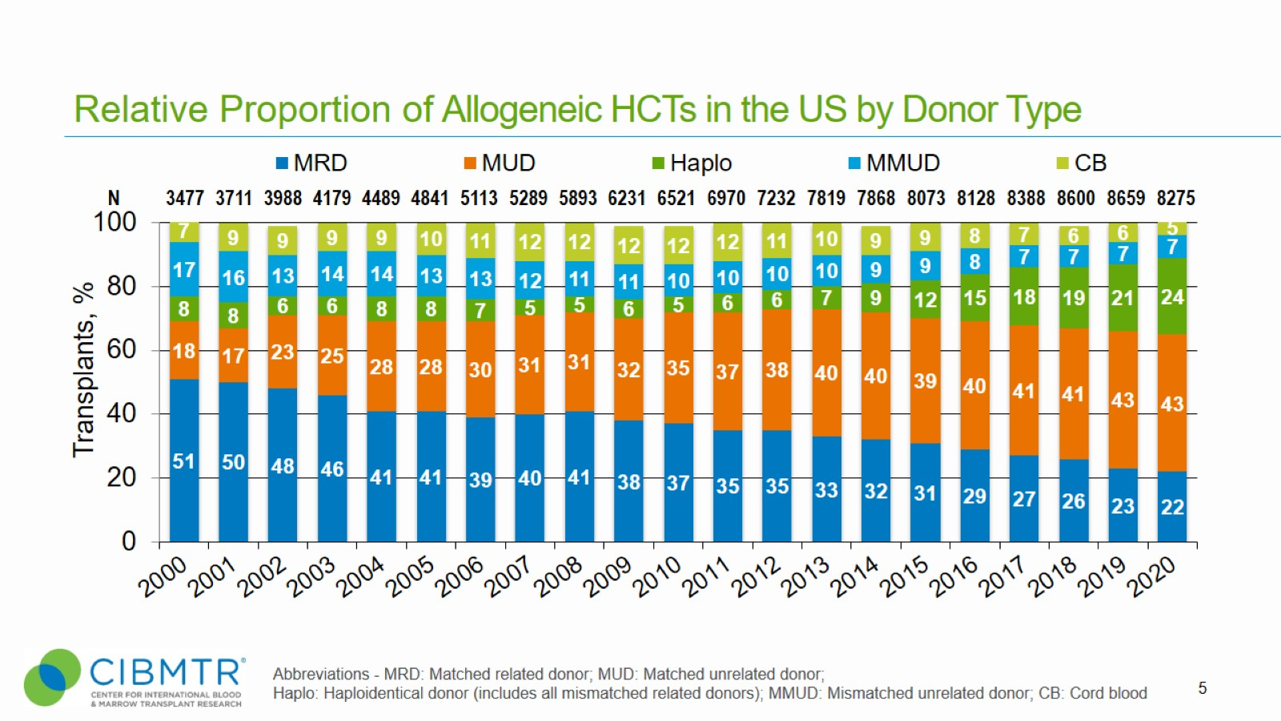
Relative Proportion of Allogeneic HCTs in the US by Donor Type
Notes:
Slide 5: This slide shows the relative proportion of allogeneic transplants performed by donor type since 2000. The percentage of each is represented on the bar graph.

Slide 29
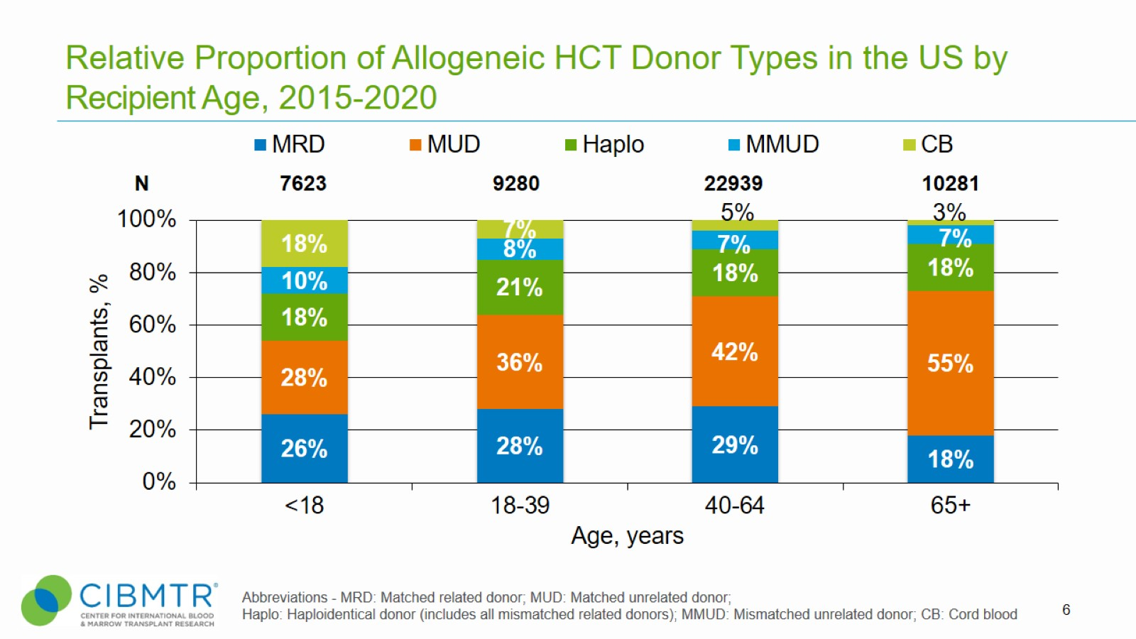
Relative Proportion of Allogeneic HCT Donor Types in the US by Recipient Age, 2015-2020
Notes:
Slide 6: Between 2015 and 2020, among pediatric recipients, matched unrelated donors were the most common donor type used followed by matched related donor. Haplo and CB donors are equally represented with a small proportion of transplant patients receiving MMUD.
For all other age groups, MUDs are the most commonly used donor type, with the use of CB and MRDs diminishing with older age

Slide 30
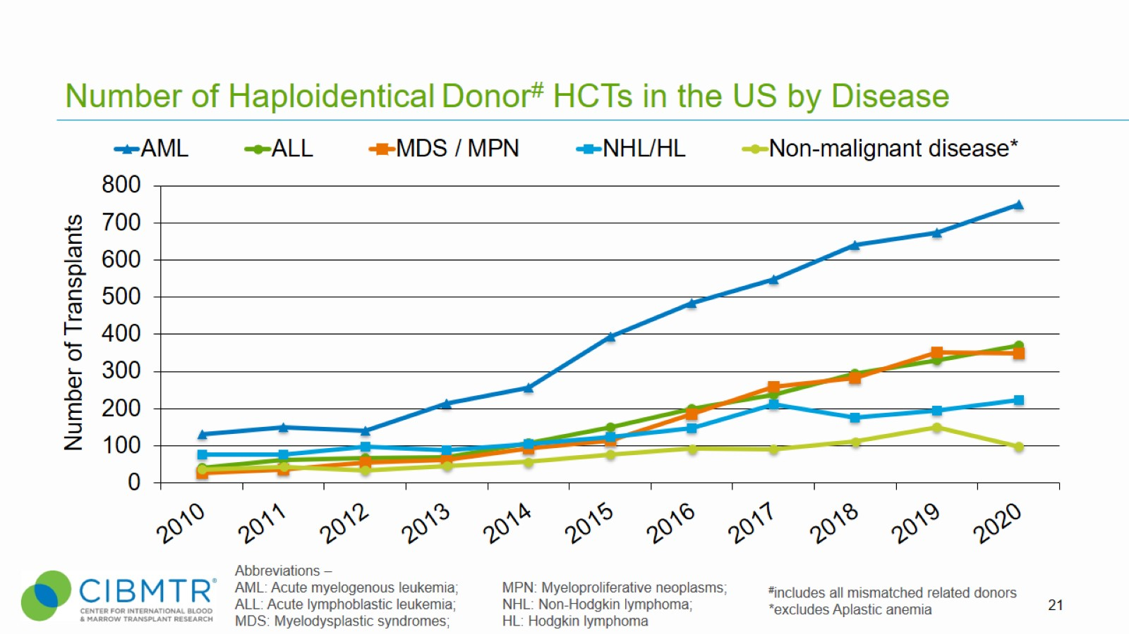
Number of Haploidentical Donor# HCTs in the US by Disease
Notes:
Slide 21: Diseases for which haploidentical transplant use is increasing include acute myelogenous leukemia, acute lymphoblastic leukemia, myelodysplastic syndromes/myeloproliferative neoplasms. There is a plateau in their use in non-malignant diseases
Non-malignant disease includes Inherited abnormalities erythrocyte differentiation or function (n=50), Severe combined immunodeficiency (SCID) and other immune system disorders (n=35), Inherited abnormalities of platelets (n=0), Inherited disorders of metabolism (n=3), Histiocytic disorders (n=10), Autoimmune Diseases (n=1) in 2020.

Slide 31
Synopsis
Why HCT?
Just say no!
  Age
  Comorbidities
  No donor
  Bad Disease
  Socioeconomic Issues

Slide 32
Patient Demographics
Characteristic | Full Cohort (n=384) | MDS (n=172) | AML (n=212) | p value
Age at HCT (median, IQR) | 61 (55-67) | 63 (56-68) | 61 (53-66) | 0.03
KPS (median, IQR) | 90% (80-90%) | 90% (80-90%) | 90% (80-90%) | 0.06
Myeloablative Conditioning | 41% (154) | 41% (68) | 41% (86) | 0.9
PBSC | 86% (328) | 87% (150) | 84% (178) | 0.4
Diagnosis to HCT (median, IQR) | 164 (124-237) | 193 (147-294) | 147 (110-208) | <0.001
Secondary disease | 39% (150) | 41% (70) | 38% (80) | 0.6
Complex karyotype | 78% (286) | 78% (131) | 78% (155) | 0.9
Bi-allelic mut | 74% (233) | 69% (94) | 78% (139) | 0.06
VAF (median, IQR) | 37% (14-54%) | 28% (12-44%) | 46% (22-64%) | <0.001
Missense mutation | 82% (217) | 87% (102) | 78% (115) | 0.06
Loss of 17/17p | 45% (166) | 36% (60) | 52% (106) | 0.002
Byrne, M et al. TCT 2022

Slide 33
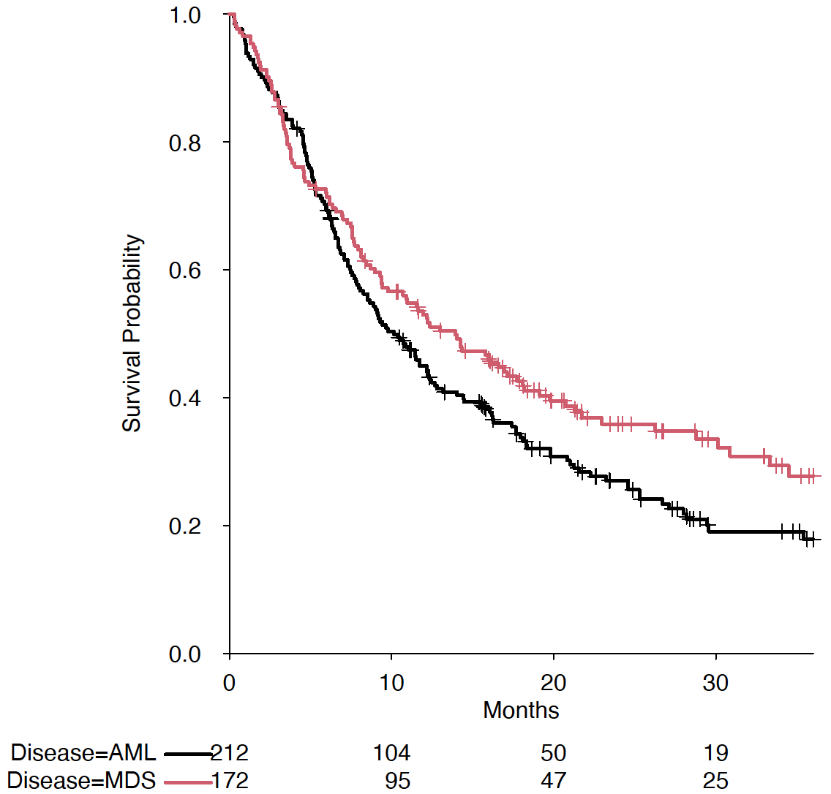
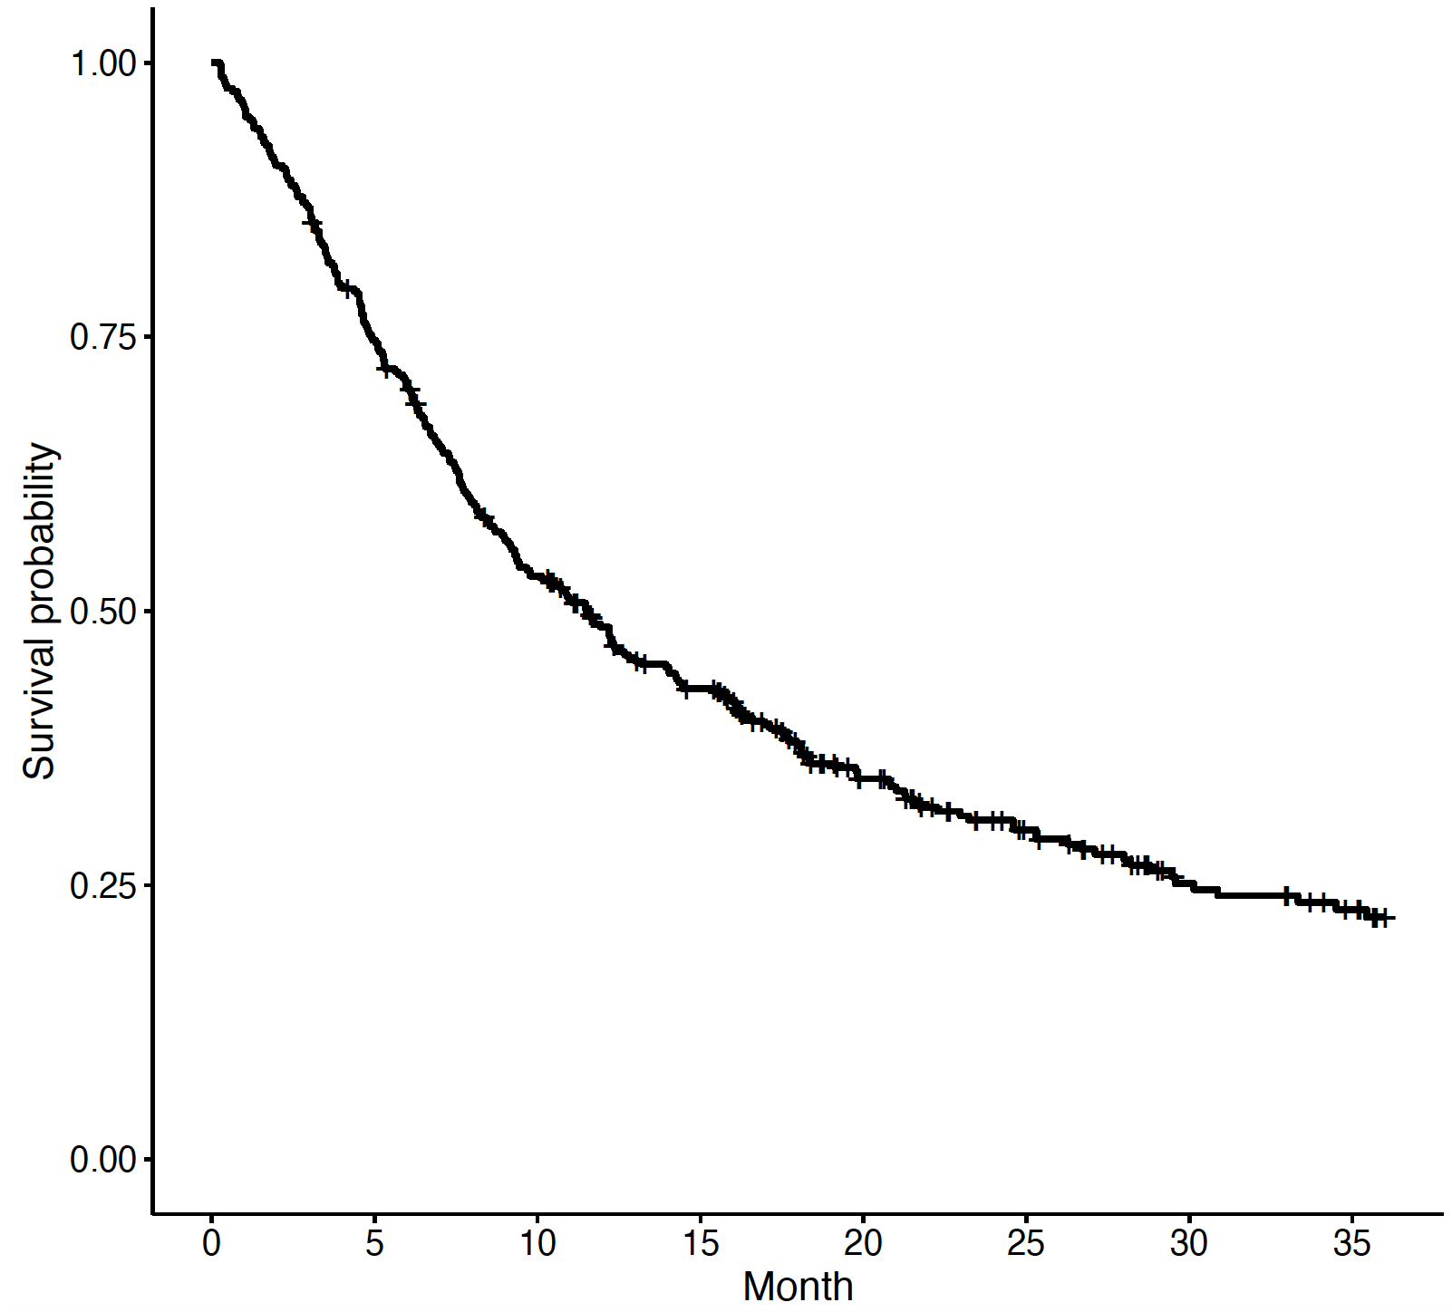

Median Overall Survival
Combined MDS/AML
12 month: 48.5%
24 month: 30.9%
36 month: 22.1%
MDS
12 month: 52.9%
24 month: 35.9%
36 month: 27.7%
AML
12 month: 44.9%
24 month: 27%
36 month: 17.9%
MDS/AML Combined
p: 0.073
Byrne, M et al. TCT 2022

Slide 34
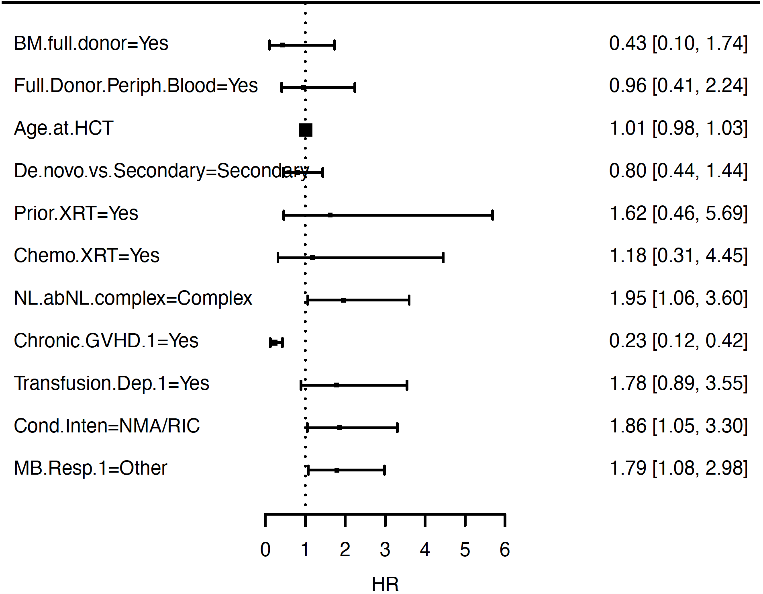
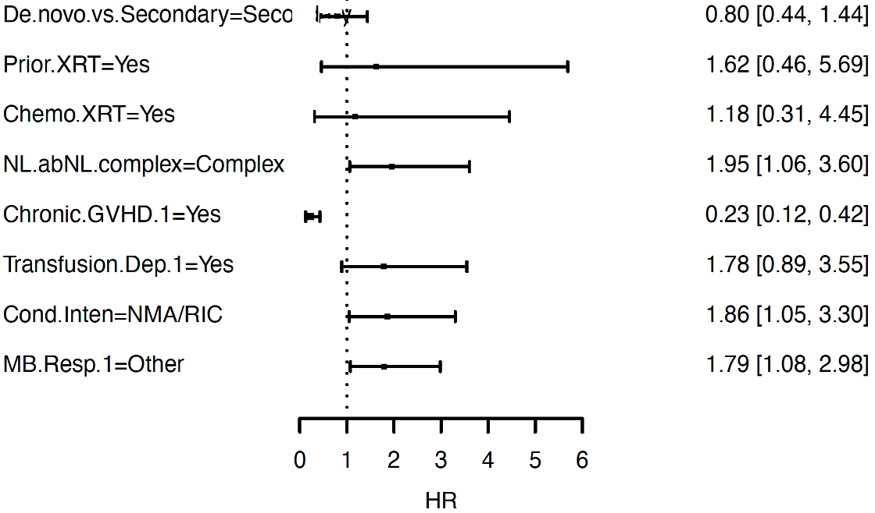
Multivariate analysis – MDS OS
BM Full Donor Chimerism
Complex karyotype, RIC/NMA conditioning, and pre-HCT response of <CR are associated with shorter OS
The development of chronic GVHD is associated with improved OS
Age at HCT was not associated with OS (p=0.31)
PB Full Donor Chimerism
Secondary MDS
Prior XRT
Prior Chemo/XRT
Complex Karyotype
Chronic GVHD
Platelet Transfusion Dep
RIC/NMA conditioning
PreHCT <CR
Byrne, M et al. TCT 2022
Notes:
Multiple imputation
6.3, model 6.2
Updated from 4/8/22 analysis.

Slide 35
Chronic GVHD – Landmark Analysis
Landmark Analysis of cGVHD vs No cGVHD at D+100 (TP53^{MUT} AML)
Landmark Analysis of cGVHD vs No cGVHD at D+100 (TP53^{MUT} MDS)
Median OS:
Absence of cGVHD: 256 days
Presence of cGVHD: 697 days
P: <0.0001
Median OS:
Absence of cGVHD: 358 days
Presence of cGVHD: 1563 days
P: <0.0001
Byrne, M et al. TCT 2022

Slide 36
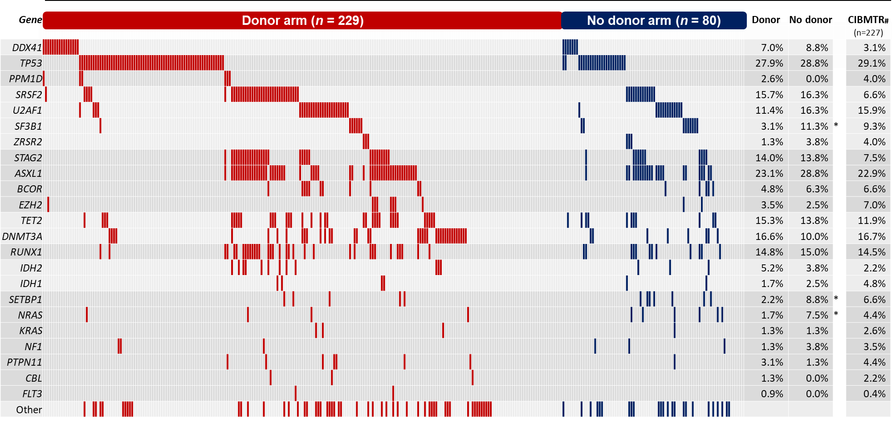
Gene mutations in BMT CTN 1102
* Significant with P-value < 0.05 (Fisher’s Exact test)
# Selection of de novo MDS patients with IPSS int-2 or high risk aged 50-75 years from Lindsley, et al. NEJM 2017
SF3B1 more common no donor
SETBP1 more common no donor
NRAS more common no donor
Versluis, J et al. TCT 2022
Notes:
These data are shown in this co-mutation plot per study arm. The overall distribution of somatic gene mutations was similar in the donor and no donor arm, with TP53 being the most frequent mutation present in 28% of patients. Mutations in ASXL1, SRSF2, and DNMT3A were other commonly mutated genes.
Patients with mutated TP53 had relatively infrequent co-occurring mutations, whereas patients with splicing factor mutations often also had other genetic alterations.
As shown in the most right column, the frequency of gene mutations in the 1102 study was comparable to those from a retrospective registry based MDS transplantation cohort, matched for age, IPSS risk group, and de novo MDS status, with again TP53 being the most commonly mutated gene.

Slide 37
Outcome in MDS patients with mutated TP53
Overall survival
CI of relapse or progression to AML
100
100
|
|
|
|
|
TP53 multi
75
|
75
|
|
|
|
|
|
|
|
|
|
|
|
|
|
|
|
|
|
|
|
|
|
TP53 wt
|
|
|
|
|
|
|
|
|
|
|
|
|
TP53 single
|
|
|
|
|
|
|
|
|
|
|
|
|
|
|
|
|
|
|
|
|
|
|
|
|
|
|
|
|
|
|
|
|
|
|
|
|
|
|
|
|
|
|
|
|
|
|
|
|
|
|
Cumulative percentage
|
|
|
|
50
|
50
|
|
|
|
|
|
|
|
|
|
|
|
|
|
|
|
|
|
|
|
|
|
|
|
|
|
|
|
|
|
|
|
|
|
|
|
|
|
|
|
|
|
|
|
|
|
|
|
|
|
|
|
|
|
|
|
|
|
|
TP53 wt
|
|
|
|
|
|
|
|
|
TP53 single
|
|
|
|
|
|
|
|
|
|
|
|
|
|
|
|
|
|
|
|
|
|
|
|
|
|
25
25
|
|
|
|
|
|
|
|
|
|
|
|
|
|
|
|
|
|
|
|
|
|
|
|
|
|
|
|
|
|
|
|
TP53 multi
|
|
|
|
|
|
|
|
|
0
0
|
|
0
6
12
18
24
30
36
0
6
12
18
24
30
36
At risk:
Months
from
enrollment
At risk:
Months
from
enrollment
TP53
wt
222
210
164
124
97
68
25
222
169
124
92
71
53
18
TP53
single
39
34
22
12
5
3
0
39
29
14
8
4
2
0
TP53
multi
48
36
21
12
9
7
3
48
21
11
6
4
4
2
Versluis, J et al. TCT 2022
Notes:
These Kaplan-meier curves depict the outcomes measured from enrollment.
As shown on the left, TP53 mutations were associated with poor outcome with overall survival at 3 years of 21% compared with 52% for patients without TP53. Survival was similar between the TP53 single and TP53 multi allelic states.
The figure on the right shows the cumulative incidence of MDS relapse or progression to AML which was again higher in patients with mutated TP53, and was highest for patients with TP53 multi with an estimate of 68% at 3 years.
Next, we performed multivariable cox regression analysis to account for other covariates,

Slide 38
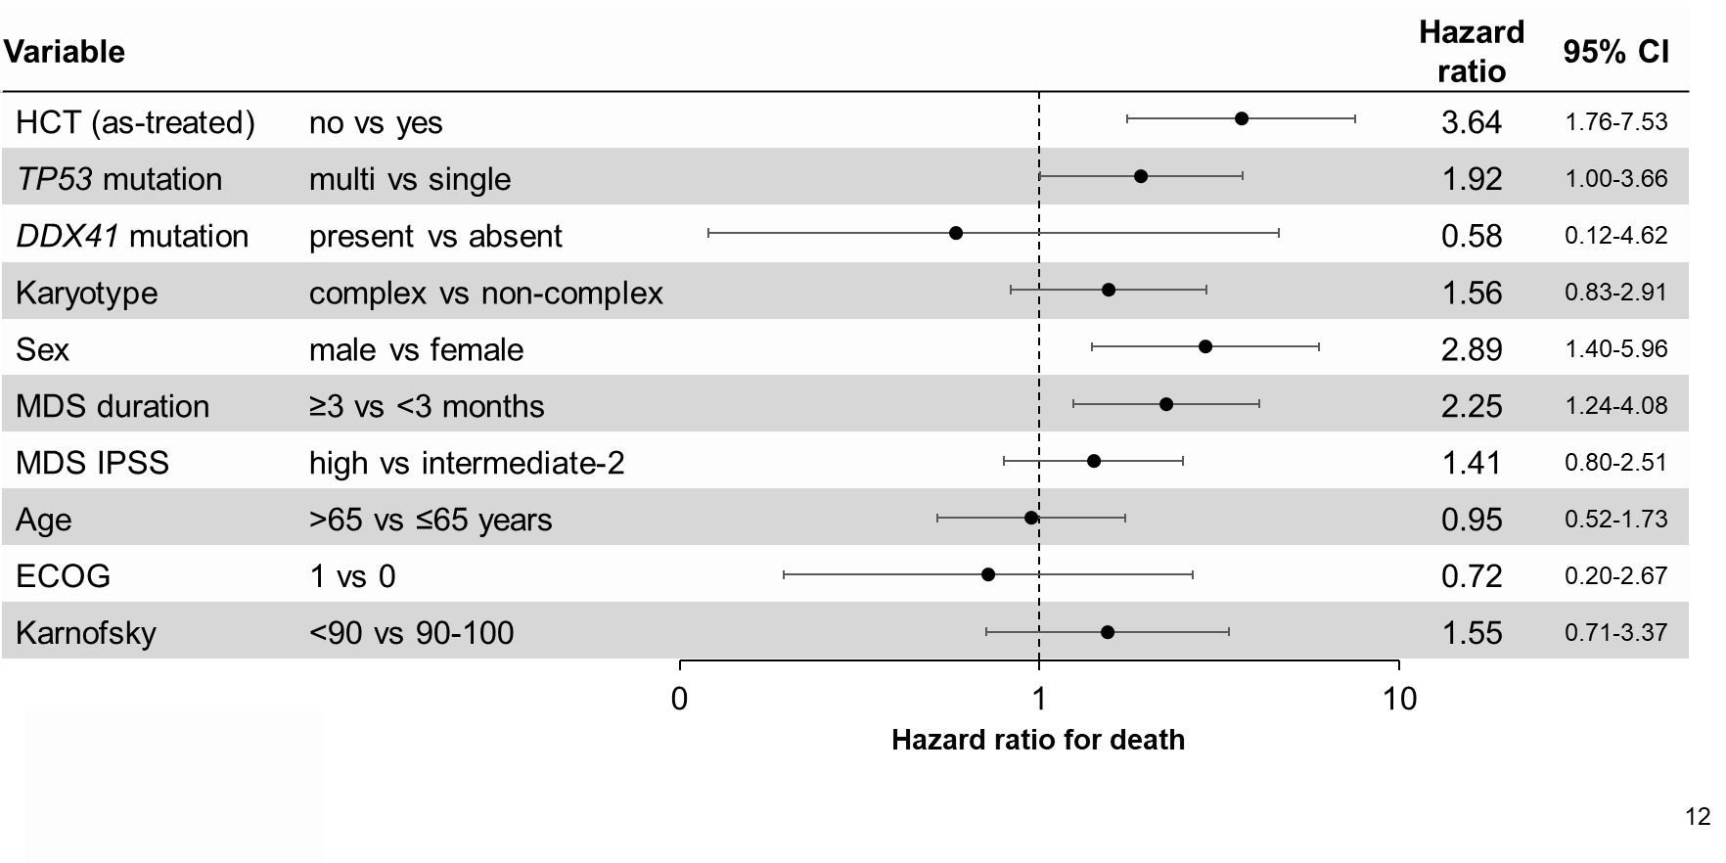
Multivariable analysis – overall survival in TP53
Versluis, J et al. TCT 2022
Notes:
To specifically assess the impact of HCT in the subset of patients with the highest risk of death, we applied this multivariable model to TP53 mutated patients. We observed that, independent of TP53 allelic status, allogeneic transplantation was associated with better overall survival compared with patients who were not transplanted.
Additionally, outcomes were also worse in patients with TP53 multi compared with TP53 single allelic state.

Slide 39
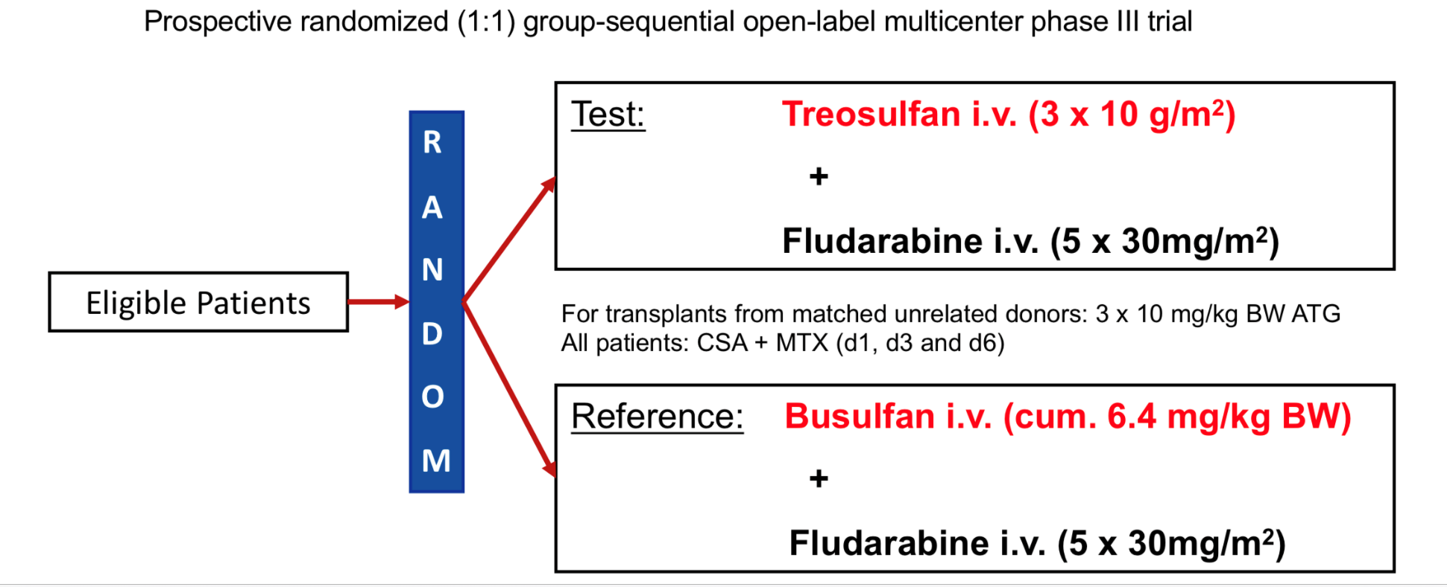
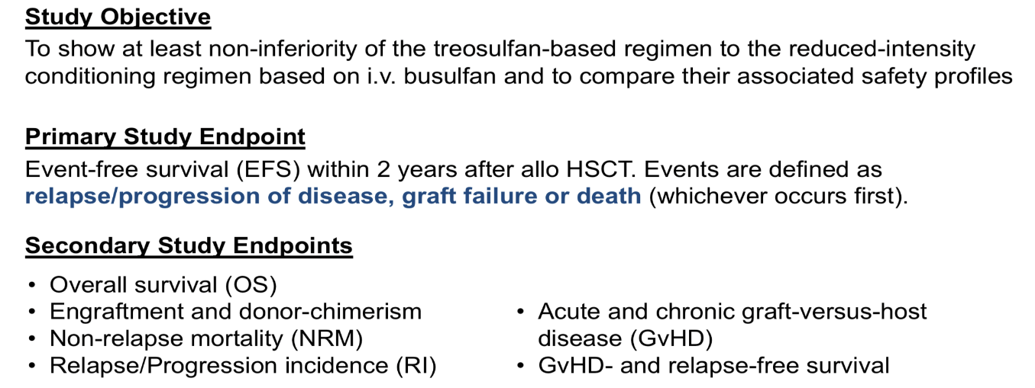
Treo vs. Bu2
N=570
AML n=352
MDS n=199
No HCT n=19
AML CR or MDS
Age 50-70 or HCT-CI >2
KPS >60%
MUD or MRD (9/10)
Beelen et al. Lancet Hematology 2020;7:E28-E39 and BBMT 2019

Slide 40
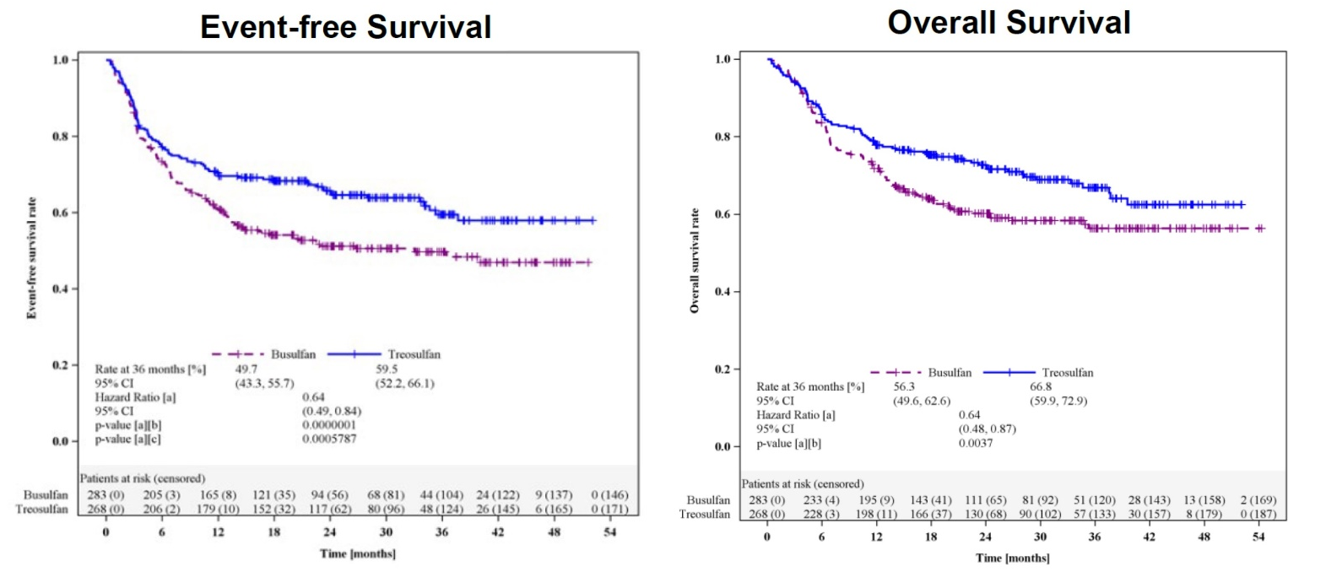

Treo vs. Bu2
Treo 30 gm/m2 n=268
Bu 6.4 mg/kg n=283
Beelen et al. Lancet Hematology 2020;7:E28-E39 and BBMT 2019

Slide 41
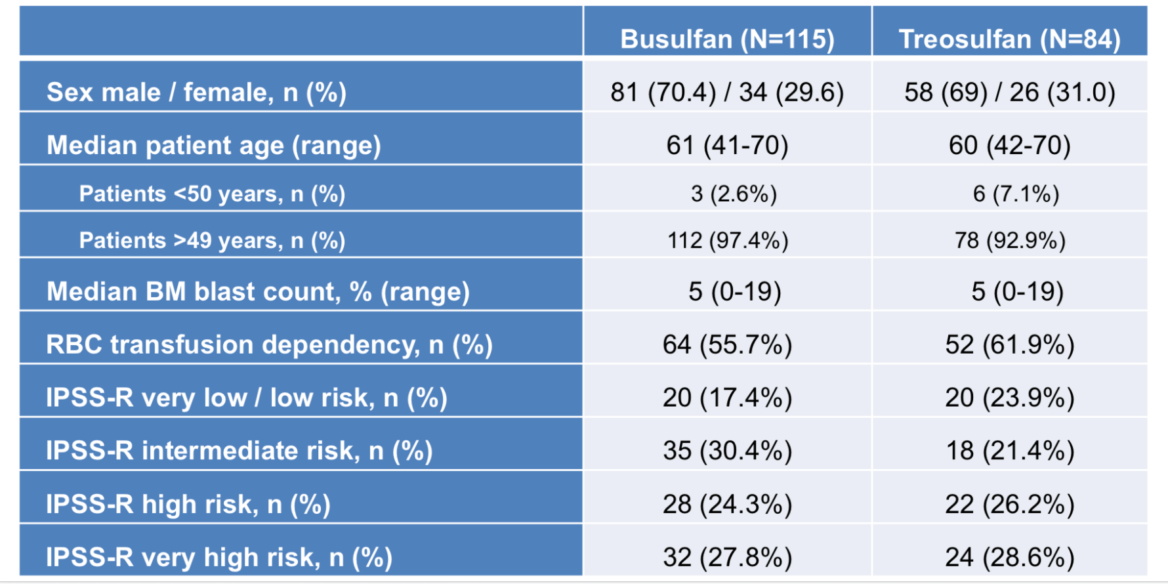
Treo vs. Bu2: MDS
Stelljes et al. TCT 2022

Slide 42
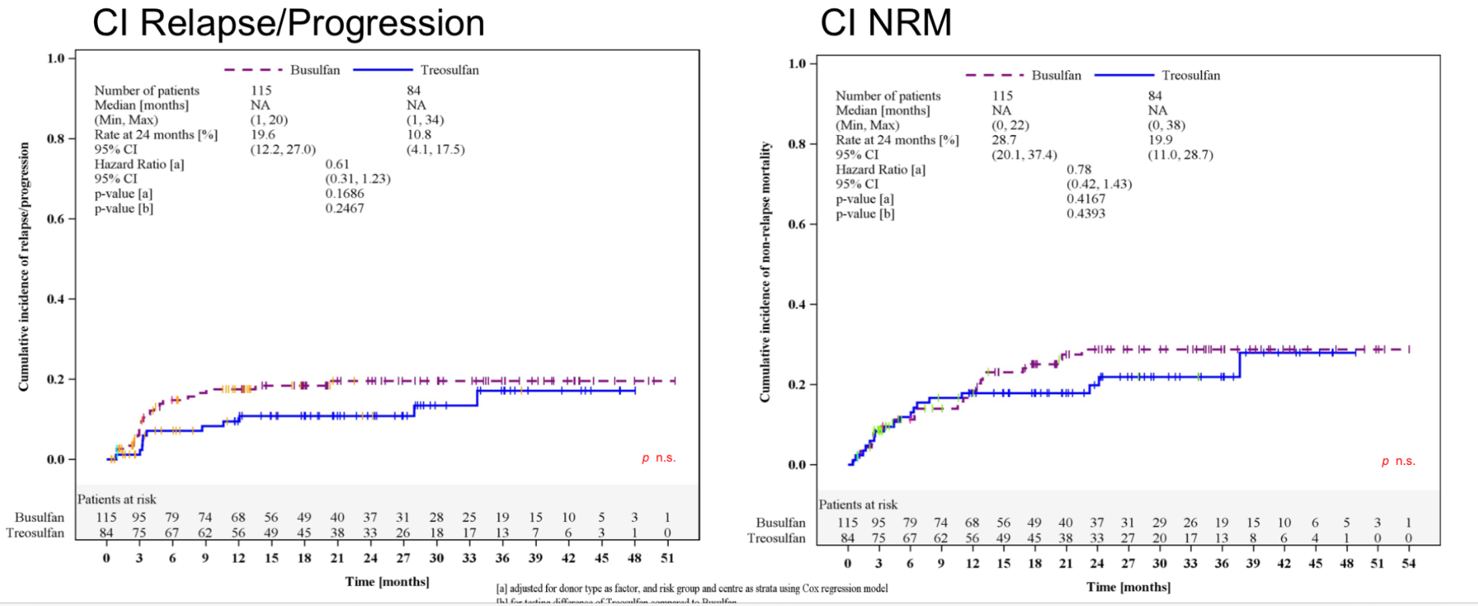
Treo vs. Bu2: MDS
Stelljes et al. TCT 2022

Slide 43
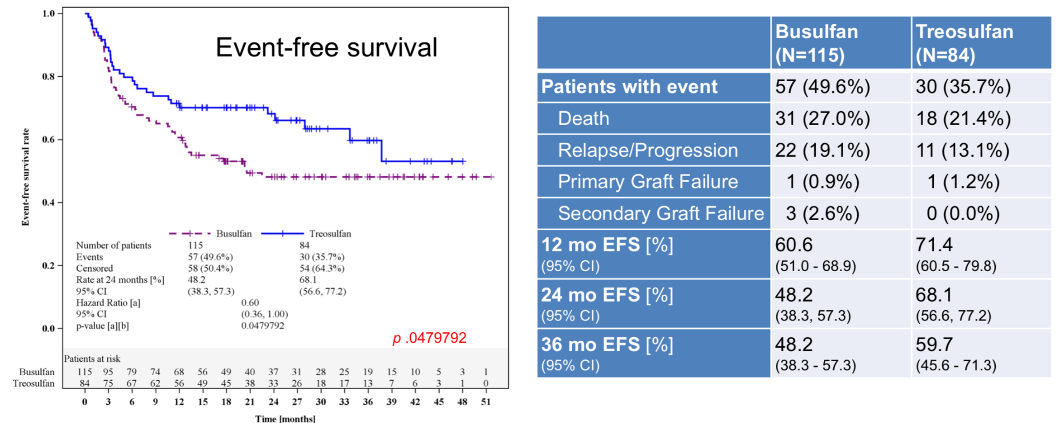
Treo vs. Bu2: MDS
Stelljes et al. TCT 2022

Slide 44
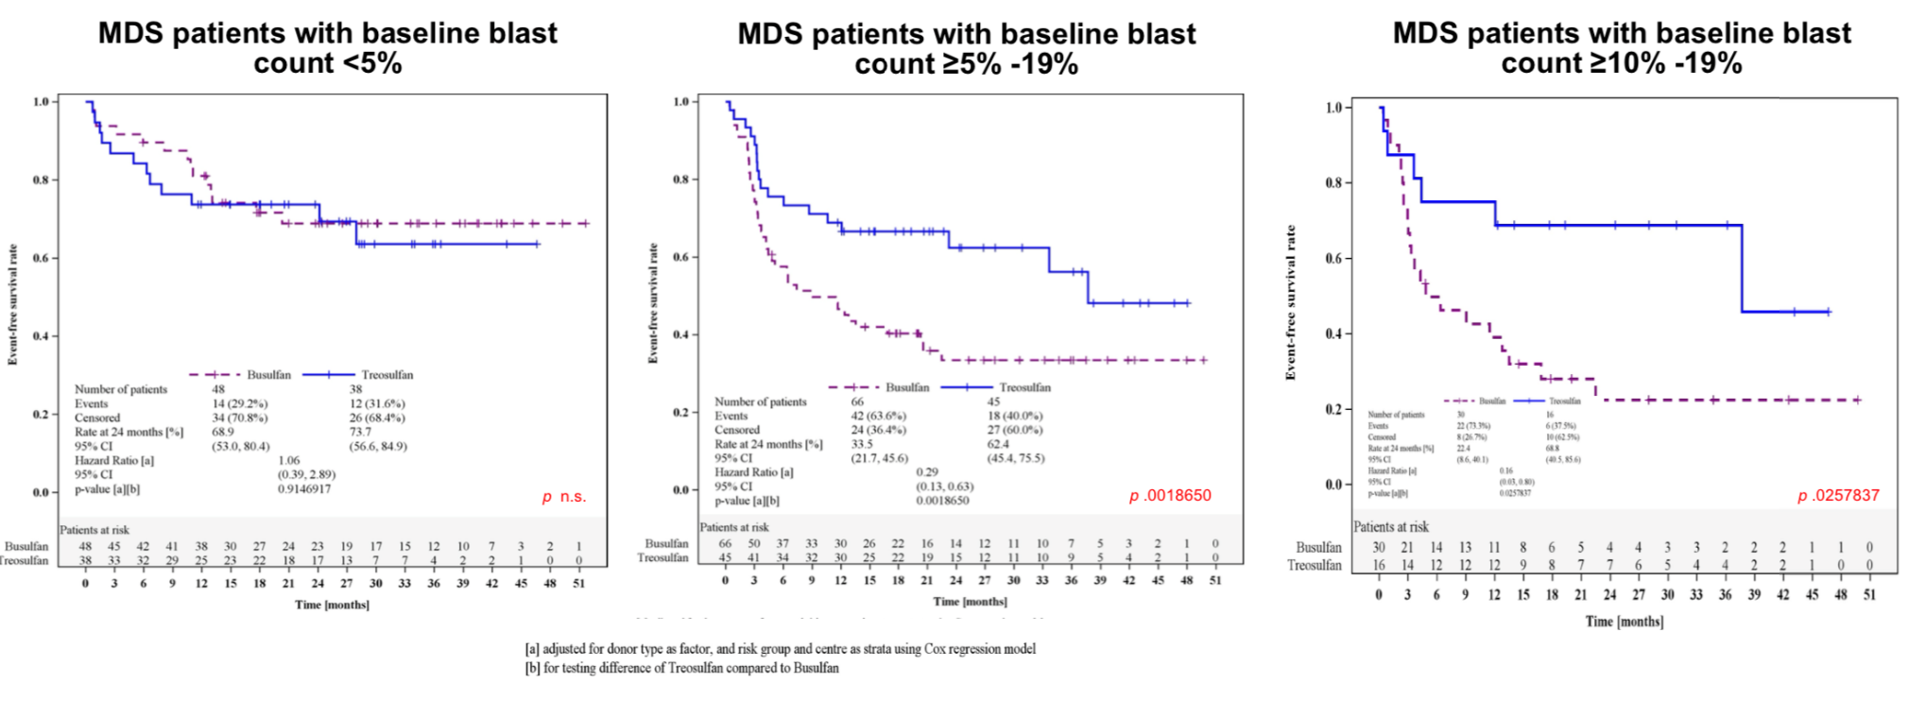
Treo vs. Bu2: MDS
Stelljes et al. TCT 2022

Slide 45


Use of Radioimmunotherapy for Transplant Conditioning
Reduction of late toxic effects of external γ-radiation (TBI)
  Medically infirm patients
  Reduction in secondary cancers
Higher doses of radiation without increasing toxicity
  disease control
  engraftment
The antibody targets the radioactive isotope to specific cells:
  malignant cells
  e.g. T-cells

Slide 46
Beta vs Alpha Emitters
β
 | ¹³¹Iodine (ß/ɣ) | ⁹⁰ Yttrium (β) | ²¹¹Astatine (α)
Half life | 8 days | 2.7 days | 7.2 hours
Mean path length | 0.8 mm | 2.7 mm | 60-80 µm
Median energy (MeV) | 0.66 | 2.3 | 6.8
α
.

Slide 47

Treatment Schema (FH#9595)
2-3 Gy TBI
PBSC HCT
Fludarabine
90 mg/m²
Eval
Eval
Eval
Eval
²¹¹At-anti
CD45 MAb
Days
-7
-4
-3
-2
0
30
40
56
84
96
150
180
Related
MMF
BID------
CSP
BID---------------------------------------------------------
HLA-matched
MMF
TID---------BID-----
Unrelated
CSP
BID---------------------------------------------------------
SIR
QD--------------------------------------------------------------------------
NCT03128034

Slide 48
Diagnosis and Marrow Blasts at Transplant (FH#9595)
38-71(median 60)
years old
Prior transplant n=3
Diagnosis at Transplant | N 20 | Pre-transplant BM blasts (%)
AML (n=14)
Secondary AML (n=9)
CR ± MRD* | 3 | 0.03, 0, 3.5
Refractory disease | 6 | 70, 10, 26, 85, 31, 20
Primary AML (n=5)
CR ± MRD | 3 | 0.4, 0, 0.22
Refractory disease | 2 | 35, 80
MPAL (n=1)
Refractory disease | 1 | 30
MDS-EB1/2 (n=5)
CR ± MRD | 4 | 0.3, 0, 0.09, 0
Refractory disease | 1 | 6
*CR= complete remission
*MRD= measurable residual disease
Sandmaier et al. TCT meeting 2021

Slide 49
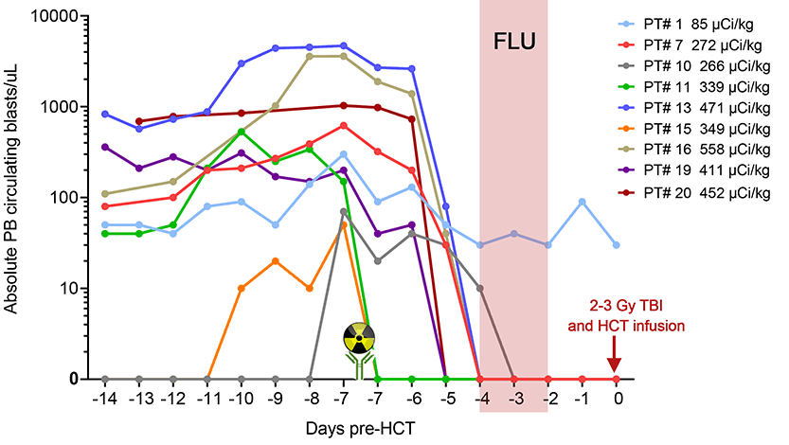
Peripheral Blast Clearance After ²¹¹At-BC8-B10 (FH#9595)
Infusion of
²¹¹At-BC8-B10
Sandmaier et al. TCT meeting 2021

Slide 50
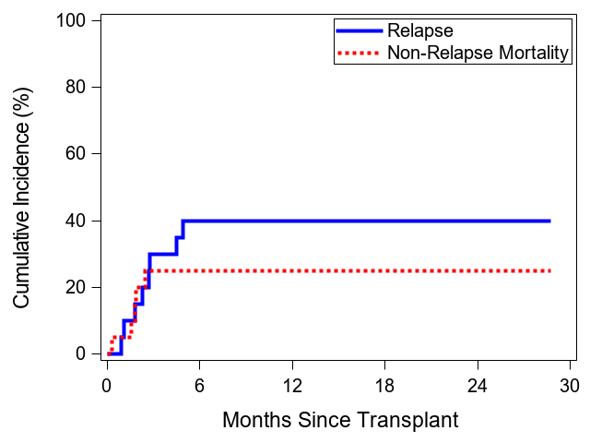
Relapse and NRM after Transplant (FH#9595)
40%
25%
Sandmaier et al. TCT meeting 2021

Slide 51
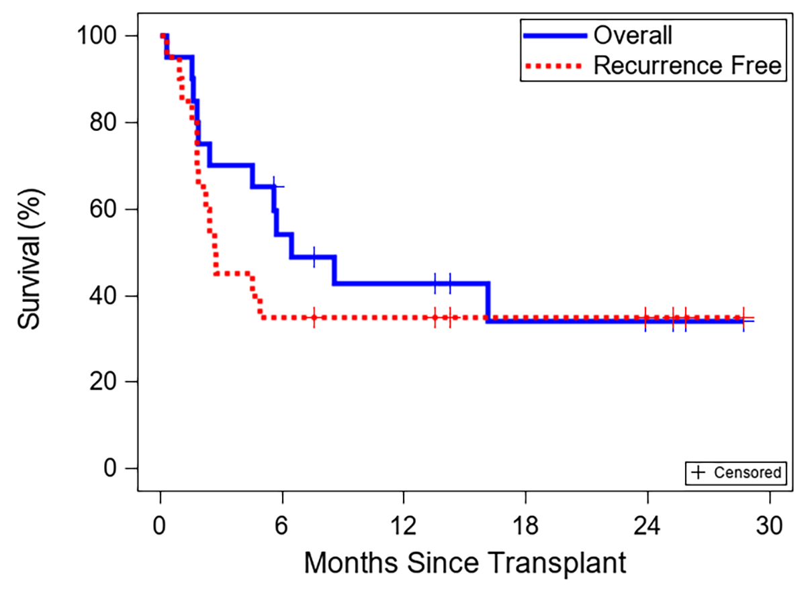
Survival after Transplant (FH#9595)
43%
35%
Sandmaier et al. TCT meeting 2021

Slide 52
Targeting CD117 on HSCs using JSP191 – humanized monoclonal antibody targeting CD117
CD117 (c-Kit) is receptor for stem cell factor (SCF) on hematopoietic stem cells (HSCs)
SCF-CD117 signaling regulates survival, proliferation and differentiation of HSCs
CD117 is expressed on normal HSCs and hematopoietic progenitor cells, MDS HSCs and progenitors, AML leukemic stem cells (LSCs) and blasts
Targeted high-affinity epitope directly blocks SCF-CD117 signaling leading to HSC depletion
  Binding Kd of 1.0 pM
  Potently inhibits SCF signaling (Ki=70 pM)
Engineered, aglycosylated IgG1 minimizes off target effects
  No mast cell activation, no agonist activity, no FcR binding, no ADCC (CD117 expressed on Mast cells, germ cells, melanocytes, Cajal cells in GI tract, others)
Notes:
**Jasper to present**

Slide 53
RIC
Day -4 of the protocol JSP 191=2000 ng/mL or is predicted to reach =2000 ng/mL.
Phase1/2 Trial
3+3 dose escalation scheme
MDS or AML with MID/MRD
MRD or MUD (8/8) PBSCT
Age > 60 or HCT-CI > 2
2 Gy TBI
G-PBSCT
JSP191 ≤ 500 ng/mL or are predicted ≤ 500 ng/mL
Flu
30 mg/m²/d
JSP 191
~-14
-4 -3 -2 -1 0 28 42 56 84 100 180
Days
MMF 15mg/kg TID
TAC 0.05mg/kg BID
Sir 2 mg daily
Sirolimus begins three days before PBSC infusion, is dosed initially at 2 mg PO daily, and adjusted to achieve target serum levels of 3 – 12 ng/mL through Transplant Day +150. In the absence of GVHD, sirolimus taper begins Transplant Day +151 and tapered off by Transplant Day +180. Tacrolimus begins three days before PBSC infusion, is dosed initially at 0.05 mg/kg PO b.i.d. or 0.01 mg/kg IV b.i.d, and adjusted to achieve target serum levels of 8 – 12 ng/mL. Tacrolimus IV is infused over 2–3 hours. In the absence of GVHD, tacrolimus taper begins on Transplant Day +96 and tapered off by Transplant Day +180. MMF is dosed at 15 mg/kg PO Q 8 hours, and begins the evening of the donor PBSC infusion, then tapered to 15 mg/kg PO b.i.d on Transplant Day +31 until Transplant Day +39, and then is discontinued without tapering further on Transplant Day +40
Notes:
Sirolimus begins three days before PBSC infusion, is dosed initially at 2 mg PO daily, and adjusted to achieve target serum levels of 3 – 12 ng/mL through Transplant Day +150. In the absence of GVHD, sirolimus taper begins Transplant Day +151 and tapered off by Transplant Day +180. Tacrolimus begins three days before PBSC infusion, is dosed initially at 0.05 mg/kg PO b.i.d. or 0.01 mg/kg IV b.i.d, and adjusted to achieve target serum levels of 8 – 12 ng/mL. Tacrolimus IV is infused over 2–3 hours. In the absence of GVHD, tacrolimus taper begins on Transplant Day +96 and tapered off by Transplant Day +180. MMF is dosed at 15 mg/kg PO Q 8 hours, and begins the evening of the donor PBSC infusion, then tapered to 15 mg/kg PO b.i.d on Transplant Day +31 until Transplant Day +39, and then is discontinued without tapering further on Transplant Day +40

Slide 54
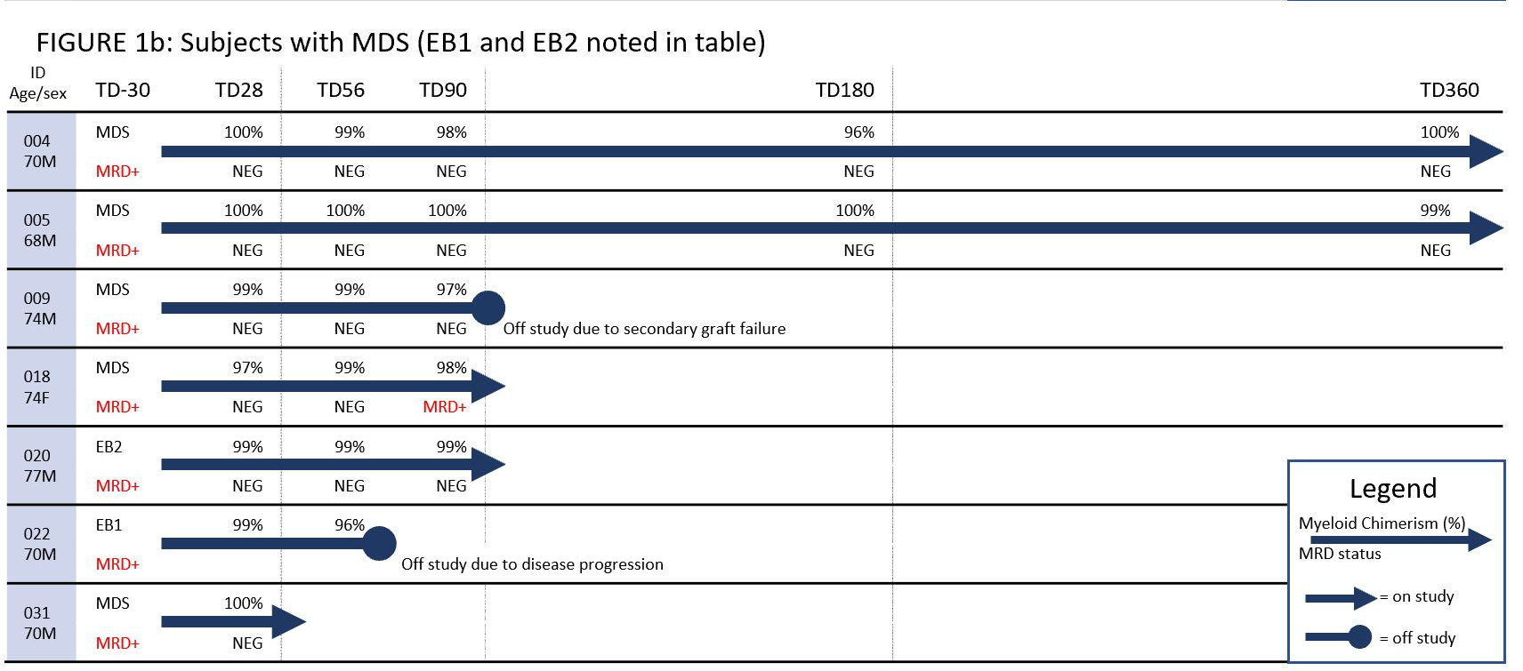
JSP 191

Slide 55
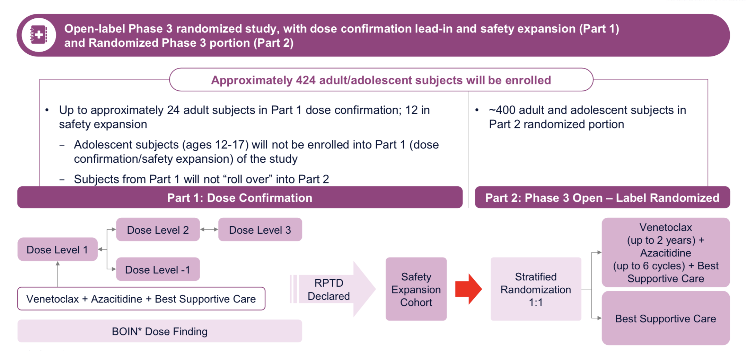
Maintenance Strategies: VIALE-T

Slide 56
Synopsis
Why HCT?
Just say no!
  Age
  Comorbidities
  No donor
  Bad Disease
  Socioeconomic Issues—i.e. systemic racism
Beyond-ARC T cell therapy

Slide 57
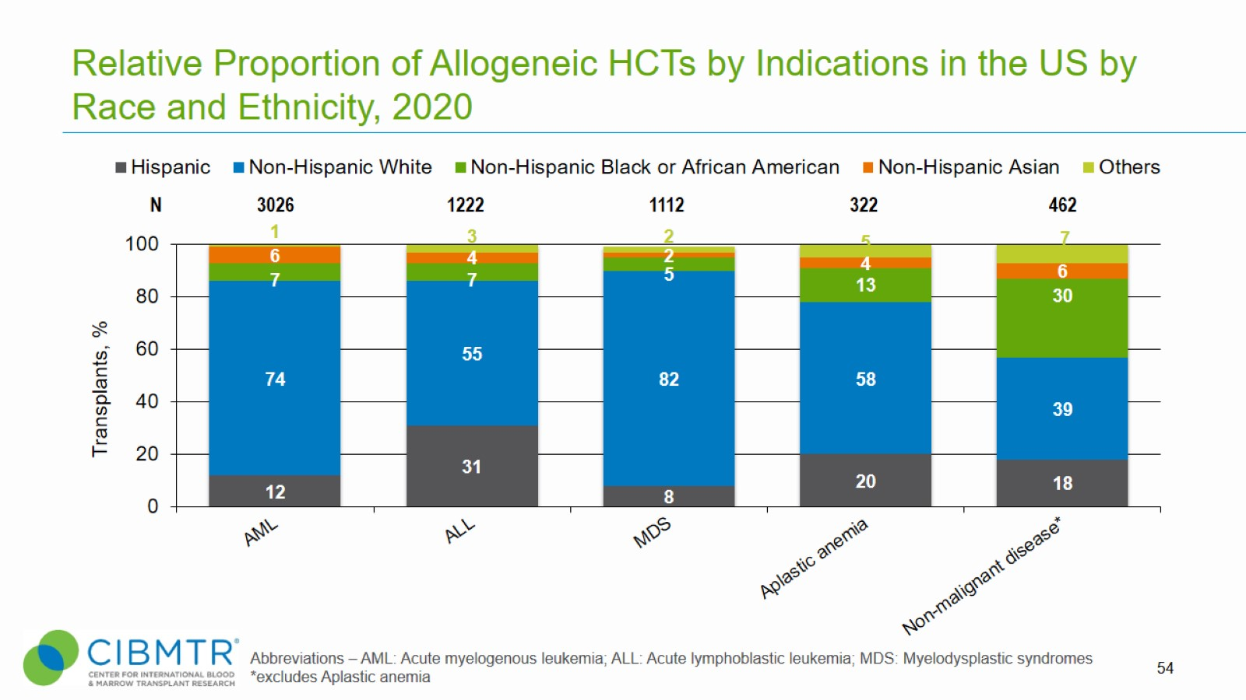
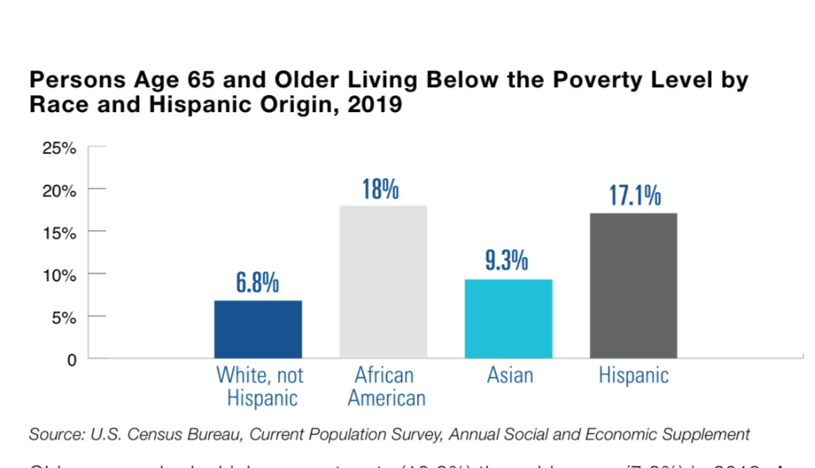
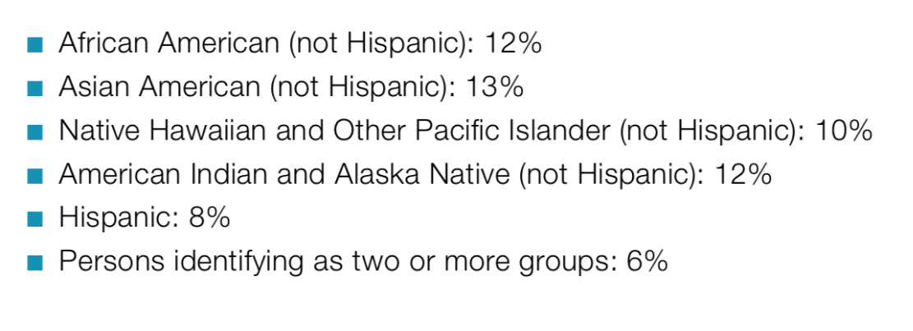
Relative Proportion of Allogeneic HCTs by Indications in the US by Race and Ethnicity, 2020
The percentage of people age 65 and older within each racial and ethnic minority group were as follows.
■
African American (not Hispanic): 12%
■
Asian American (not Hispanic): 13%
■
Native Hawaiian and Other Pacific Islander (not Hispanic): 10%
■
American Indian and Alaska Native (not Hispanic): 12%
■
Hispanic: 8%
■
Notes:
Slide 54
Race and Ethnicity in ‘Others’ category includes non-Hispanic Native Hawaiian or other Pacific Islander (AML n=5; ALL n=4; MDS n=5; Aplastic anemia n=2; Non-malignant disease n=1 ), American Indian or Alaska Native (AML n=9; ALL n=12; MDS n=3; Aplastic anemia n=3; Non-malignant disease n=3), More than one race (AML n=16; ALL n=6; MDS n=5; Aplastic anemia n=7; Non-malignant disease n=8), and Non-resident of the US (AML n=14; ALL n=18; MDS n=9; Aplastic anemia n=4; Non-malignant disease n=20).
Non-malignant disease includes Inherited abnormalities erythrocyte differentiation or function (n=191), Severe combined immunodeficiency (SCID) and other immune system disorders (n=163), Inherited abnormalities of platelets (n=5), Inherited disorders of metabolism (n=49), Histiocytic disorders (n=49), and Autoimmune Diseases (n=5).

Slide 58
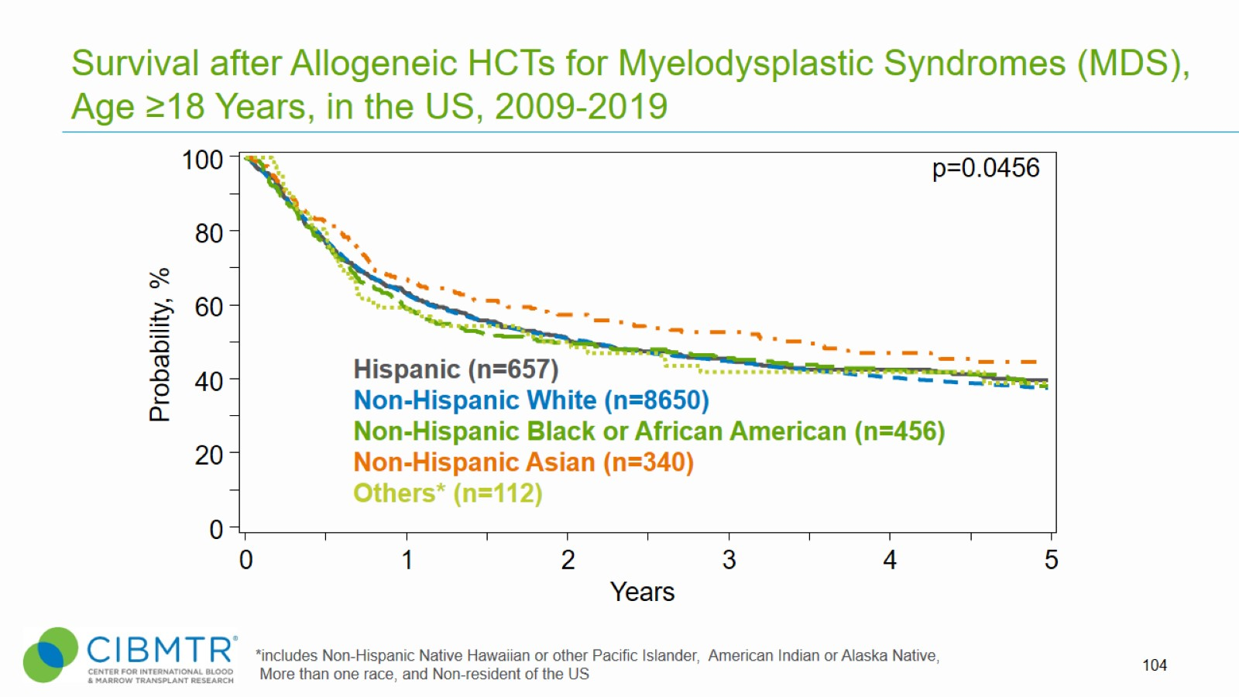
Survival after Allogeneic HCTs for Myelodysplastic Syndromes (MDS), Age ≥18 Years, in the US, 2009-2019
Notes:
Slide 104: Among adult patients with MDS receiving Allogeneic transplant between 2009 and 2019, the 3-year probabilities (95%CI) of survival following transplant with a Race and Ethnicity of Hispanic, Non-Hispanic White, Non-Hispanic Black or African American, Non-Hispanic Asian and Others were 47% (44-52%), 46% (45-47%), 47% (42-52%), 54% (49-60%), and 45% (36-57%), respectively.
Trend data only is presented and any significant p values reflect global differences between indicated groups and not any specific differences between indicated groups. Caution interpreting these univariate curves is important as adjustment for other relevant factors using multi-variable analyses has not been done.

Slide 59
Conclusions
Int-2/High Risk MDS refer for HCT. Delay for Low/Int-1 risk
Age alone is not a contraindication to HCT
While comorbidities increase TRM they should not be considered as a barrier to HCT
Alternative Donor Options (haplo) are effective
Disease related risk factors may be addressed by novel conditioning regimens and maintenance strategies
SES primarily affects access to appropriate health care in historically disadvantaged racial groups
ARC-T cell therapy exciting area of investigation

