Slide 1




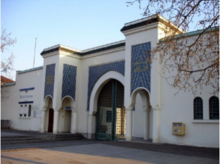

LUSPATERCEPT in lower risk MDS
Pierre Fenaux
Département d’hématologie et immunologie Hôpitaux St Louis, R Debré, Avicenne
Université de Paris
GFM
MDS clinical roadmap, July 2023

Slide 2
TARGETING INEFFECTIVE ERYTHROPOIESIS in LOWER RISK MDS
Anemia , ineffective erythropiesis and its management in lower risk MDS
Luspatercept as second line treatment in MDS-RS
Perspectives
  Combinations
  Other lower risk MDS
  Luspatercept as first line treatment

Slide 3
TARGETING INEFFECTIVE ERYTHROPOIESIS in LOWER RISK MDS
Anemia and its management of anemia in lower risk MDS
Luspatercept as second line treatment in MDS-RS
Perspectives
  Combinations
  Other MDS types
  Luspatercept as first line treatment

Slide 4
Anemia in MDS WITH NO EXCESS OF MARROW BLASTS
Until recently called « refractory anemia »
MDS without excess of blasts :
  with or without ringed sideroblasts (RS)
  Uni or multilineage dysplasia
  MDS with del 5q
Ineffective erythropoiesis is the major cause of anemia (except in MDS with with del 5q)
Treatment
  First line
    ESA (non del 5q)
    Lenalidomide (del 5q)
  Second line
    HMA
    Lenalidomide +/- ESA
    ATG
    Imetelstat

Slide 5



MDS with ringed sideroblasts
Very low risk of AML progression if isolated SF3B1 mutations (or with TET2)
Generally isolated anemia
Same response rate to ESAs as other lower risk MDS, but shorter responses (Park et al, J Clin Oncol, 2017)
Second line treatments
  Lenalidomide + ESA (Toma et al, Leukemia, 2015): 40 % response
  Azacitidine (Thépot et al, Haematologica,2016 ): 20 % response
  ATG: low response rate
  Allo SCT:15 % mortality at 60, plus medium and long term side effects
  Imetelstat : 40% achievement of TI

Slide 6
Active drug
14
Blood transfusion
12
Transfusion given
10
Hb (g/dL)
8
6
4
0
30
60
90
120
150
180
210
Days of treatment
Notes:
Epoetin treatment produces a steady increase in Hb level, whereas regular transfusion produces dramatic fluctuations in Hb.^{1, 2}
The absence of this Hb fluctuation means that epoetin treatment can achieve and maintain Hb targets far more effectively than regular transfusion.
Österborg A. Recombinant human erythropoietin (rHuEPO) therapy in patients with cancer-related anaemia: what have we learned? Med Oncol 1998; 15 (Suppl 1): S47–S49.
Ludwig H, Fritz E, Kotzmann H, Hocker P, Gisslinger H, Barnas U. Erythropoietin treatment of anaemia associated with multiple myeloma. N Engl J Med 1990; 322: 1693–1699.

Slide 7
Quality of Life is correlated to Hb levels
65
60
Quality of Life (LASA, mm)
55
50
45
7
8
9
10
11
12
13
14
Hb level (g/dl)
LASA: Linear Analog Scale Assessment
Crawford et al. Cancer 2002; 95: 888–95
Notes:
In a study by Crawford et al,¹ a positive relationship was shown between Hb increases during epoetin therapy and corresponding Quality of Life improvements (shown as changes in Linear Analog Scale Assessment [LASA] values) in patients with cancer receiving chemotherapy.
Furthermore, as the figure demonstrates, a greater increase in Quality of Life score was seen with an incremental Hb increase from 10 g/dl to
12 g/dl (6.7 mm) compared with a Hb increase from 8 g/dl to 10 g/dl (3.7 mm). This suggests that earlier initiation of treatment for anaemia (i.e. at 10–11 g/dl rather than 8 g/dl) results in a greater improvement in Quality of Life.
1. Crawford J, Cella D, Cleeland CS, Cremieux PY, Demetri GD, Sarokhan BJ, Slavin MB, Glaspy JA. Relationship between changes in hemoglobin level and quality of life during chemotherapy in anemic cancer patients receiving epoetin alfa therapy. Cancer 2002; 95: 888–895.

Slide 8
TARGETING INEFFECTIVE ERYTHROPOIESIS in LOWER RISK MDS
Anemia and its management of anemia in MDS-RS
Luspatercept as second line treatment in MDS-RS
Perspectives
  Other MDS types
  Combinations
  Luspatercept as first line treatment

Slide 9
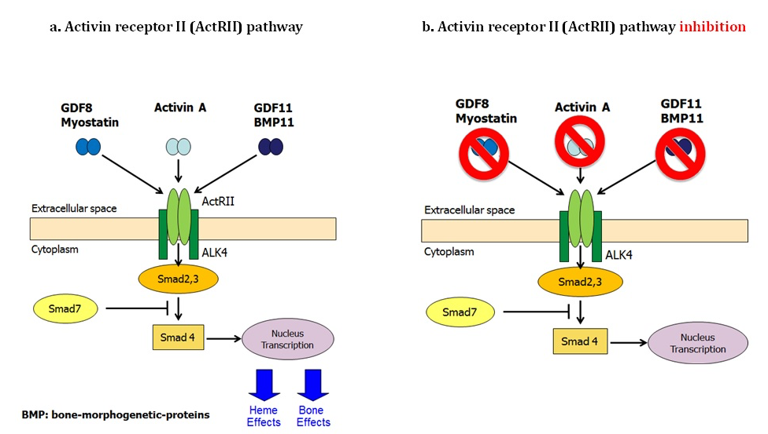
TGF beta inhibition

Slide 10
LUSPATERCEPT
Luspatercept
ActRIIB / IgG1 Fc recombinant
fusion protein
TGF-β superfamily ligand
Modified extracellular domain of
ActRIIB
ActRIIB
Cytoplasm
P
Smad2/3
Nucleus
Complex
Human
IgG1 Fc
domain
Erythroid maturation
1. Suragani RN, et al. Nat Med. 2014;20:408-414;
2. Platzbecker U, et. A. Lancet Oncol. 2017; 18:1338.
ActRIIB, human activin receptor type IIB; IgG1 Fc, immunoglobulin G1 fragment crystallizable; RBC-TI, red blood cell transfusion independence;
RS, ring sideroblasts; TGF-β, transforming growth factor beta.
Notes:
In a phase II study in LR, non-del(5q) MDS, luspatercept yielded a high frequency of transfusion-reduction or RBC-TI in patients with MDS-RS (52%) vs other subtypes (30%)²

Slide 11
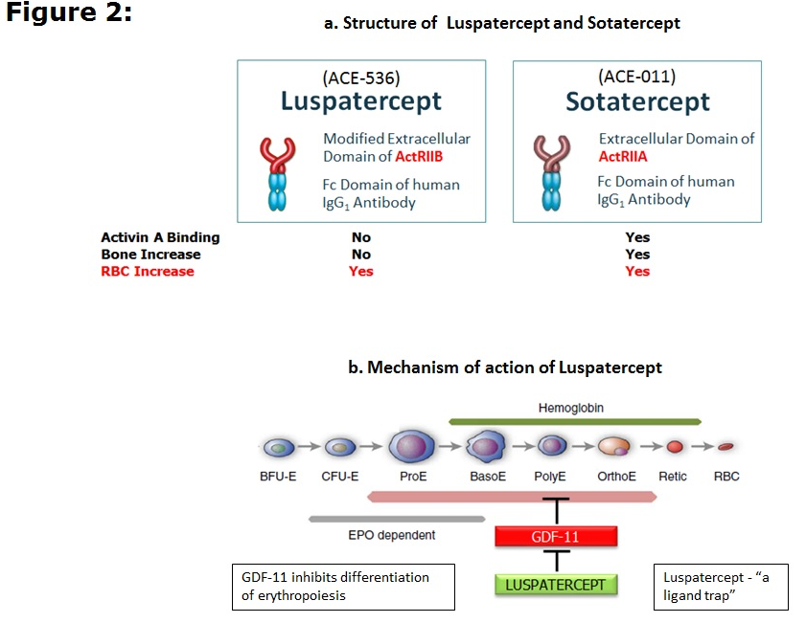
Luspatercept

Slide 12
Assessment of Longer-Term Efficacy and Safety in the Phase 3, Randomized, Double-Blind, Placebo-Controlled MEDALIST Trial of Luspatercept to Treat Anemia in IPSS-R Very Low-, Low-, or Int-Risk RBC Transfusion-Dependent MDS with Ring Sideroblasts
Pierre Fenaux^{1,2}, Ghulam J. Mufti³, Rena Buckstein⁴, Valeria Santini⁵, María Díez-Campelo⁶, Carlo Finelli⁷,
Mario Cazzola⁸, Osman Ilhan⁹, Mikkael A. Sekeres¹⁰, Rami S. Komrokji¹¹, Alan F. List¹¹, Amer M. Zeidan¹²,
Amit Verma¹³, Abderrahmane Laadem¹⁴, Rodrigo Ito¹⁴, Jennie Zhang¹⁴, Anita Rampersad¹⁴, Daniel Sinsimer¹⁴,
Peter G. Linde¹⁵, Guillermo Garcia-Manero¹⁶, Uwe Platzbecker¹⁷
¹Service d’Hématologie Séniors, Hôpital Saint-Louis, Assistance Publique-Hôpitaux de Paris, Paris, France; ²Université Paris 7, Paris, France; ³Department of Haemato-Oncology, King’s College London, London, UK; ⁴Odette Cancer Centre, Sunnybrook Health Sciences Centre, Toronto, ON, Canada; ⁵MDS Unit, Azienda Ospedaliero Universitaria Careggi, University of Florence, Florence, Italy; ⁶Hematology Department, Institute of Biomedical Research of Salamanca, University Hospital of Salamanca, Salamanca, Spain; ⁷Department of Oncology and Hematology, S. Orsola-Malpighi University Hospital, Bologna, Italy; ⁸Fondazione IRCCS Policlinico San Matteo, University of Pavia, Pavia, Italy; ⁹Department of Hematology, Ankara University School of Medicine, Ankara, Turkey; ¹⁰Department of Hematology and Medical Oncology, Cleveland Clinic, Cleveland, OH, USA; ¹¹Moffitt Cancer Center, Tampa, FL, USA; ¹²Department of Internal Medicine, Yale School of Medicine and Yale Cancer Center, Yale University, New Haven, CT, USA; ¹³Department of Oncology, Albert Einstein College of Medicine, Bronx, NY, USA; ¹⁴Bristol-Myers Squibb, Summit, NJ, USA; ¹⁵Acceleron Pharma, Cambridge, MA, USA; ¹⁶Department of Leukemia, University of Texas MD Anderson Cancer Center, Houston, TX, USA; ¹⁷Medical Clinic and Policlinic 1, Hematology and Cellular Therapy, University Hospital Leipzig, Hematology and Cellular Therapy, Leipzig, Germany

Slide 13
Luspatercept is approved by the US FDA and by EMA for the treatment of anemia in adult patients with β-thalassemia who require regular RBC transfusions²
In the primary results of the MEDALIST trial³ luspatercept met the following endpoints with statistical significance versus placebo:
  Primary endpoint: RBC-TI ≥ 8 weeks (Weeks 1–24)
  Key secondary endpoint: RBC-TI ≥ 12 weeks (Weeks 1–24, Weeks 1–48)
Presented here is an updated analysis of longer-term clinical benefit and safety data from the MEDALIST trial
Luspatercept
ActRIIB / IgG1 Fc recombinant
fusion protein
Modified extracellular domain of
ActRIIB
Human
IgG1 Fc
domain
Suragani RN, et al. Nat Med. 2014;20:408-414.
Reblozyl [package insert]. Summit, NJ, USA: Celgene Corporation; 2019.
MEDALIST authors. Blood. 2018;132:abstract 1.
ActRIIB, human activin receptor type IIB; IgG1 Fc, immunoglobulin G1 fragment crystallizable; RBC-TI, RBC transfusion independence; RS, ring sideroblasts; US FDA, United States Food and Drug Administration.

Slide 14
Study design
Inclusion Criteria
MDS with RS (WHO): ≥ 15% RS or ≥ 5% with SF3B1 mutation
< 5% blasts in bone marrow
Non-del(5q) MDS
IPSS-R Very low-, Low-, or Intermediate-risk
Prior ESA response
Refractory, intolerant
ESA naive: EPO > 200 U/L
Average RBC transfusion burden
≥ 2 U/8 weeks
No prior treatment with disease-modifying agents (e.g. IMiD agents, HMAs)
Luspatercept 1.0 mg/kg (s.c.) every 21 days
(n = 153)
Randomized 2:1
Dose titrated up to a maximum of 1.75 mg/kg
Placebo (s.c.) every 3 weeks
(n = 76)
Disease and response assessment
Week 24 and every 6 months
Treatment discontinued for lack of clinical benefit or disease progression per IWG criteria
Patients followed ≥ 3 years post final dose for AML progression, subsequent MDS treatment, and overall survival; crossover between groups was not allowed
Primary analysis data cutoff date May 8, 2018; last data cutoff date an 2021
Patients randomized between March 2016 and June 2017 at 65 sites in Belgium, Canada, France, Germany, Italy, Netherlands, Spain, Sweden, Turkey, UK, and USA.

Slide 15
Evaluation of efficacy and safety with longer-term follow-up new data cutoff: July 1, 2019ª
Efficacy
Achievement of RBC-TI ≥ 8 weeks over the entire treatment period and number of individual
response periods
Cumulative duration of RBC-TI ≥ 8 weeks in all responders
Defined as the sum of all durations of RBC-TI ≥ 8 weeks for all patients achieving RBC-TI ≥ 8 weeks during the entire treatment phase
Clinical benefit
Defined as achieving RBC-TI ≥ 8 weeks and / or mHI-E^{b}
Total duration of clinical benefit
Defined as the time from achieving clinical benefit to end of treatment
ª Primary analysis data cutoff date May 8, 2018.¹ ^{b} According to IWG 2006 criteria.²
IWG, International Working Group; mHI-E, modified hematologic improvement–erythroid.
MEDALIST authors. Blood. 2018;132:abstract 1.
Cheson BD, et al. Blood. 2006;108:419-425.

Slide 16
Baseline patient characteristics
Characteristic | Luspatercept (n = 153) | Placebo (n = 76)
Age, median (range), years | 71 (40–95) | 72 (26–91)
Male, n (%) | 94 (61.4) | 50 (65.8)
RBC transfusion burden, median (range), U/8 weeksª | 5 (1–15) | 5 (2–20)
≥ 6 U/8 weeks, n (%) | 66 (43.1) | 33 (43.4)
≥ 4 to < 6 U/8 weeks, n (%) | 41 (26.8) | 23 (30.3)
< 4 U/8 weeks, n (%) | 46 (30.1) | 20 (26.3)
IPSS-R, n (%)^{b}
Very low | 18 (11.8) | 6 (7.9)
Low | 109 (71.2) | 57 (75.0)
Intermediate | 25 (16.3) | 13 (17.1)
SF3B1 mutation, n (%)^{c} | 138 (93.2)^{c} | 64 (86.5)^{c}
Serum EPO, n (%)^{d}
< 200 U/L | 88 (57.5) | 50 (65.8)
≥ 200 U/L | 64 (41.8) | 26 (34.2)
Baseline hemoglobin, median (range), g/dLe | 7.6 (6–10) | 7.6 (5–9)
Serum ferritin, mean (SD), μg/L | 1,348.0 (971.24) | 1,503.8 (1,242.94)
ª In the 16 weeks prior to randomization. ^{b} 1 patient in the luspatercept arm was classified as IPSS-R High-risk. ^{c} Of patients with available baseline gene mutation data: n = 148 in the luspatercept arm; and n = 74 in the placebo arm; no patients with SF3B1 mutation had RS < 15%.^{d} Data were missing for 1 patient in the luspatercept arm. ^{e} Baseline hemoglobin was defined as the last value measured on or before the date and time of first dose.
EPO, erythropoietin; SD, standard deviation.
MEDALIST authors. Blood. 2018;132:abstract 1.

Slide 17
RBC-TI ≥ 8 weeks Achieved any time during treatment period
P < 0.0001ª
OR (95% CI):ª 5.978 (2.840–12.581)
47.7%
n = 73
15.8%
n = 12
Primary endpoint previously reported: 37.9% luspatercept versus 13.2% placebo patients achieved RBC-TI ≥ 8 weeks during Weeks 1–24 (P < 0.0001)¹
ª Determined using a Cochran-Mantel-Haenszel test stratified for average baseline transfusion requirement (≥ 6 U/8 weeks vs < 6 U/8 weeks) and baseline IPSS-R score (Very low or Low vs Intermediate).
CI, confidence interval; OR, odds ratio.
MEDALIST authors. Blood. 2018;132:abstract 1.

Slide 18
RBC-TI ≥ 8 weeks achieved during the entire treatment period
Response by baseline transfusion burden
RBC-TI ≥ 8 Weeks Over the Entire Treatment Period | Luspatercept (n = 153) | Placebo (n = 76) | Luspatercept Minus Placebo
 |  |  | OR (95%CI)ª | P Valueª
Average baseline RBC transfusion requirement, n/N (%)
≥ 6 U/8 weeks | 14/66 (21.2) | 2/33 (6.1) | 4.17 (0.89–19.60) | 0.0547
≥ 4 to < 6 U/8 weeks | 20/41 (48.8) | 2/23 (8.7) | 10.00 (2.07–48.28) | 0.0013
< 4 U/8 weeks | 39/46 (84.8) | 8/20 (40.0) | 8.36 (2.51–27.83) | 0.0002
ª Determined using a Cochran-Mantel-Haenszel test.
Higher RBC-TI ≥ 8 weeks for luspatercept versus placebo regardless of baseline transfusion burden

Slide 19
Luspatercept patients achieving rbc-ti ≥ 8 weeks (n = 73)
Analysis of multiple response periods
RBC transfusion event
RBC-TI < 8 weeks
RBC-TI ≥ 8 weeks
−16
−8
0
8
16
24
32
40
48
56
64
72
80
88
96
104
112
120
128
136
144
156
160
168
176
184
−16
−8
0
8
16
24
32
40
48
56
64
72
80
88
96
104
112
120
128
136
144
156
160
168
176
184
Time (weeks)
Time (weeks)
Of the 73 luspatercept-treated patients achieving RBC-TI ≥ 8 weeks during the entire treatment period:
  51 (69.9%) had ≥ 2 separate response periods
  28 (38.4%) had ≥ 3 separate response periods
  15 (20.5%) had ≥ 4 separate response periods
Response according to IWG 2006 criteria.
Transfusion events are not representative of changes in RBC units transfused.

Slide 20
Cumulative Duration of RBc-ti ≥ 8 weeksª IN ALL RESPONDERS
1.0
0.9
Luspatercept
Placebo
Censored
0.8
Duration, median (95% CI), weeks: 79.9 (53.7–112.3) vs 21.0 (10.9–NE)
Hazard ratio (95% CI): 0.485 (0.205–1.149)
0.7
0.6
0.5
Probability of Transfusion Independence
0.4
0.3
0.2
0.1
0
0
10
20
30
40
50
60
70
80
90
100
110
120
130
140
150
160
170
180
Duration (weeks)
Number of patients^{b}
Luspatercept | 73 | 63 | 55 | 52 | 48 | 44 | 40 | 35 | 32 | 27 | 24 | 22 | 11 | 8 | 5 | 1 | 1 | 1
Placebo | 12 | 11 | 7 | 4 | 4 | 2 | 2 | 2 | 1 | 1 | 1
ª Cumulative duration of RBC-TI ≥ 8 weeks is defined as the sum of all durations of RBC-TI for patients achieving RBC-TI ≥ 8 weeks during the entire treatment phase.
^{b} In the intent-to-treat population; patients who maintained response were censored from the analysis.
NE, not estimable.

Slide 21
Treatment exposure and cumulative duration of response
Parameter | Luspatercept (n = 153) | Placebo (n = 76)
Treatment duration, median (range), weeks | 50.9 (6.0–172.0) | 24.0 (7.0–103.0)
In patients achieving RBC-TI ≥ 8 weeks during the entire treatment phase | 109.1 (18.0–172.0)ª | 53.6 (24.0–103.0)^{b}
Patients remaining on treatment as of July 1, 2019 data cutoff, n (%) | 41 (26.8) | 0
Cumulative duration of RBC-TI ≥ 8 weeks (sum of all periods of RBC-TI ≥ 8 weeks),^{c} median (95% CI), weeks | 79.9 (53.7–112.3)ª | 21.0 (10.9–NE)^{b}
ª In the 73 patients in the luspatercept arm who achieved RBC-TI ≥ 8 weeks during the entire treatment phase. ^{b} In the 12 patients in the placebo arm who achieved RBC-TI ≥ 8 weeks during the entire treatment phase. ^{c} Cumulative duration of RBC-TI ≥ 8 weeks is defined as the sum of all durations of RBC-TI for patients achieving RBC-TI ≥ 8 weeks during the entire treatment phase.
Of the 153 luspatercept-treated patients, 12 (7.8%) remained transfusion free after the first dose of luspatercept through Week 48
Patients receiving luspatercept had longer duration of treatment, duration of the longest single period of RBC-TI ≥ 8 weeks, and cumulative duration of RBC-TI ≥ 8 weeks

Slide 22
Achievement and duration of clinical benefit over the entire treatment period
Clinical Benefit and Duration | Luspatercept | Placebo
Clinical benefitª – all patients, n/N (%) | 98/153 (64.1) | 20/76 (26.3)
Baseline transfusion burden ≥ 6 U/8 weeks | 37/66 (56.1) | 9/33 (27.3)
Baseline transfusion burden ≥ 4 to < 6 U/8 weeks | 22/41 (53.7) | 3/23 (13.0)
Baseline transfusion burden < 4 U/8 weeks | 39/46 (84.8) | 8/20 (40.0)
Duration of clinical benefit^{b} – all patients, median (range), weeks | 92.3 (8–172) | 26.8 (8–103)
Baseline transfusion burden ≥ 6 U/8 weeks | 66.0 (8–148) | 23.9 (8–103)
Baseline transfusion burden ≥ 4 to < 6 U/8 weeks | 96.1 (13–150) | 45.7 (45–51)
Baseline transfusion burden < 4 U/8 weeks | 91.7 (21–172) | 26.8 (18–76)
ª Defined as achieving RBC-TI ≥ 8 weeks and/or mHI-E per IWG 2006 criteria¹ over the entire treatment phase.
^{b} Duration of clinical benefit is defined as the time from start of response (RBC-TI ≥ 8 weeks and/or mHI-E) to end of treatment.
.
Durable clinical benefit with luspatercept was achieved regardless of baseline transfusion burden
Cheson BD, et al. Blood. 2006;108:419-425.

Slide 23
Safety summary
Summary of TEAEs, n (%) | Luspatercept (n = 153) | Placebo (n = 76)
Patients with ≥ 1 TEAE | 134 (87.6) | 63 (82.9)
Patients with ≥ 1 TEAE resulting in treatment discontinuation | 21 (13.7) | 6 (7.9)
Specific TEAEsª resulting in discontinuation
Fatigue | 2 (1.3) | 0
Diarrhea | 0 | 0
Asthenia | 1 (0.7) | 0
Dizziness | 0 | 0
Nausea | 0 | 0
Back pain | 0 | 0
Headache | 1 (0.7) | 0
Dyspnea | 0 | 0
ª TEAEs occurring more frequently in the luspatercept arm.
.
The overall frequency of SAEs was 41.8% in the luspatercept arm and 30.3% in the placebo arm
  After adjusting for exposure, the incidence of SAEs per 100 patient-years was comparable between the luspatercept (EAIR 42.3/100 patient-years) and placebo (EAIR 55.7/100 patient-years) arms
  The overall EAIR of SAEs was comparable between the luspatercept arm and placebo arm
Incidence of grade 3 TEAEs was balanced between treatment arms
EAIR, exposure-adjusted incidence rate; TEAE, treatment-emergent adverse event; SAE, serious adverse event.

Slide 24
safety
Frequent TEAEs (ANY GRADE) by treatment cycle
New onset of TEAEs generally decreased over time in both treatment arms during the first 24 weeks of the study
Includes disease assessment at Week 25. TEAEs included AEs that started on or after the day of the first dose and on or before 42 days after the last dose. The onset date of the AE was used to determine the cycle. AEs with a duration overlapping multiple cycles were only counted in the first overlapped cycle. If an AE occurred multiple times in different cycles, it was counted once in each cycle. If an AE occurred multiple times within the same cycle, it was counted only once. If a patient experienced multiple events under the same preferred term, then the patient was counted only once for that preferred term.
AE, adverse event; Ext., extension cycle.

Slide 25
SAFETY
Disease progression
Summary of Disease Progression, n (%) | Luspatercept (n = 153) | Placebo (n = 76)
Progression to HR-MDS or AML | 8 (5.2) | 4 (5.3)
HR-MDS | 5 (3.3) | 2 (2.6)
AML | 3 (2.0) | 2 (2.6)
AML, acute myeloid leukemia; HR-MDS, higher-risk myelodysplastic syndromes.

Slide 26
Health-Related Quality of Life Outcomes in Patients with Myelodysplastic Syndromes with Ring Sideroblasts Treated with Luspatercept in the MEDALIST Phase 3 Trial.
Oliva et al, J Clin Medicine ,2022,
EORTC QLQ-C30 and the QOL-E questionnaire assessed every 6 weeks
No clinically meaningful within-group changes and between-group differences across all domains of the EORTC QLQ-C30 and QOL-E.
patients treated with luspatercept reported marked improvements in their daily life owing to the reduced transfusion burden, relative to placebo.

Slide 28
WBC and ANC increased
Platelets stable
… in Luspatercept treated patients

Slide 29
124 (81.0%) vs 39 (51.3%) patients in the luspatercept and placebo arms, respectively, achieved mean absolute increase in neutrophils of >0.5x109/L
108 (70.6%) vs 32 (42.1%) patients in the luspatercept vs placebo arms achieved mean absolute increase in platelets >30x 109/L

Slide 30
TGF beta inhibition in MDS-RS
Anemia and its management of anemia in MDS-RS
Luspatercept as second line treatment in MDS-RS
Perspectives
  Other MDS types
  Combinations
  Luspatercept as first line treatment

Slide 31
N=58
Luspatercept SC / 21 days at 0·125 mg/kg to 1·75 mg/kg for five doses. Expansion cohort 1·0 mg/kg
63% HI-E in patients receiving 0·75–1·75 mg/kg versus 22% at lower dose concentrations

Slide 33

Perspectives with Luspatercept
Combination with EPO
  Combola trial: Luspatercept vs Luspatercept + EPO
  GFM registry: Addition of EPO to Luspatercept if Luspatercept failure
Combination with Lenalidomide

Slide 34
28 consecutive pts treated with luspatercept and ESA after no response (n=18) or loss of initial response to luspatercept monotherapy (n=7)
24 SF3B1 mutated
HI rate to luspatercept + ESA was 36% (10/28) 5/7 pts (71%) who responded originally to luspatercept alone vs 3 out of 18 pts (17%) who did not respond to luspatercept alone responded to ESA add
the median duration of response to luspatercept and ESA combination therapy was 16.6 months

Slide 35
.
the median duration of response to luspatercept and ESA combination therapy was 16.6 months

Slide 36
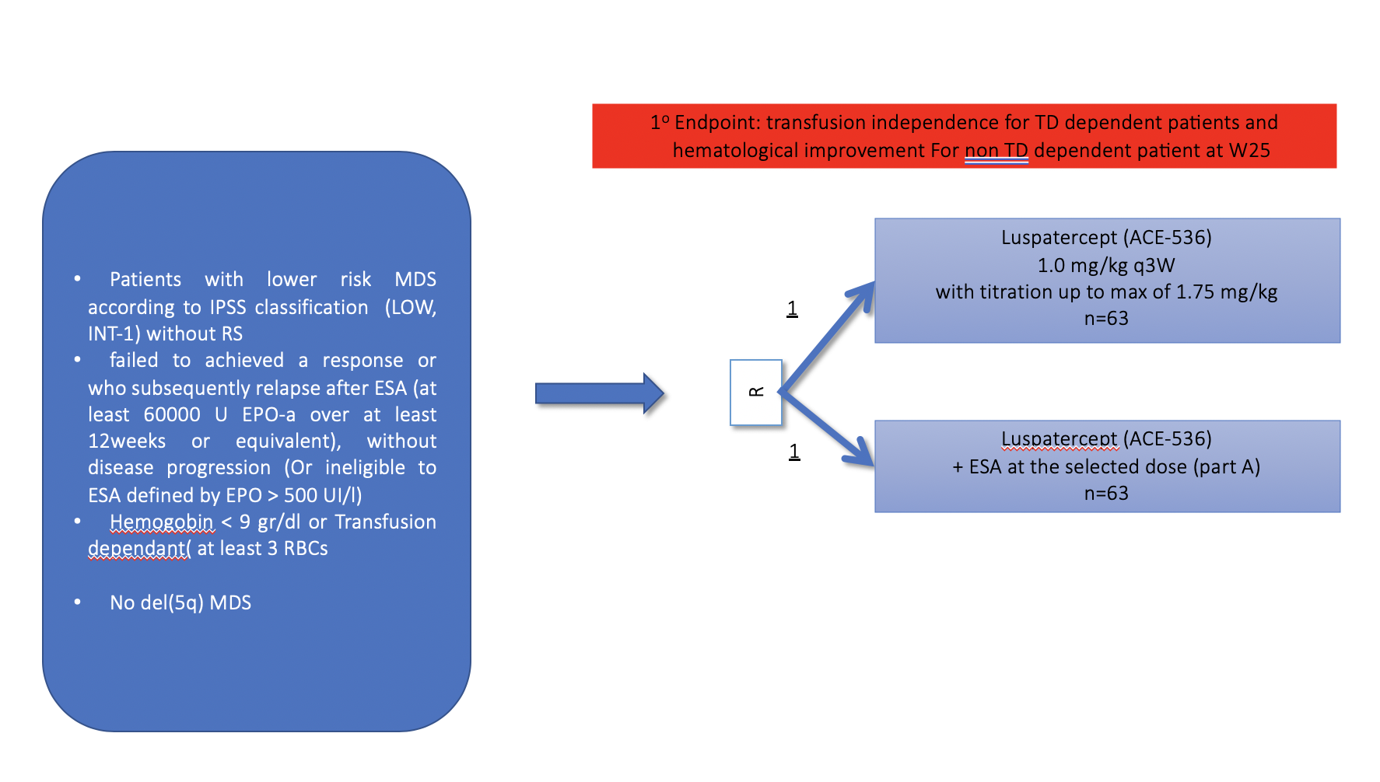
Combola Trial

Slide 37

Luspatercept versus epoetin alfa for treatment of anemia in ESA-naive lower-risk myelodysplastic syndromes patients requiring RBC transfusions: data from the phase 3 COMMANDS study
Matteo Giovanni Della Porta,^{1,2} Uwe Platzbecker,³ Valeria Santini,⁴ Amer M. Zeidan,⁵ Pierre Fenaux,⁶ Rami S. Komrokji,⁷ Jake Shortt,⁸ David Valcarcel,⁹ Anna Jonasova,¹⁰ Sophie Dimicoli-Salazar,¹¹
Ing Soo Tiong,¹² Chien-Chin Lin,¹³ Jiahui Li,¹⁴ Jennie Zhang,¹⁴ Ana Carolina Giuseppi,¹⁴ Sandra Kreitz,¹⁵ Veronika Pozharskaya,¹⁴ Karen L. Keeperman,¹⁴ Shelonitda Rose,¹⁴ Jeevan K. Shetty,^{15*}
Sheida Hayati,¹⁴ Sadanand Vodala,¹⁴ Andrius Degulys,^{16,17} Stefania Paolini,¹⁸ Thomas Cluzeau,¹⁹ Guillermo Garcia-Manero²⁰
¹Cancer Center IRCCS Humanitas Research Hospital, Milan, Italy; ²Department of Biomedical Sciences, Humanitas University, Milan, Italy; ³Medical Clinic and Policlinic 1, Hematology and Cellular Therapy, University Hospital Leipzig, Leipzig, Germany; ⁴MDS Unit, Hematology, University of Florence, AOUC, Florence, Italy; ⁵Department of Internal Medicine, Yale School of Medicine and Yale Cancer Center, Yale University, New Haven, CT; ⁶Service d'Hématologie Séniors, Hôpital Saint-Louis, Université Paris 7, Paris, France; ⁷Moffitt Cancer Center, Tampa, FL; ⁸Monash University and Monash Health, Melbourne, VIC, Australia; ⁹Hospital Universitari Vall d'Hebron, Barcelona, Spain; ¹⁰Medical Department Hematology, Charles University General University Hospital, Prague, Czech Republic; ¹¹Hôpital Haut-Lévêque, Centre Hospitalier Universitaire de Bordeaux, Bordeaux, France; ¹²Malignant Haematology & Stem Cell Transplantation, The Alfred, Melbourne, Victoria, Australia; ¹³Department of Laboratory Medicine, National Taiwan University Hospital, Taipei, Taiwan; ¹⁴Bristol Myers Squibb, Princeton, NJ; ¹⁵Celgene International Sàrl, a Bristol-Myers Squibb Company, Boudry, Switzerland; ¹⁶Hematology, Oncology and Transfusion Medicine Center, Vilnius University Hospital Santaros Klinikos, Vilnius, Lithuania; ¹⁷Institute of Clinical Medicine, Faculty of Medicine, Vilnius University, Vilnius, Lithuania.; ¹⁸IRCCS University Hospital of Bologna, “Seràgnoli” Institute of Hematology, Bologna, Italy, Italy; ¹⁹Département d'Hématologie Clinique, Université Cote d'Azur, CHU Nice, Nice, France; ²⁰Department of Leukemia, University of Texas MD Anderson Cancer Center, Houston, TX.
*At the time of the study
Presentation number S102

Slide 38
The COMMANDS study
  The COMMANDS study (NCT03682536) is a phase 3, global, open-label, randomized trial comparing the efficacy and safety of luspatercept versus epoetin alfa for the treatment of anemia due to IPSS-R LR-MDS in ESA-naive patients who require RBC transfusions
Key eligibility criteria
≥ 18 years of age
IPSS-R very low-, low, or intermediate-risk MDS (with or without RS) by WHO 2016, with < 5% blasts in bone marrowª
Required RBC transfusions (2–6 pRBC
units/8 weeks for a minimum of 8 weeks immediately prior to randomization)
Endogenous sEPO < 500 U/L
ESA-naive
Patients stratified by:
Baseline sEPO level
Baseline RBC transfusion burden
RS status
Post-treatment safety follow-up
Monitoring for other malignancies, HR-MDS or AML progression, subsequent therapies, survival
For 5 years from first dose or 3 years from last dose, whichever is later
Luspatercept (N = 178)
1.0 mg/kg s.c. Q3W
titration up to 1.75 mg/kg
Response assessment at
day 169 and every
24 weeks thereafter
1:1
Randomized
End treatment
Due to lack of clinical benefit^{c}
or disease progression
per IWG criteria
Epoetin alfa (N = 178)^{b}
450 IU/kg s.c. QW
titration up to 1050 IU/kg
ªMDS with del(5q) were excluded. ^{b}2 patients randomized to the epoetin alfa arm withdrew consent prior to receiving their first dose; ^{c}Clinical benefit defined as transfusion reduction of ≥ 2 pRBC units/8 weeks versus baseline; AML, acute myeloid leukemia; ESA, erythropoiesis-stimulating agent; IPSS-R, Revised International Prognostic Scoring System; IWG, International Working Group; LR-MDS, lower-risk MDS; MDS, myelodysplastic syndromes; pRBC, packed RBC; QW, once weekly; Q3W, every 3 weeks; RBC, red blood cell; RS, ring sideroblasts; s.c., subcutaneously; sEPO, serum erythropoietin; WHO, World Health Organization.

Slide 39
Study endpoints
Composite primary endpoint (weeks 1–24)
Secondary endpoints
(weeks 1–24)
Secondary and exploratory endpoints
RBC-TI for ≥ 12 weeks
WITH CONCURRENT
mean hemoglobin
increase ≥ 1.5 g/dL
HI-E response ≥ 8 weeks per IWG criteria
RBC-TI for 24 weeks
RBC-TI for ≥ 12 weeks
Duration of RBC-TI for
≥ 12 weeks (week 1−EOT)
Impact of baseline mutations on response
Subgroup analyses
The data cutoff date for this planned interim analysis was August 31, 2022
    This prespecified interim analysis was planned for when ~300 patients had either completed 24 weeks of treatment or discontinued prior to completing 24 weeks of treatment (at 85% of information for the primary endpoint)
Safety
Treatment discontinuation
TEAE
HR-MDS/AML progression
Death
HI-E, hematological improvement-erythroid; RBC-TI, RBC transfusion independence; TEAE, treatment-emergent adverse event.

Slide 40
Primary endpoint: luspatercept superior to epoetin alfa
Of 301 pts included in the efficacy analysis, 86 (58.5%) patients receiving luspatercept and 48 (31.2%) epoetin alfa achieved the primary endpoint
    Achievement of the primary endpoint favored luspatercept or was similar to epoetin alfa for all subgroups analyzed
Patients (%)
≤ 200 U/L
> 200–500 U/L
< 4 U/
8 weeks
≥ 4 U/
8 weeks
RS+
RS−
Mutated
WT
Baseline sEPO level
Baseline RBC transfusion burden
RS status
SF3B1 mutation status
This prespecified interim analysis included 301 patients who had either completed 24 weeks of treatment or discontinued prior to completing 24 weeks of treatment.

Slide 41
Secondary endpoints: luspatercept superior to epoetin alfa
ªDuring weeks 1-24.
 | Luspatercept (N = 147) | Epoetin alfa (N = 154)
Time to first RBC transfusion (week 1–EOT) | n = 93 168.0 (64.0–323.0) | n = 116 42.0 (22.0–55.0)
HI-E ≥ 8 weeksª
RBC-TI 24 weeksª
RBC-TI ≥ 12 weeksª

Slide 42
Duration of RBC-TI ≥ 12 weeksª
 | Median duration (95% CI), weeks | HR (95% CI)
Luspatercept | 126.6 (108.3 to NE) | 0.456 (0.260 to 0.798)
Epoetin alfa | 77.0 (39.0 to NE) | 87 (48.9)
1.0
0.9
0.8
0.7
0.6
0.5
0.4
0.3
0.2
0.1
0
Probability
0
10 20 30 40 50 60 70 80 90 100 110 120 130 140 150 160 170 180
Duration of RBC-TI (weeks)
No. at risk Luspatercept | 98 | 98 | 91 | 74 | 61 | 49 | 42 | 37 | 31 | 28 | 21 | 17 | 11 | 8 | 6 | 1 | 1 | 0
Epoetin alfa | 71 | 71 | 63 | 47 | 33 | 24 | 23 | 19 | 15 | 11 | 9 | 8 | 7 | 5 | 5 | 2 | 2 | 1 | 0
EOT, end of treatment; NE, not estimable; RBC-TI, red blood cell transfusion independence.
ªIn ITT responders during weeks 1–EOT.

Slide 43
Department of hematology and immunology of Hospitals St Louis, R Debré, AvicennE APHP and University of Paris
Hôpital St Louis
Hôpital Robert Debré
7 services of adult hematology (H Dombret, N Boissel, G Socié, B Arnulf, E Oksenhendler, P Fenaux, C Thiéblemont)
ICU (E Azoulay)
pneumology (A Tazi)
pediatric hématology service (A Baruchel)
Sickle cell disease unit(M Benkerrou)
Hôpital Avicenne
Adult hematology service (C Gardin)

Slide 44

Groupe Francophone des Myélodysplasies
Activates clinical trials in MDS (35 centers in France and Belgium
+ Switzerland)
Website: www. gfmgroup.org
Online registry of French MDS cases
Close cooperation with:
- a patient support group
- the International MDS Foundation
- the European Leukemia Net

