Slide 1

Hypomethylating Agents:
When and How
Mikkael A. Sekeres, MD, MS
Chief, Division of Hematology
Sylvester Comprehensive Cancer Center
@MikkaelSekeres

Slide 2
DISCLOSURES OF COMMERCIAL SUPPORT
Name of Company | Research support | Employee | Consultant | Stockholder | Speaker’s Bureau | Scientific Advisory Board | Other
Celgene/BMS |  |  |  |  |  | X
Takeda/Millenium |  |  |  |  |  | X
Novartis |  |  |  |  |  | X
Kurome |  |  |  |  |  | X
Syros |  |  |  |  |  | X

Slide 3
HMAs and MDS| Agenda
Predicting Response to HMAs (When)
Clinical Management Strategies (How)
@MikkaelSekeres

Slide 4
HMAs and MDS| Agenda
Predicting Response to HMAs (When)
Clinical Management Strategies (How)
@MikkaelSekeres

Slide 5
MDS | Modifying MLD
Sekeres and Patel Hematology (ASH Educ Book) 2019.

Slide 6
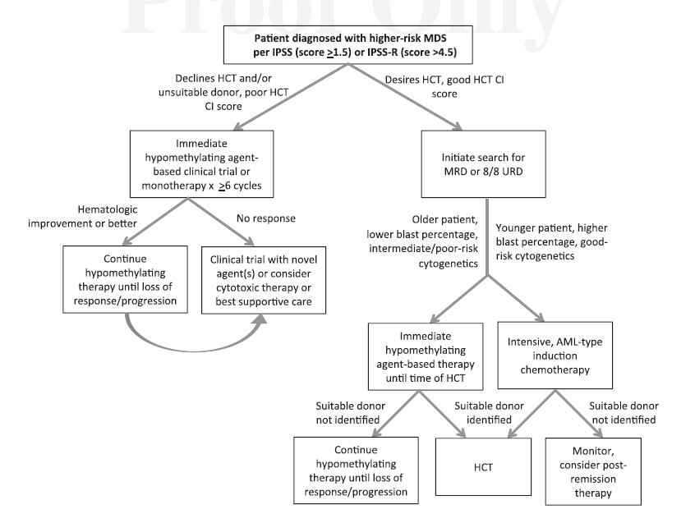
Higher-risk MDS | HMA and HCT
Sekeres and Cutler Blood 2014;123:829.
Notes:
Phocomelia

Slide 7
Lower-risk MDS | Modifying MLD: HMA
Response | N (%)
CR | 33 (36)
mCR | 8 (9)
HI | 13 (14)
ORR | 54 (59)
SD | 31 (34)
PD | 6 (7)
Median time to best response: 2 months (range: 1-20)
Median number of cycles received: 9 (range: 2-32)
Jabbour et al. for MDS CRC Blood 2017;130:1514
Notes:
Phocomelia

Slide 8
Treating MDS| AZA
1.0
Log-Rank p=0.0001
HR = 0.58 [95% CI: 0.43, 0.77]
0.9
0.8
0.7
ORR=35%
0.6
50.8%
0.5
24.4 months
Proportion Surviving
0.4
15 months
26.2%
0.3
AZA
0.2
CCR
0.1
0.0
0
5
10
15
20
25
30
35
40
Time (months) from Randomization
Fenaux P, et al. Lancet Oncology 2009;10:223-232.
Notes:
8
Fenaux P, et al. Azacitidine (AZA) Treatment Prolongs Overall Survival (OS) in Higher-Risk MDS Patients Compared with Conventional Care Regimens (CCR): Results of the AZA-001 Phase III Study. Blood. 2007;110(11):817a.
9.4 months difference
At the 2-year time point, the proportion of patients in the azacitidine group (50.8%) that had survived was approximately 2-fold that of the combined CCR (26.2%) treatment group, for a difference of 24.6% (95% CI 13.1, 36.1; p < 0.0001).

Slide 9
Treating MDS | DAC
Median OS 10.1 vs. 8.5 months
Lubbert et al. JCO 2011;29:1987.
Notes:
Phocomelia

Slide 10
Higher-risk MDS | HMAs: DAC/CED
Median OS 18.3 months
Garcia-Manero et al. Blood 2020.
Notes:
Phocomelia

Slide 11
HMAs| Methylation/Response
Figueroa et al. JCI 2015;125:1857-72

Slide 12
HMAs| Mutations/Response
NR CR, PR, HI
TET2/DNMT3A
Neither mutated | 68 (74) | 55 (81) | 13 (19)
One or both mutated | 24 (26) | 15 (62) | 9 (38) | 0.09
TET2/DNMT3A/IDH1/IDH2
None mutated | 64 (70) | 51 (80) | 13 (20)
1 gene mutated | 24 (26) | 18 (75) | 6 (25)
2 genes mutated | 4 (4) | 1 (25) | 3 (75) | 0.06^{b}
ASXL1
Wild type | 68 (74) | 53 (78) | 15 (22)
Mutant | 24 (26) | 17 (71) | 7 (29) | 0.58
N = 92 Patients treated with AZA or DAC
Traina et al. Leukemia 2014;28:78-87.

Slide 13
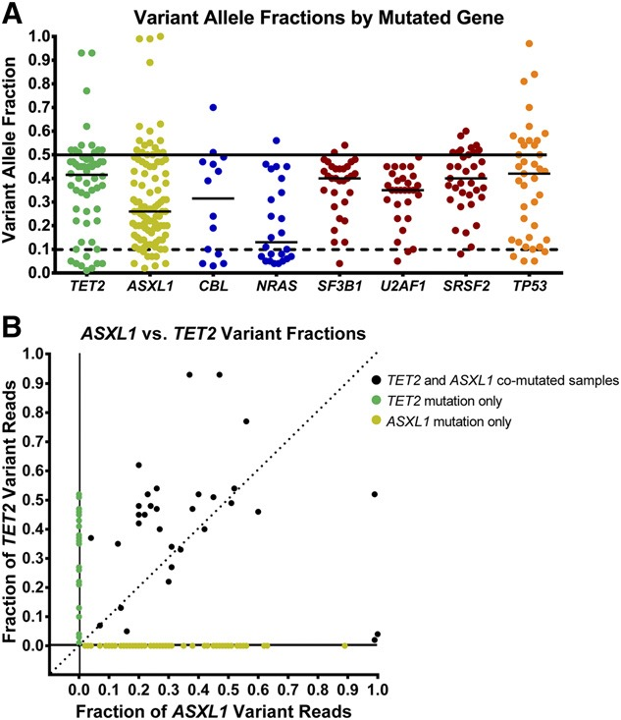
HMAs| Mutations/Response
Bejar et al. Blood 2014;124:2705-12

Slide 14

HMAs| Mutations/Response
ASXL1
TET2
RUNX1
HMA Response
Patient 1
TP53
RCOR
SRSF2
HMA Resistance
Patient 2
Nazha A, et al. JCO Prec Oncol 2019;3

Slide 15
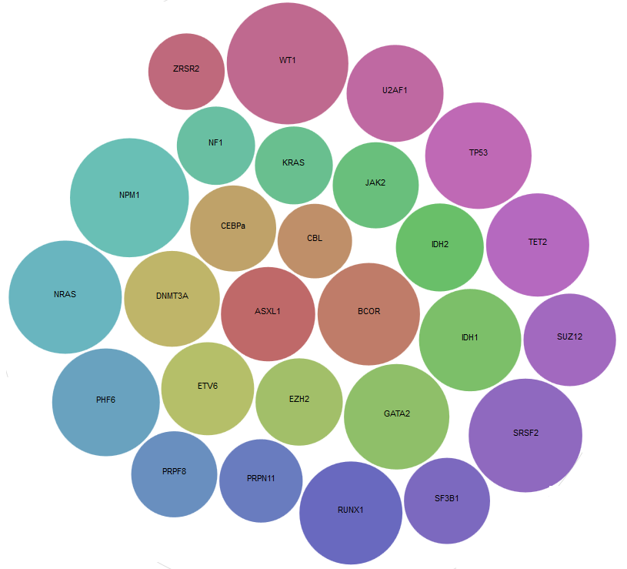
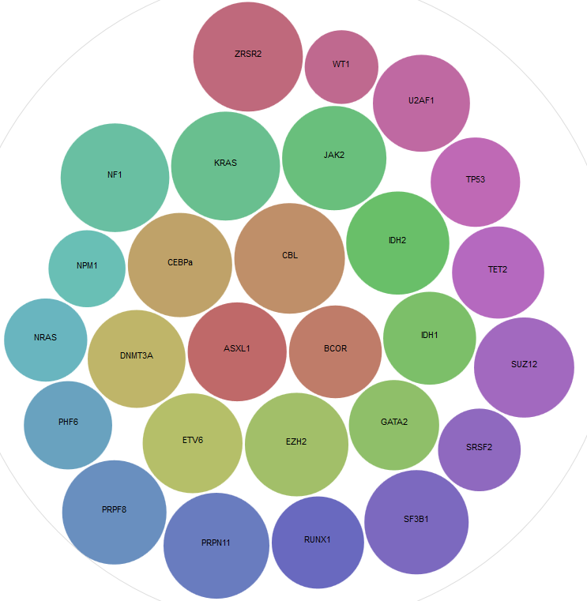
HMAs| Mutations/Response
Responders
Non-Responders
WT1
ZRSR2
WT1
ZRSR2
U2AF1
U2AF1
NF1
TP53
NF1
KRAS
JAK2
KRAS
JAK2
TP53
NPM1
CEBPA
CBL
TET2
CBL
IDH2
IDH2
NPM1
CEBPA
TET2
NRAS
DNMT3A
ASXL1
BCOR
IDH1
IDH1
SUZ12
NRAS
DNMT3A
ASXL1
BCOR
SUZ12
PHF6
ETV6
EZH2
PHF6
GATA2
GATA2
SRSF2
ETV6
EZH2
SRSF2
PRPF8
PRPN11
PRPF8
SF3B1
RUNX1
SF3B1
PRPN11
RUNX1
N = 433 Patients treated with HMAs Validated in 113 Patients enrolled in S1117
Nazha A, et al. JCO Prec Oncol 2019;3

Slide 16
Results: Association Rules
Predictive Tools|Mutations/Response
Training
Association Rules (Resistance)
ASXL1, NF1
ASXL1, EZH2, TET2
ASXL1, EZH2, RUNX1
EZH2, SRSF2, TET2
ASXL1, EZH2, SRSF2
ASXL1, RUNX1, SRSF2
ASXL1, TET2, SRSF2
ASXL1, BCOR, RUNX1
31% pts
> 3 mutations/sample
29% pts
Very Low/Low risk by IPSS-R
ORR to HMAs = 43%
Median # mutations per patient = 3 (range, 0-9)
Accuracy: 87%
Association Rules (Response)
TET2, RUNX1, SRSF2
Nazha A, et al. JCO Prec Oncol 2019;3

Slide 17
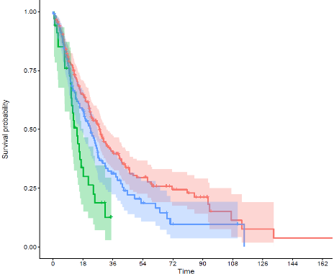
Predictive Tools|Mutations/Response
Group | Median OS (m)
<3 mut/sample | 28.2
>3 mut/sample w/o rules (69%) | 22.8
>3 mut/sample w rules (31%) | 14.6
Nazha A, et al. JCO Prec Oncol 2019;3

Slide 18
Personalized Model to Predict HMA Response in MDS
Methods
Dataset
• 514 patients from 3 institutions, received 4+ cycles HMA
• Serial CBCs available for first 90 days’ treatment
• 6+ months of follow up (mean 25 months), IWG response criteria
Data Analysis
• 3 state-of-the-art decision tree algorithms evaluated
• Lab values, change from baseline used to train predictions
Radakovich, et al. ASH 2020

Slide 19
Cohort Characteristics
 | Total | CC | Moffitt | SHC | p-value
Number | 514 | 324 | 100 | 90
Female (%) | 154 (30%) | 101 (31%) | 28 (28%) | 25 (27%) | .72
Age, mean | 72 | 72 | 70 | 75 | .001
Days of follow-up, mean | 753 | 777 | 715 | 713
De novo, n (%) | 336 (79%) | 260 (81%) | 76 (76%) | --- | .41
Number of cycles, mean | 12.6 | 12.5 | 12.9 | --- | <.001
% Marrow Blasts, mean | 3.3 | 0.1 | 7.6 | 10.1 | <.001
Progression to AML (%) | 170 (33%) | 111 (34%) | 31 (31%) | 28 (31%) | .76
Radakovich, et al. ASH 2020

Slide 20
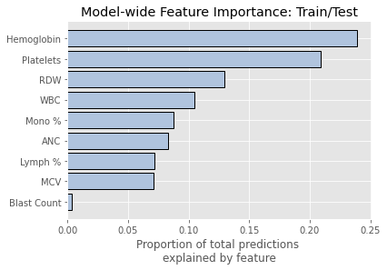
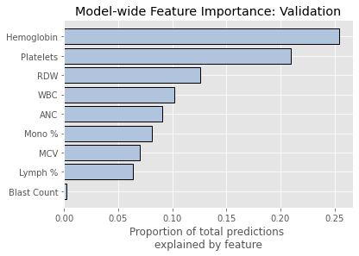
Important Variables
Model-wide Feature Importance: Train/Test
Model-wide Feature Importance: Validation
Hemoglobin
Platelets
RDW
WBC
Mono %
ANC
Lymph %
MCV
Blast Count
Hemoglobin
Platelets
RDW
WBC
ANC
Mono %
MCV
Lymph %
Blast Count
Proportion of predictions explained by feature
Proportion of predictions explained by feature
Radakovich, et al. ASH 2020

Slide 21
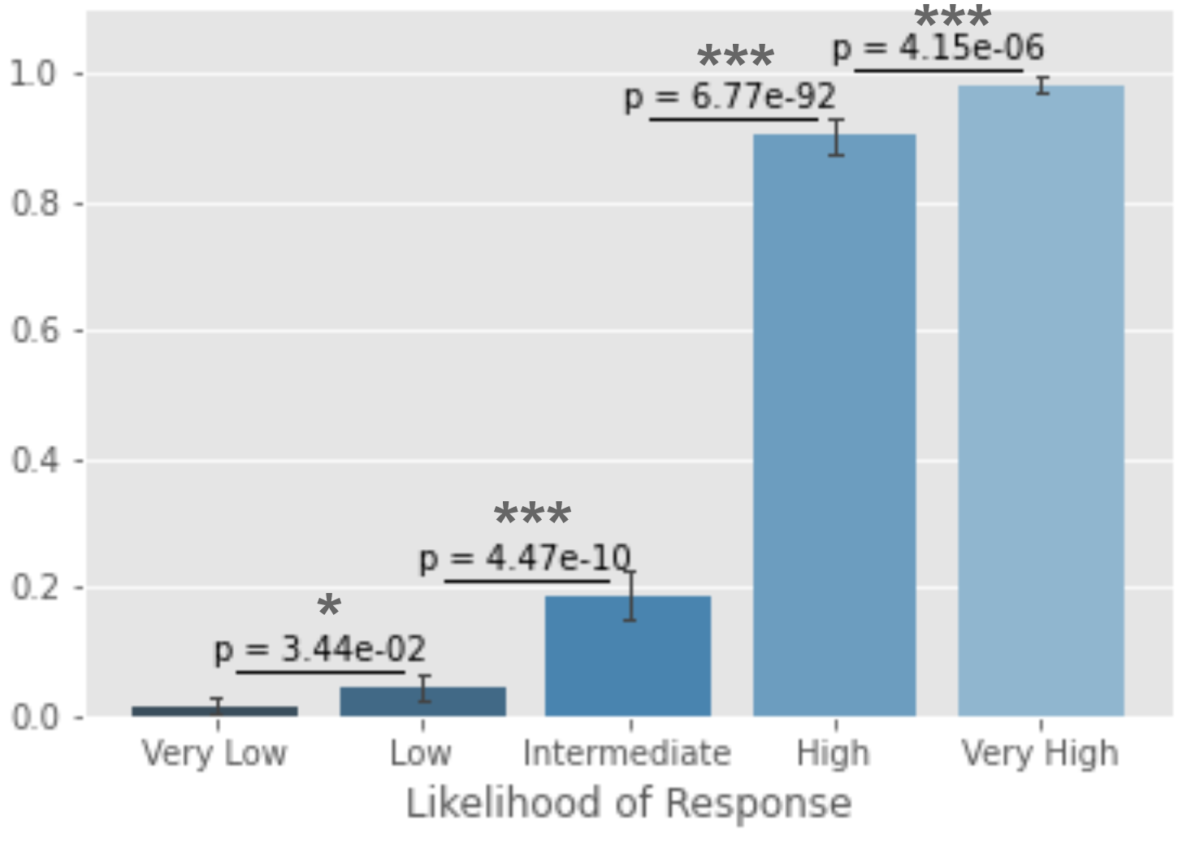
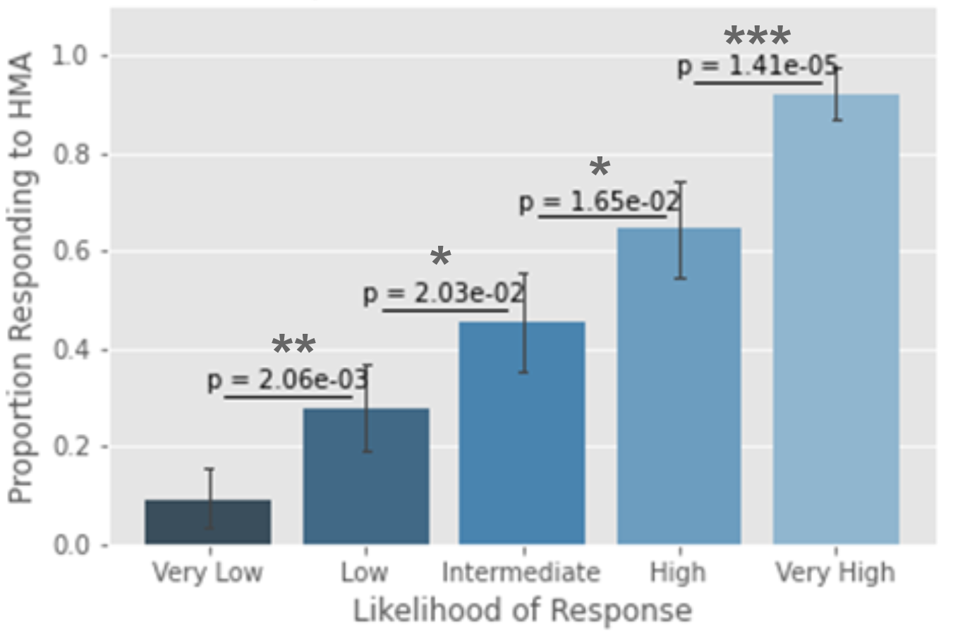
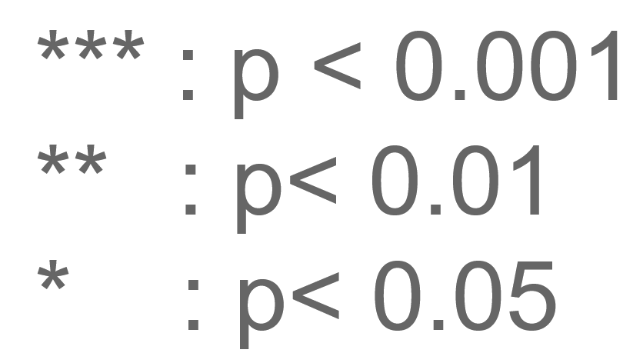
Predictions Effectively Stratify Response
Train/Test
Validation
Proportion Responding
Proportion Responding
Radakovich, et al. ASH 2020

Slide 22
HMAs and MDS| Agenda
Predicting Response to HMAs (When)
Clinical Management Strategies (How)
@MikkaelSekeres

Slide 23
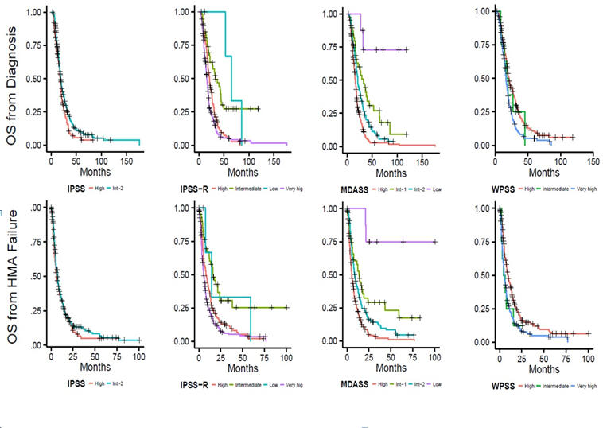
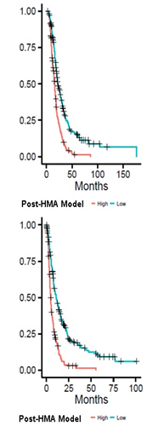
Survival at HMA Failure According to IPSS-R, IPSS, MDPSS
Model Incorporates ECOG PS, Age, Blast %, Cytogenetics, Plts, pRBC Txf
Nazha et al. for MDS CRC. Haematologica 2016;101:e224

Slide 24
HMAs and MDS| Management
Patients who don’t tolerate SQ may tolerate IV
@MikkaelSekeres

Slide 25
HMAs and MDS| Management
Keep patients on HMA-based treatment for minimum of 4-6 months
@MikkaelSekeres

Slide 26
Higher-risk MDS | Combinations
Response Variable | AZA | AZA+LEN (P-value vs. AZA) | AZA+VOR (P-value vs. AZA) | Total n=277
Median Tx Duration (Wks) | 25 | 24 | 20 | 22
Overall Response Rate (%) | 38 | 49 (.16) | 27 (.16) | 38%
CR/PR/HI (%) | 24/0/14 | 24/1/25 | 17/1/9 | 22/1/16%
CMML ORR (%) | 5 (28) | 13 (68) (.02) | 2 (12) (.41) | 37%
ORR Duration (median) | 10 months | 14 months (.41) | 15 months (.31) | 14 months
CMML ORR Duration (median) | 15 months | 14 months (.87) | 24 months (.69) | 15 months
Sekeres et al. JCO 2017;35:2745-53.

Slide 27
Pevonedistat: first-in-class small-molecule inhibitor of NAE¹
Inhibiting NAE blocks ubiquitination of select proteins upstream of the proteasome^{1,2}
Disrupts cell cycle progression and cell survival, leading to cell death in cancers, including myeloid malignancies.^{1,3}
 | Pevonedistat + azacitidine n=32 | Azacitidine n=35
Median EFS, months | 20.2 | 14.8
Hazard ratio (95% CI) | 0.539 (0.292–0.995) P=0.045
100
75
Randomized phase 2 trial of pevonedistat + azacitidine vs azacitidine alone (NCT02610777)⁴
Patients with higher-risk MDS/CMML or AML with
20–30% blasts
Encouraging clinical efficacy was observed, particularly in higher-risk MDS (Figure); ORR was 79% vs 57%
Combination had comparable safety profile to azacitidine alone, with no increase in myelosuppression
Probability of EFS (%)
50
25
Pevonedistat + azacitidine
Azacitidine
0
0
3
6
9
12
15
18
21
24
27
30
33
36
39
Time (months)
 | 32 | 30 | 28 | 25 | 24 | 20 | 16 | 11 | 10 | 8 | 2 | 1 | 1 | 0
 | 35 | 29 | 23 | 22 | 18 | 12 | 9 | 6 | 5 | 4 | 0 | 0 | 0 | 0
CI, confidence interval; EFS, event-free survival; NAE, NEDD8-activating enzyme; NEDD8, neural precursor cell expressed, developmentally downregulated 8.
1. Soucy TA, et al. Nature 2009;458:732–6; 2. Brownell JE, et al. Mol Cell 2010;37:102–11;
3. Soucy TA, et al. Clin Cancer Res 2009;15:3912–6; 4. Sekeres MA, et al. Leukemia 2021;35:2119–24.
Sekeres MA, et al. Blood 2021;138(Suppl. 1):242

Slide 28
Overall best response rate for complete ITT population and response rates in individual disease cohorts
ITT
Higher-risk MDS
Higher-risk CMML
AML with
20–30% blasts
44
Patients, %
Pevonedistat + azacitidine, n=227
Pevonedistat + azacitidine, n=161
Pevonedistat + azacitidine, n=16
Pevonedistat + azacitidine, n=50
Azacitidine, n=227
Azacitidine, n=163
Azacitidine, n=11
Azacitidine, n=53
CR, complete remission; CRi, CR with incomplete bone marrow recovery; HI, hematologic improvement.
Sekeres MA, et al. Blood 2021;138(Suppl. 1):242
Notes:
Table 15.2.4.5, Table 15.2.4.5B, Table 15.2.4.5C, Table 15.2.4.5D

Slide 29
HMAs and MDS| Management
HCPs may be more likely intolerant of side effects than patients
@MikkaelSekeres

Slide 30
Higher-risk MDS | Toxicity Perception
Question | Physicians (%, n=61) | Patients (%, n=200) | P-Value
Burden of treatment outweighed benefit | 69 | 35 | <.001
Fatigue was too great to continue | 60 | 33 | .002
Treatment made the patient (me) feel too sick to continue | 79 | 33 | <.001
Treatment side effects interfered with regular activities | 74 | 35 | <.001
Steensma et al. Cancer 2014;120:1670. Gerds et al. ASH 2014:2642a

Slide 31
Higher-risk MDS | Combinations
Toxicity Variable | AZA | AZA+LEN (P-value vs. AZA) | AZA+VOR (P-value vs. AZA) | Total n=271
Febrile neutropenia (n) | 10 | 13 (.66) | 12 (.51) | 36
GI (n) | 4 | 12 (.10) | 14 (.02) | 28
Rash (n) | 3 | 14 (<.01) | 1 (1) | 17
Off Tx due to Toxicity/Side Effect/Complication | 8% | 20% (.05) | 21% (.03) | 18%
Non-protocol defined dose modifications | 24% | 43% (.002) | 42% (.01) | 33%
Sekeres et al. JCO 2017;35:2745-53.

Slide 32

HMAs and MDS| Trials
Choose schedules centers can accommodate
Ensure eligibility reflects real patients
Provide guidelines preventing dose reduction/delays that will hurt efficacy
Choose meaningful (EFS, OS) endpoints
Make sure Phase 2 endpoints include meaningful outcomes that will translate to randomized trials
@MikkaelSekeres

Slide 33
HMAs and MDS| Management
Remember, our patients don’t fail therapies;
Our therapies fail our patients.
@MikkaelSekeres

Slide 34



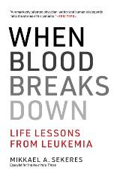
Thanks!!!

