Slide 1
MDS Clinical Roadmap: Novel Agents in Frontline HR-MDS
David A. Sallman, MD
Associate Member
Myeloid Section Head
david.sallman@moffitt.org

Slide 2
Disclosures
I disclose the following financial relationship(s):
Agios, Advisory Board or Panel, Speaker’s Bureau
Gilead/Kite, Advisory Board or panel
Servier, Advisory Board or panel
Jazz, Grants/Research Support
Incyte, Speaker’s Bureau
Novartis Advisory Board or Panel,
Abbvie, Advisory Board of Panel,
Syndax – Advisory Board or Panel
Intellia – Advisory Board or Panel
BMS – Advisory Board or Panel, Speakers Bureau
Janssen – Steering Committee
Curis – Advisory Board or Panel
Shattuck Labs – Advisory Board or Panel
Aprea – Research Support

Slide 3
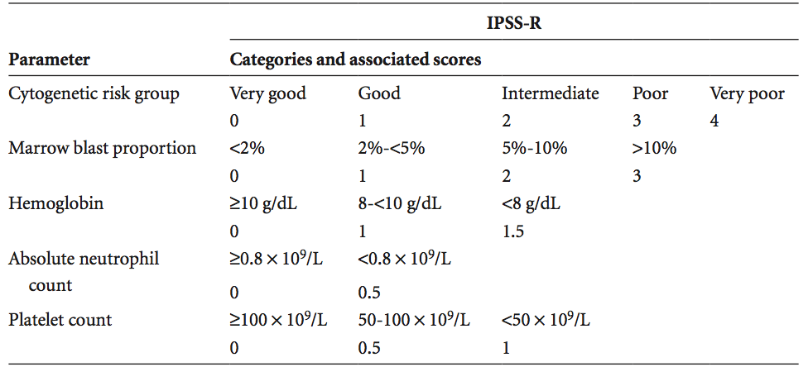
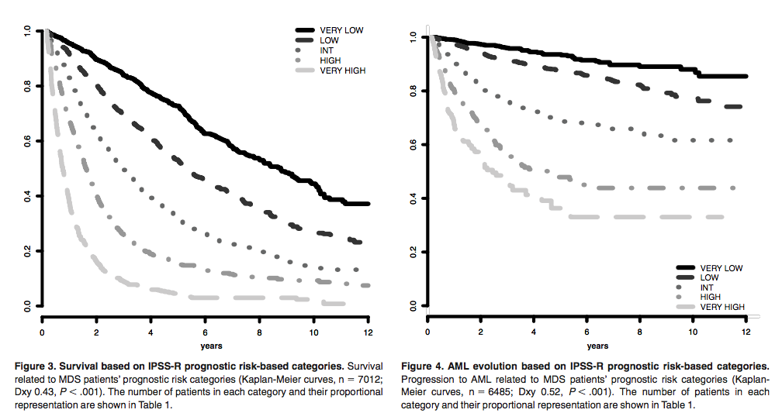
How do we define HR-MDS
Overall Survival
Progression to AML
Greenberg P et al., Blood 2012

Slide 4
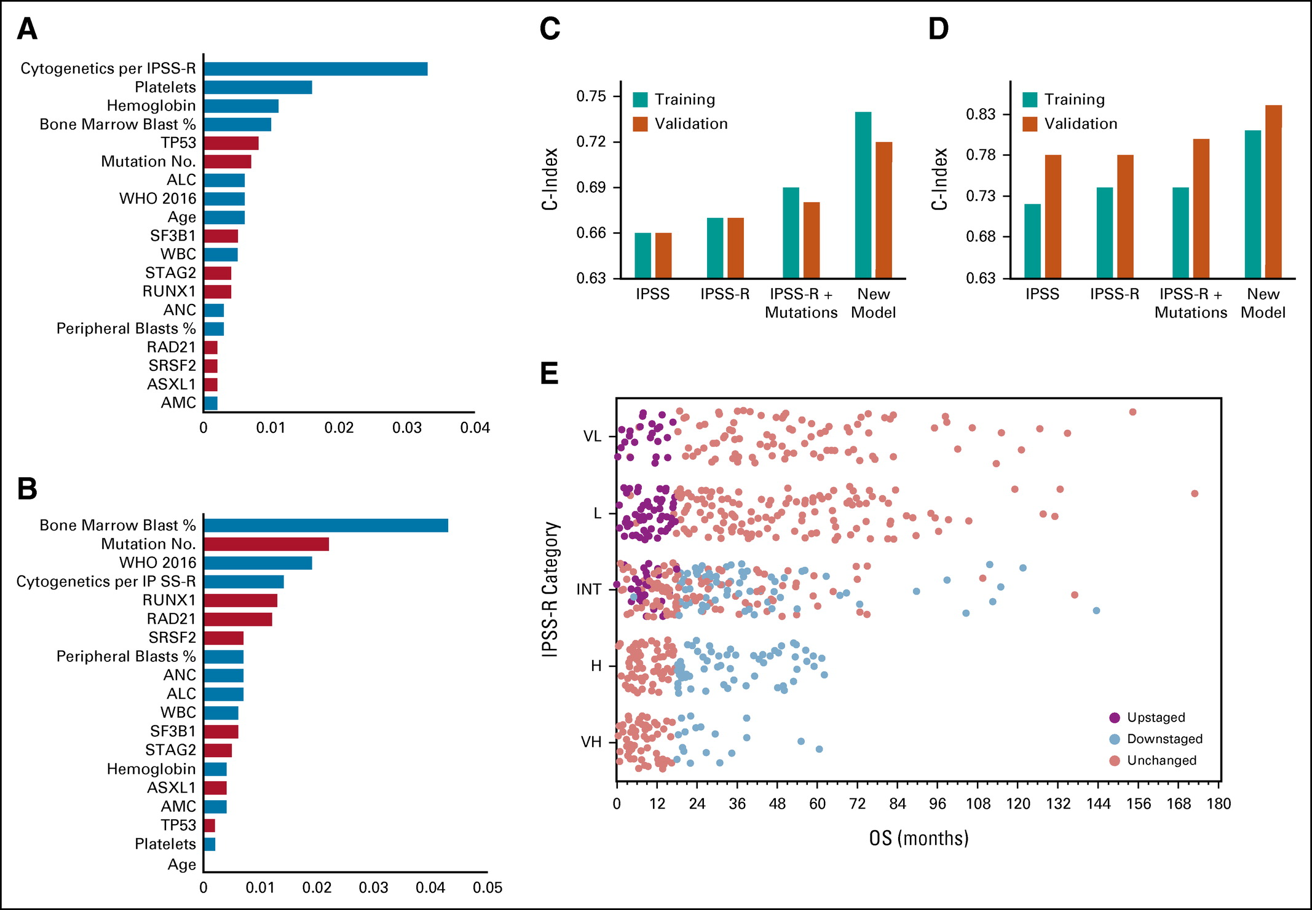
Personalized Model for MDS
Nazha A et al., JCO 2021

Slide 5
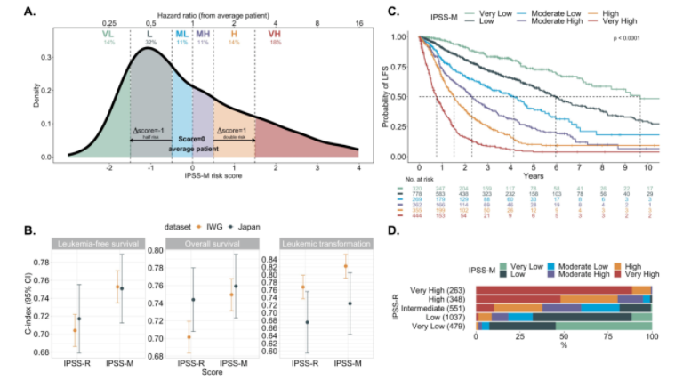
Molecular IPSS (IPSS-M)
Bernard E et al., NEJM Evidence 2022

Slide 6
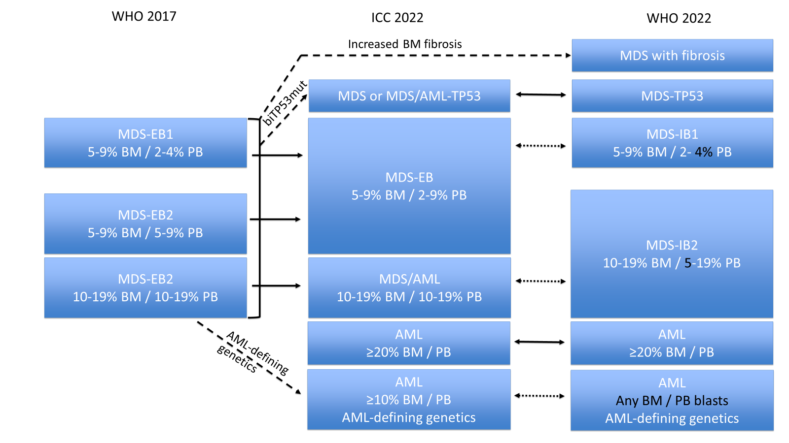
Overlap of MDS and AML
Courtesy of Hasserjian R

Slide 7
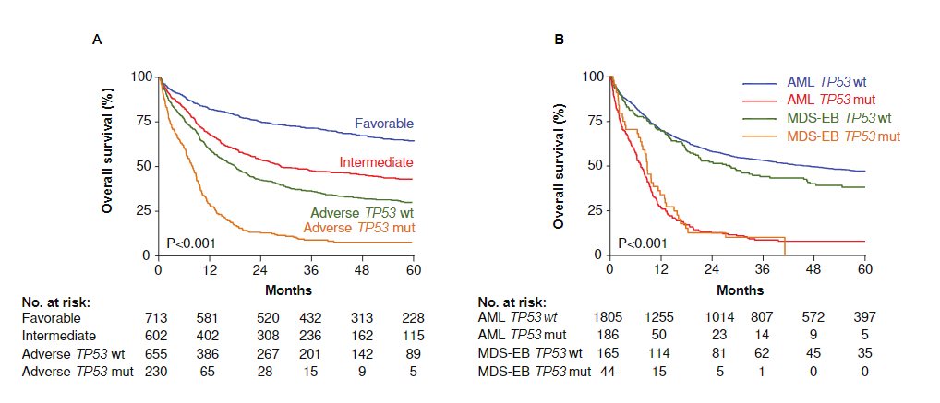
TP53 Mutant MDS and AML, One Disease ?
Grob T et al., Blood 2022
Notes:
2220 patients with AML and MDS-EB

Slide 8
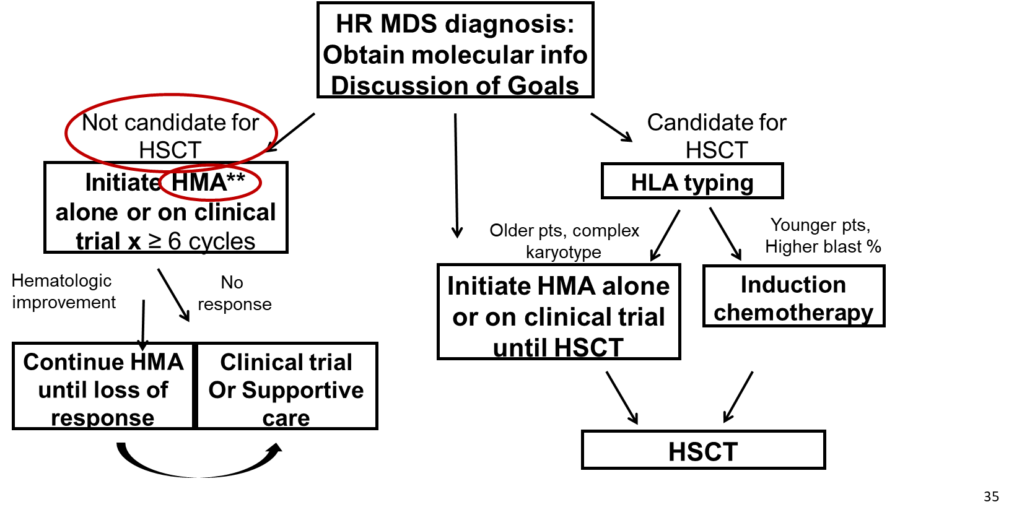
Treatment Algorithm for HR-MDS

Slide 9
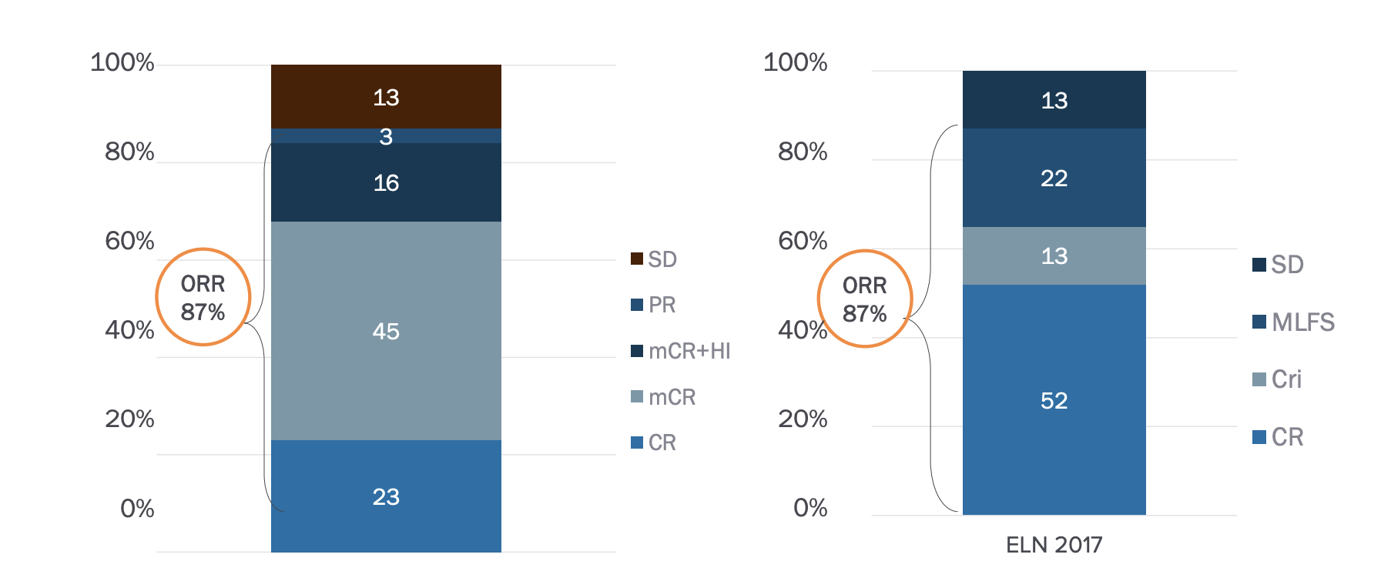
CPX-351 for Frontline Treatment of HR-MDS
Parallel Study in US (Jacoby M et al., ASH 2021)
Overall response rate was 78% with best overall responses of CR (n=4), mCR (n=10), stable disease (n=2), progressive disease (n=2) and pending (n=1). Of the 10 patients with mCR, 3 also had hematologic improvements. Similar CR rate if apply ELN.
Similar data have been shown with azacitidine (Brunner A et al., Blood Cancer J 2022)
Peterlin P et al., ASH 2021; Jacoby M, Sallman D et al., ASH 2021; (Brunner A et al., Blood Cancer J 2022

Slide 10
A Growing History of Failed Clinical Trials with HR-MDS
HMA + Len
HMA + vorinostat
HMA + durvalumab
HMA + eltrombopag
HMA + pevonedistat
HMA + eprenetapopt
Now HMA + magrolimab
Agent?, Trial Design? Heterogeneous Patients???

Slide 11
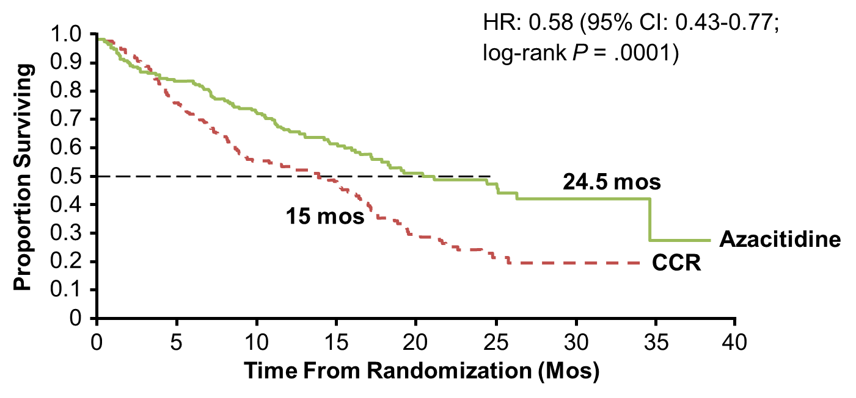
AZA-001 and OS
Real World OS has been 14-18 months; 40-50% ORR; 15-20% CR
Recent Failed P3 Trials of azacitidine + pevonedistat and azacitidine + eprenetapopt
Fenaux P, et al. Lancet Oncol. 2009;10:223-232; Zeidan A et al, Leukemia, 2016.

Slide 12
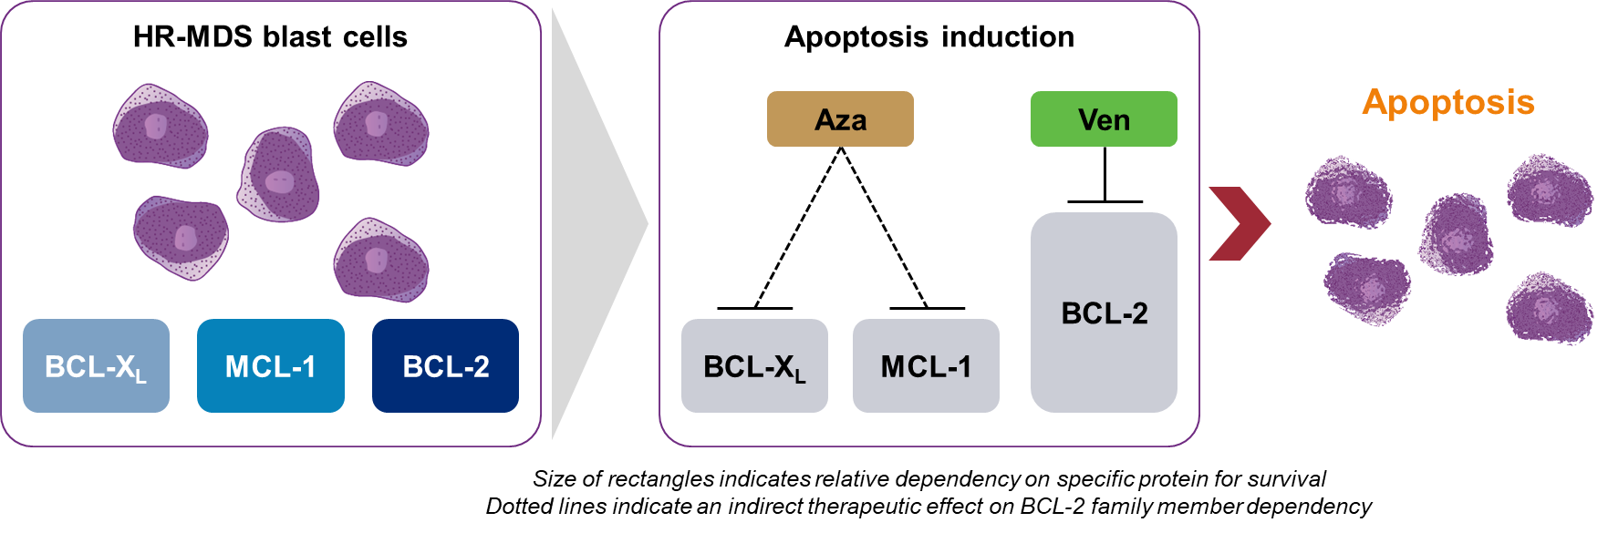
Azacitidine + Venetoclax MOA
Venetoclax is a selective, potent, orally bioavailable BCL-2 inhibitor, which has demonstrated synergy with hypomethylating agents in preclinical and clinical studies of myeloid malignancies¹⁻⁴
Ven + Aza Mechanism of Action
1. DiNardo CD, et al. Lancet Oncol. 2018;19(2):216–28. 2. DiNardo CD, et al. Am J Hematol. 2018;93(3):401–7. 3. Jilg S, et al. Exp Hematol Oncol. 2019;8:9. 4. Jin S, et al. Clin Cancer Res. 2020;26(13):3371–83.

Slide 13
Response to Frontline HMA + Ven
mCR +HI:
24%
  Median time to response:
  0.9 months (95% CI, 0.7–5.8)
  Median duration of response:
  12.4 months (95% CI, 9.9–NR)
mORR:ª
84%
Garcia et al., ASH 2021

Slide 14
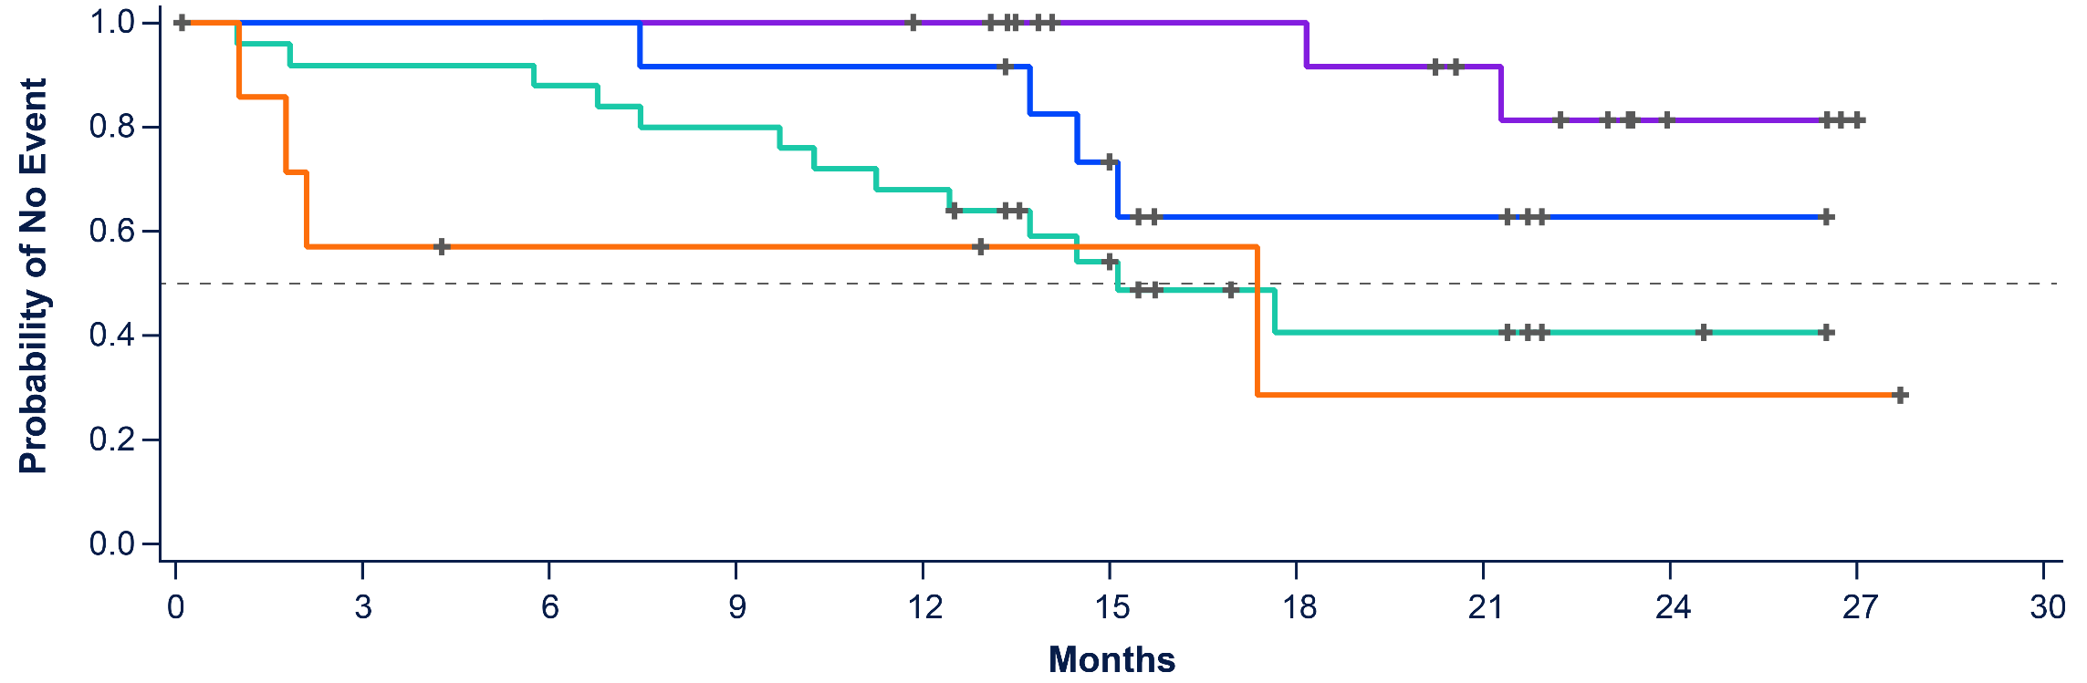
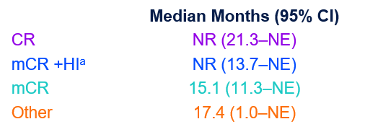
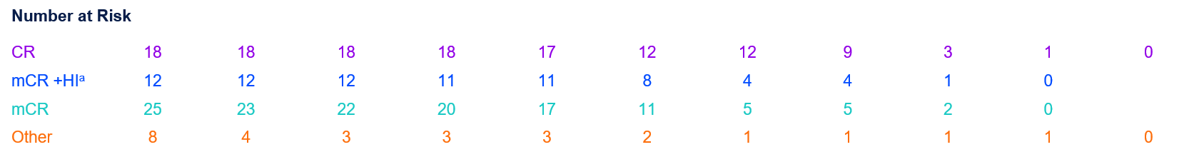
OS in HMA + ven pts treated at RP2D (n=51)
+ Censored
Garcia et al., ASH 2021

Slide 15
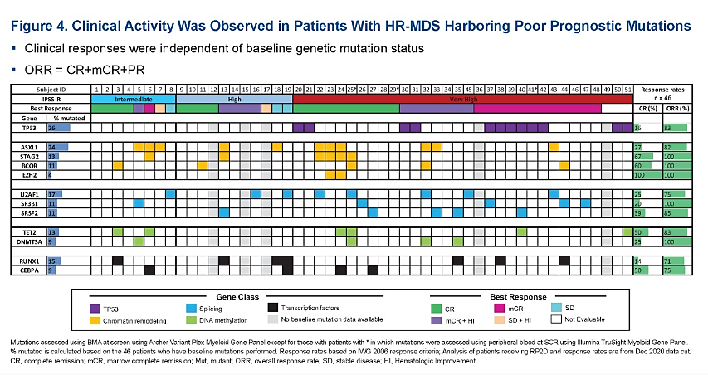
Updated Safety and Efficacy of VEN+AZA for the Treatment of Patients With Treatment-Naïve Higher-Risk MDS: Phase 1b
Clinical Activity Observed in HR-MDS Patients With Poor-Prognostic Mutations
16% CR/83% ORR
Wei A, et al. ASCO 2021
Notes:
16% CR for Tp53

Slide 16
Real-World Responses to Venetoclax + HMA in HR-MDS
 | 1L HMA VEN | 1L HMA
All cohort | n=35 | n=1127
ORR CR mCR PR HI | 77% 34% 37% (62% + HI) 3% 3% | 40% 13% 11% 1% 15% | <.005
ASXL-1 MT | n=16 | n=106
ORR CR | 87% 44% | 32% 8% | <.005
TP53 MT | n=12 | n=137
ORR CR | 75% 25% | 44% 17% | .038 .47
HMA Failure setting (n=31)
CR 13%, mCR 48%
9/31 to allo-HSCT
Median OS in R/R was 33 months and 21 months in 1L (independent of transplant status)
Komrokji R, et al. ASH 2021

Slide 17
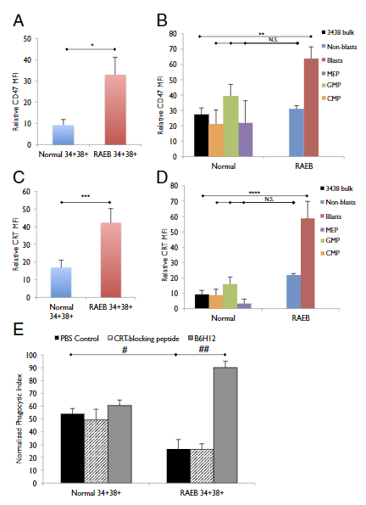
Preclinical efficacy of CD47 and AML
Majeti, Chao et al., Cell 2009; Pang W et al., PNAS 2013; Jiang H et al.,
Notes:
(D) Summary of human
leukemic chimerism in the bone marrow on day 14 relative to day 0 demonstrated a dramatic reduction in leukemic burden in anti-CD47 antibody-treated
mice compared to control IgG treatment (p = 0.006).
(E) H&E sections of representative mouse bone marrow cavities from mice engrafted with SU004 AML LSC post-treatment with either control IgG (panels 1 and 2)
or anti-CD47 antibody (panels 4 and 5). IgG-treated marrows were packed with monomorphic leukemic blasts, while anti-CD47-treated marrows were hypocellular,
demonstrating elimination of the human leukemia. In some anti-CD47 antibody-treated mice that contained residual leukemia, macrophages were detected
containing phagocytosed pyknotic cells (panels 3 and 6, arrows).
294 Cell
Furthermore, blocking monoclonal antibodies
directed against CD47 preferentially enabled
phagocytosis of AML LSC and inhibited their engraftment
in vivo. Finally, treatment of human AML LSCengrafted
mice with anti-CD47 antibody depleted
AML and targeted AML LSC.

Slide 18
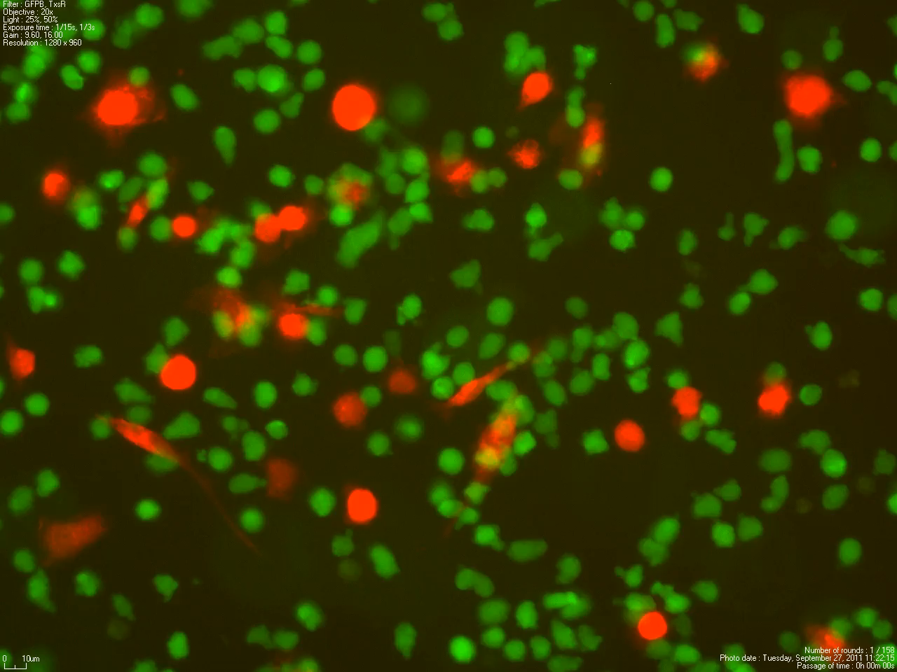
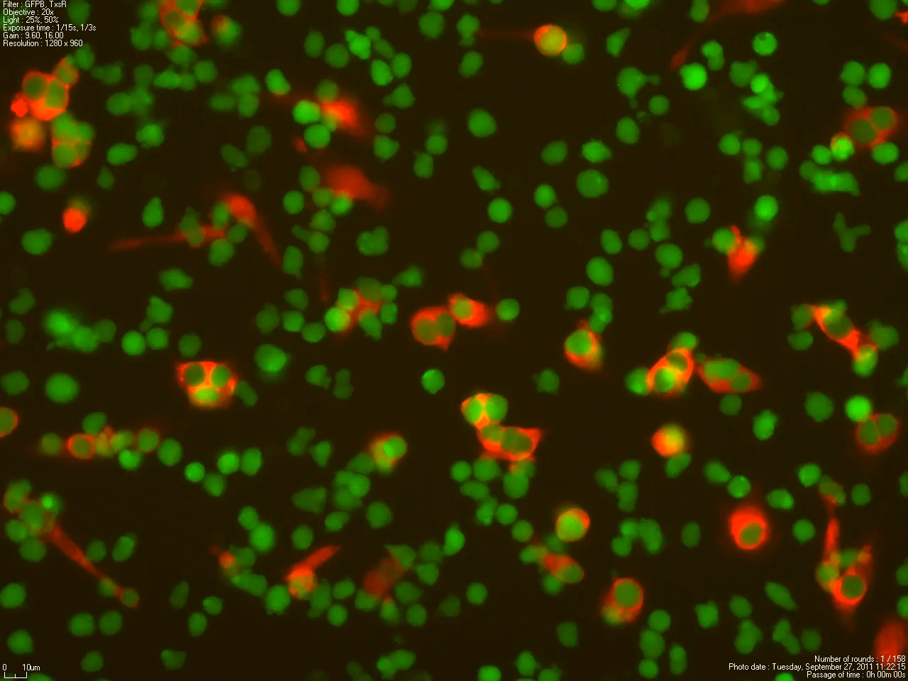
Magrolimab (Formerly 5F9) is a First-in-class Macrophage Immune Checkpoint Inhibitor Targeting CD47
Control mAb: No Phagocytosis
Anti-CD47 mAb: Phagocytosis
Macrophages Cancer cells
Magrolimab is an IgG4 anti-CD47 monoclonal antibody being investigated in multiple cancers
Sallman D et al., 2020 ASCO
Notes:
CD47 Is a Major Macrophage Immune Checkpoint and ‘Do Not Eat Me’ Signal in Myeloid Malignancies Including MDS and AML; Increased CD47 expression predicts worse prognosis in AML patients

Slide 19
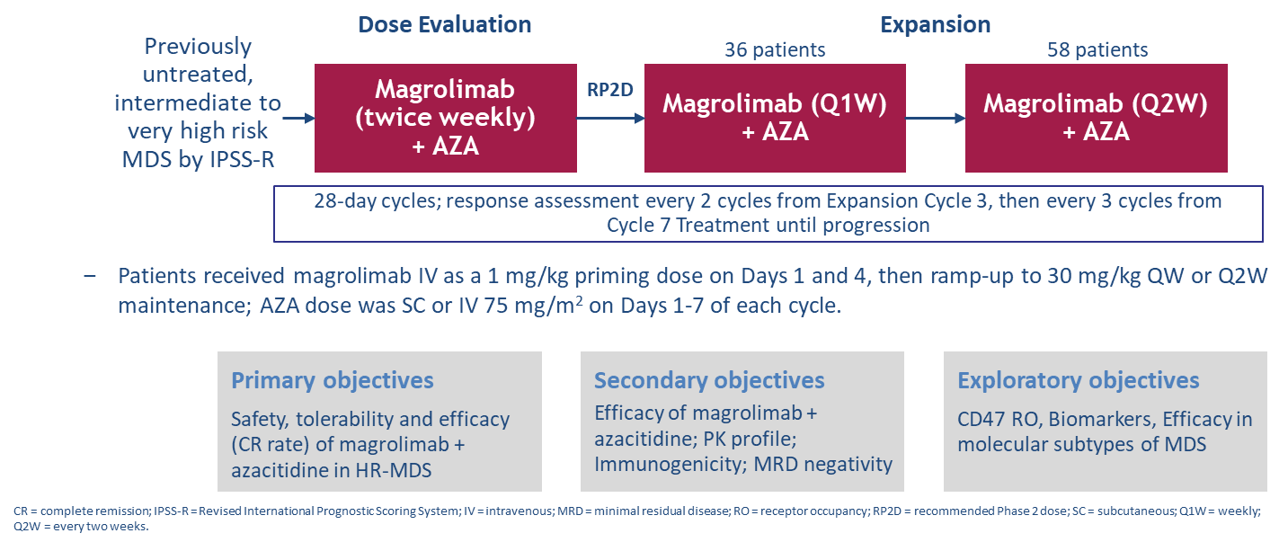
5F9005 Study Design: Magrolimab in Combination with AZA in HR-MDS
Sallman D et al., EHA 2022; Sallman D et al., JCO. 2023

Slide 20
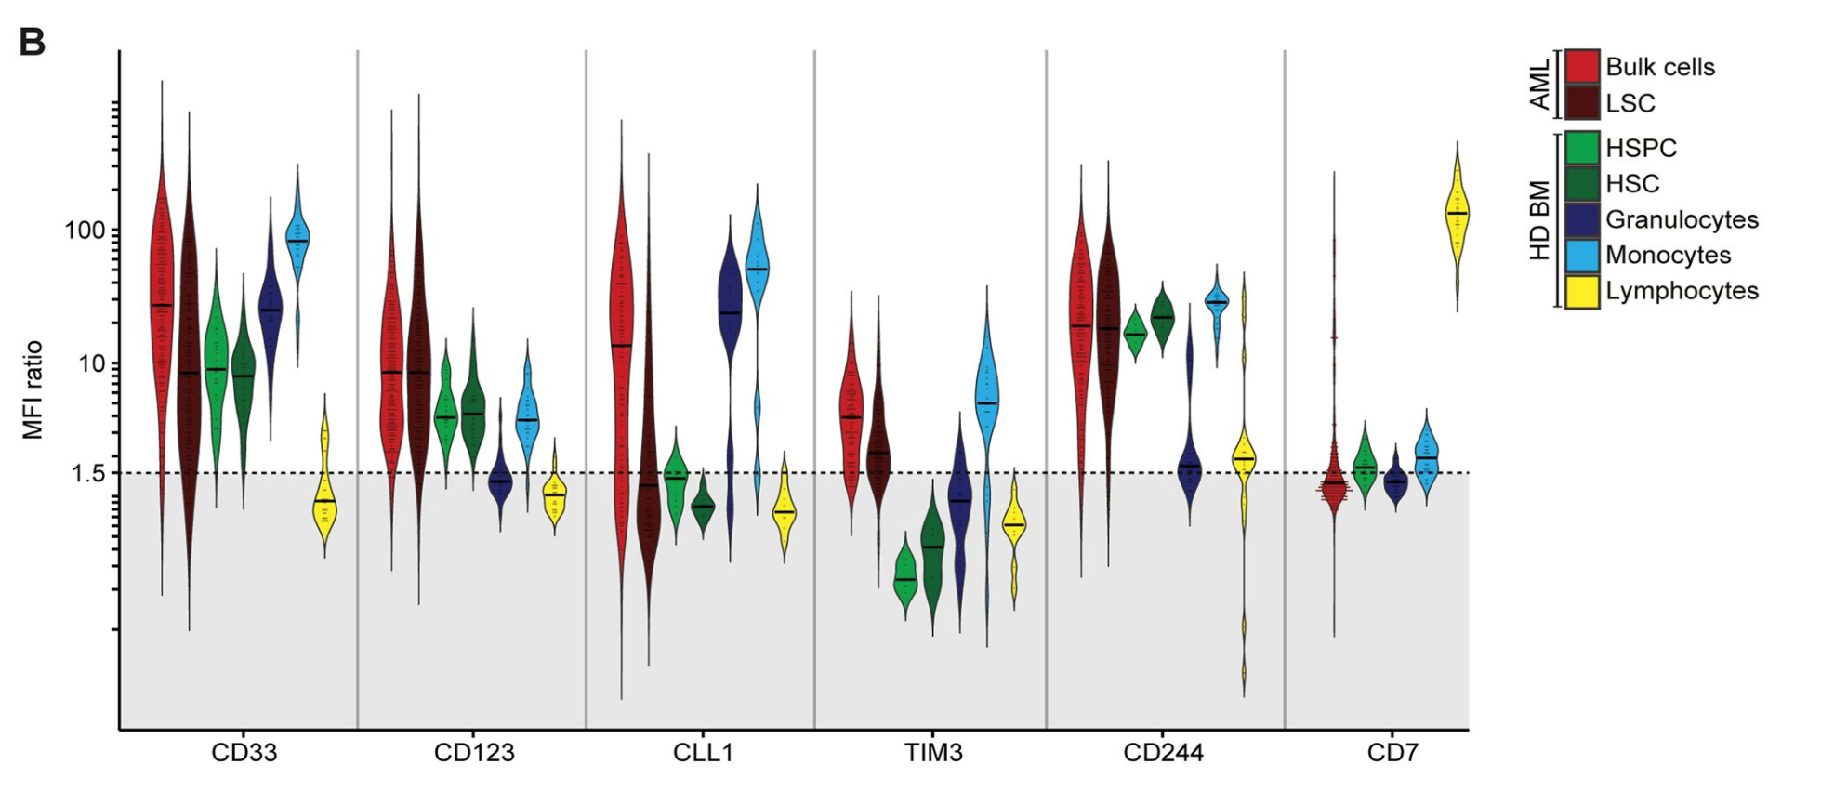
AML Target Antigens
  CD33
  CD123
  TIM3
  TLR9
  CLL-1/CLEC12A
  CD47
  CD70
Sallman D…... Daver N et al., 2020 ASCO
Notes:
flow cytometry of primary AML (n = 356) and normal bone marrow samples (n = 34), and a recently reported integrated normal tissue proteomic data set. 302 at diagnosis and 54 at relapse. CD33/TIM3 and CLL1/TIM3 to be highly positive in AML compared with normal hematopoiesis and non-hematopoietic tissues. Importnatly no major differencese between de novo and relapse. In contrast, CLL1 expression on LSC showed interindividual variability, with only a subgroup of patients being positive at initial diagnosis (45.1%) and at relapse (20.0%). he target antigen combination CD33/TIM3 could be particularly suitable for combinatorial CAR + CCR approaches, thereby minimizing stem cell and myeloid hematotoxicity and prioritizing LSC-targeting. However, this setting might facilitate immune escape of single-positive AML cells. Targeting CLL1/TIM3 could be feasible not only in the CAR + CCR setting, but also in CAR + CAR approaches, thereby maximizing the number of targetable AML cells and minimizing chances of antigen escape.

Slide 21
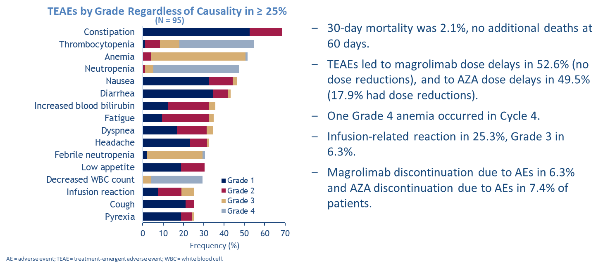
Magrolimab in Combination with AZA Is Well Tolerated in HR-MDS
Sallman D et al., EHA 2022; Sallman D et al., JCO. 2023

Slide 22
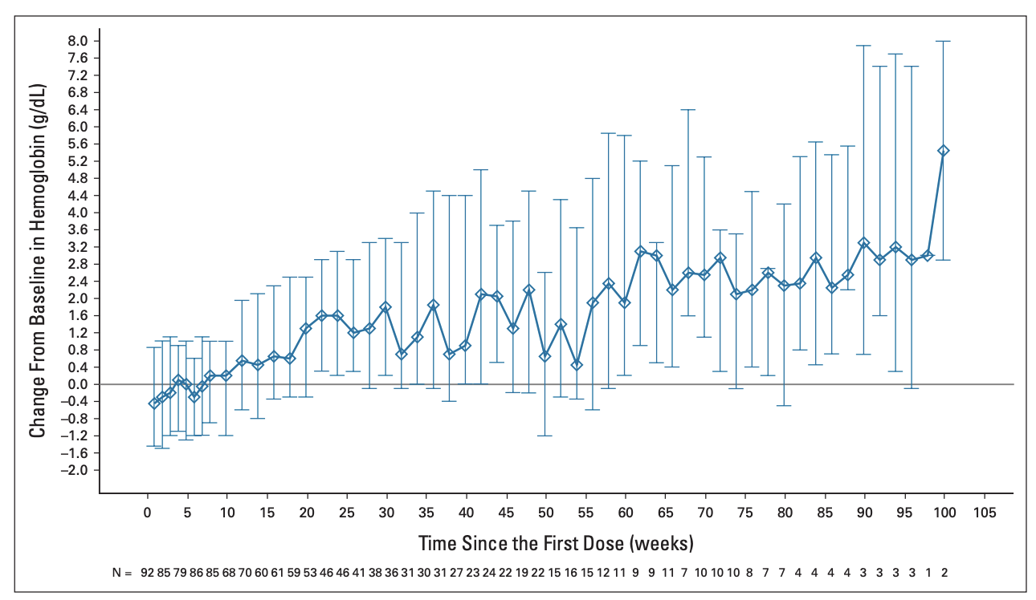
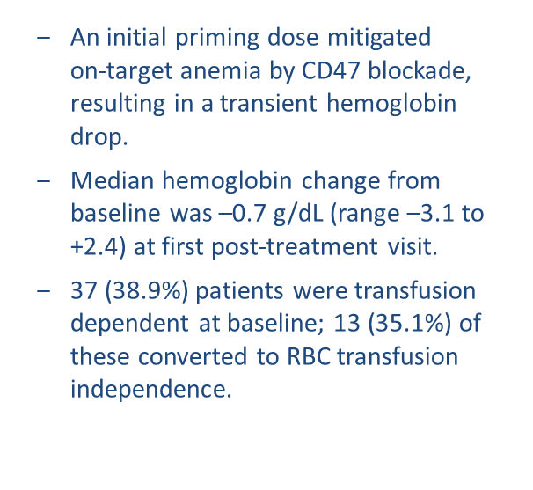
On-Target Anemia Is a Pharmacodynamic Effect and Mitigated with a Magrolimab Priming and Maintenance Dosing Regimen
Sallman D et al., EHA 2022
Sallman D et al., EHA 2022; Sallman D et al., JCO. 2023

Slide 23
Magrolimab + AZA Induces High Response Rates in HR-MDS
Sallman D et al., EHA 2022
Sallman D et al., EHA 2022; Sallman D et al., JCO. 2023

Slide 24
Durable Responses Are Seen in Patients Treated with
Magrolimab + AZA and Deepen over Time
Sallman D et al., EHA 2022
Sallman D et al., EHA 2022; Sallman D et al., JCO. 2023

Slide 25
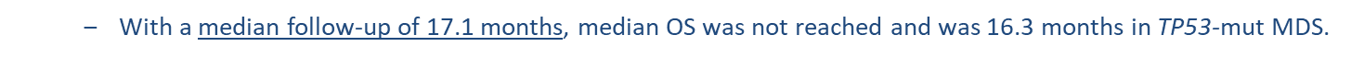
Median OS Is Encouraging in Both TP53-Wild Type and Mutant HR-MDS Patients
Sallman D et al., EHA 2022
Sallman D et al., EHA 2022; Sallman D et al., JCO. 2023

Slide 26
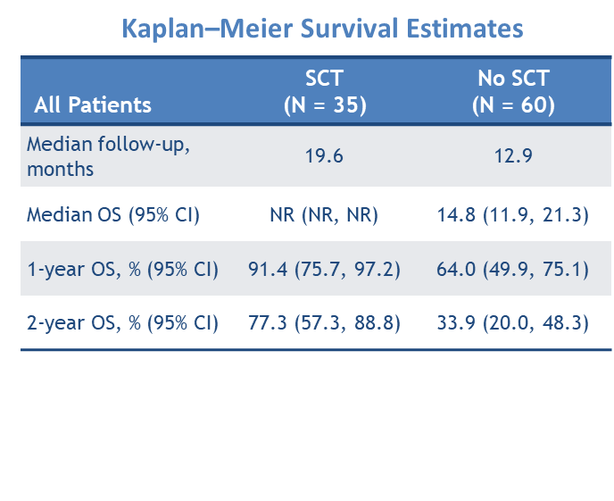
Stem Cell Transplant Outcomes Are Encouraging in HR-MDS Patients Treated with Magrolimab + AZA
Sallman D et al., EHA 2022; Sallman D et al., JCO. 2023

Slide 27
OS and PFS in TP53 mutant MDS pts with Aza+Magro
Sallman D et al., JCO 2023
Notes:
Four patients with TP53 mutation received allo-HSCT (Data Supplement). Median OS in these patients was 19.7 months (95% CI, 9.8 to 19.7) versus 13.4 months (95% CI, 9.8 to NR) in patients without allo-HSCT

Slide 28
Prognostic Value of MRD in MDS
Transplanted Cohort
Total Cohort
Non-Transplanted Cohort
Sallman D et al., JCO. 2023

Slide 29
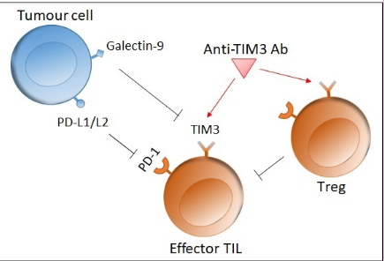
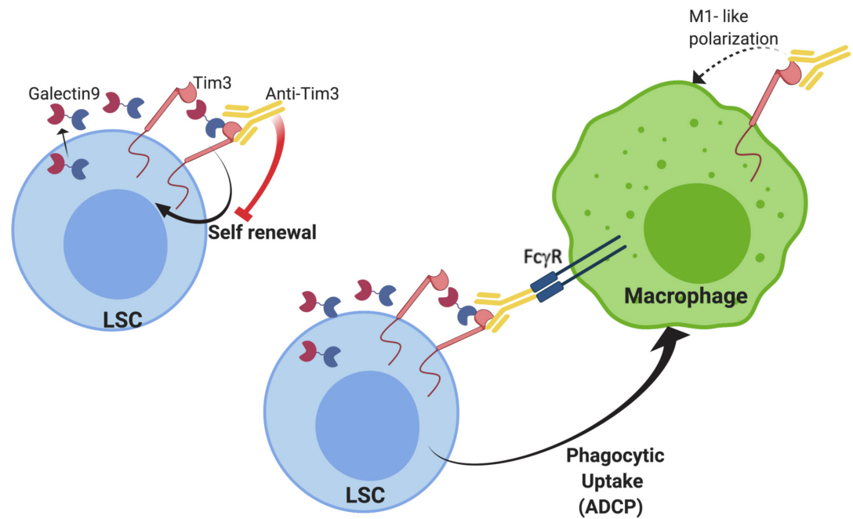
Targeting TIM3 and Sabatolimab
TIM-3 promotes autocrine LSC self-renewal
Blocking TIM-3 inhibits downstream signaling that promotes self-renewal
TIM-3 ligation on T-Cells leads to apoptosis of the effector cell
May also promote phagocytosis by myeloid cells, macrophages
Acharya N, et al. J Immunother Cancer. 2020;8:e000911. Kikushige et al., Cell Stem Cell 2015
Notes:
Tim3 on an effector T cell and galectin-9 on a tumour cell inhibits the immune response by inducing apoptosis in the T cell. Tim3 is also upregulated on Treg, which in turn inhibit effector T cell function. Blocking Tim3 with a mAb thus enhances T cell proliferation and immune function.

Slide 30
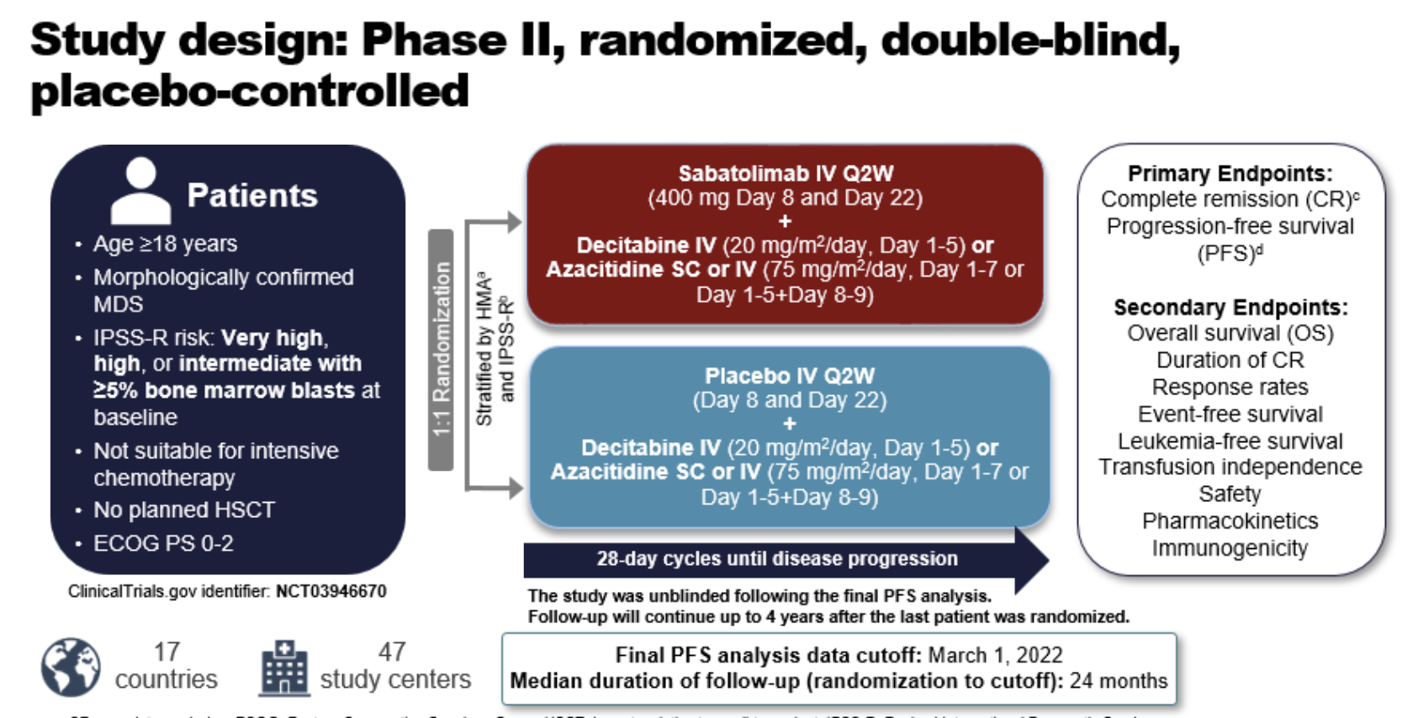
Zeidan A et al., ASH 2022
Notes:
Over 30% TP53 mutant in both arms

Slide 31
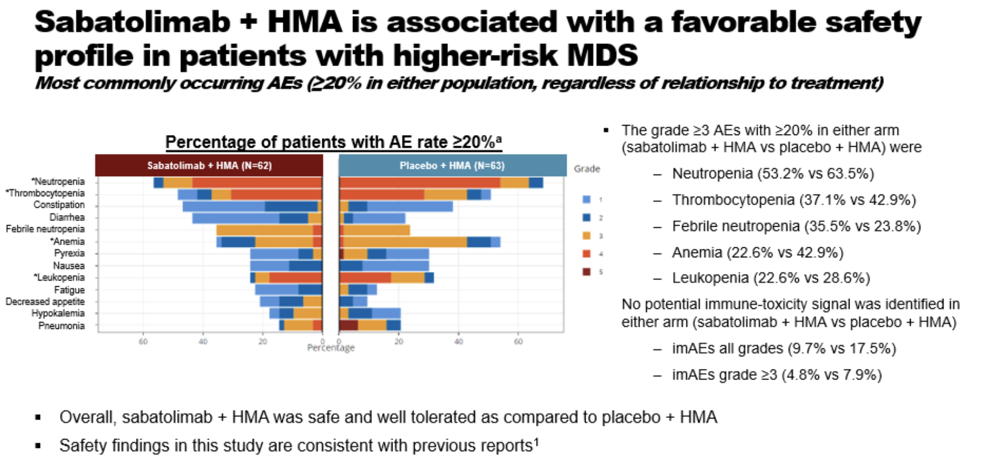
Zeidan A et al., ASH 2022
Notes:
imAEs 13% MDS; 21% AML; 10% ≥ G3 (only AML); No G4/G5
7/7 imAE had remission with MDS (no difference in AML) from. Phase 1

Slide 32
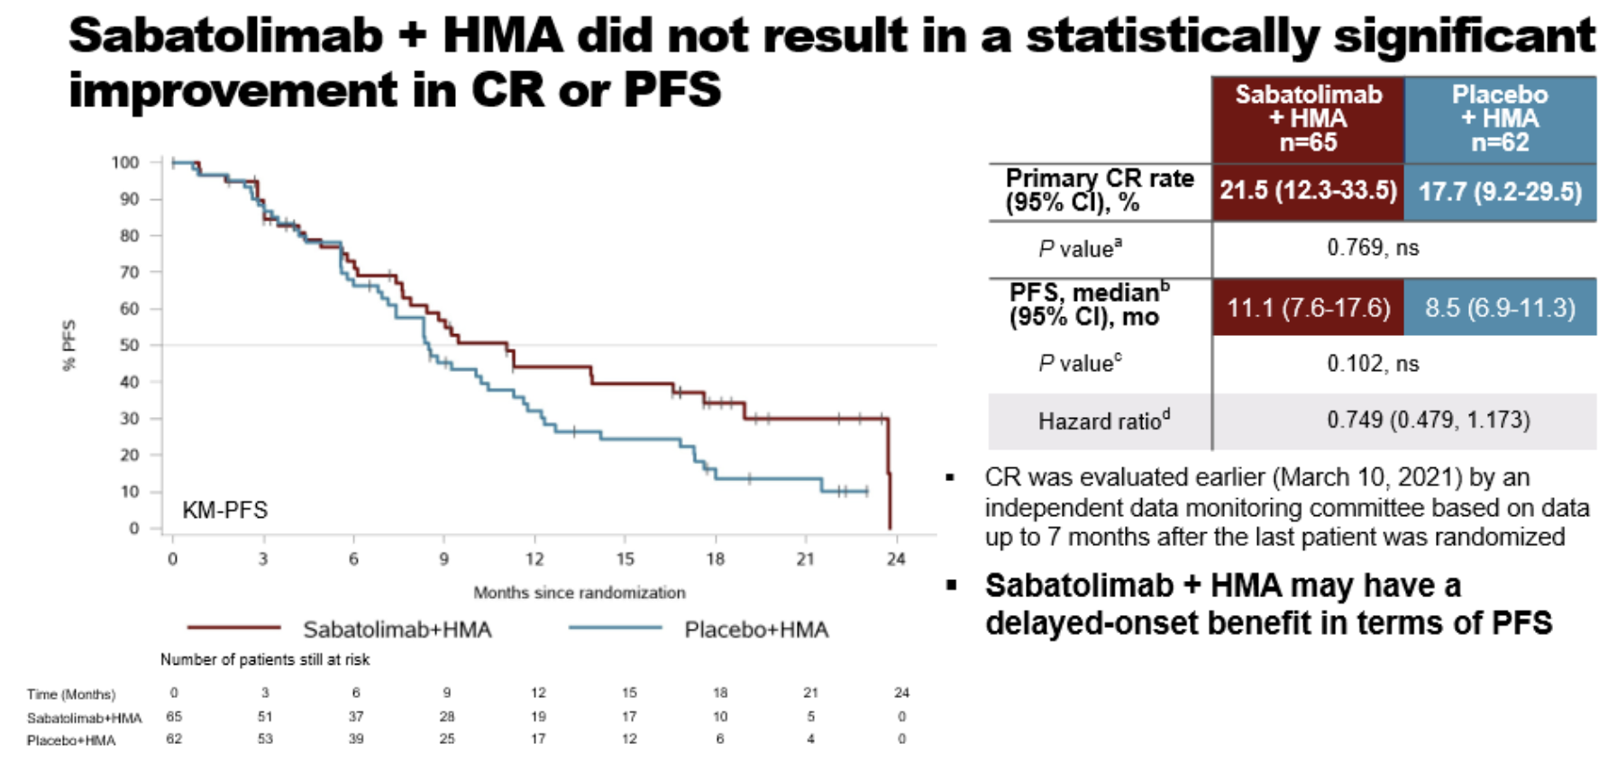
Lower Burden of Disease (<10% blasts, IPSS-R and
IPSS-M int/high risks) with improved outcomes
Zeidan A et al., ASH2022
Notes:
Duration of CR. Was double; Tp53 may have impacted this with superimposable curves

Slide 33
Future Directions
Multiple HMA-based doublets currently in phase 3 clinical trials
  VERONA: AZA +/- VEN in ND HR-MDS (excludes therapy related)
  ENHANCE: AZA +/- Magrolimab in HR-MDS (unfortunately study terminated based on lack of efficacy, data not presented to date)
  STIMULUS-MDS1: HMA +/- sabatolimab in HR-MDS
  SELECT MDS-1: AZA +/- tamibarotene in RARA-positive MDS
Targeted Interventions for molecular subsets
  IDH1/IDH2inh similar (if not more) activity to AML; TP53? Splicing?
Improving Outcomes with HSCT: total therapy
Further evaluation of mechanisms of synergy and resistance with combination therapies and other novel strategies
Evaluation of MRD by serial high sensitivity NGS or duplex sequencing
What to do for HMA failure and how will frontline landscape impact the R/R setting?

Slide 34
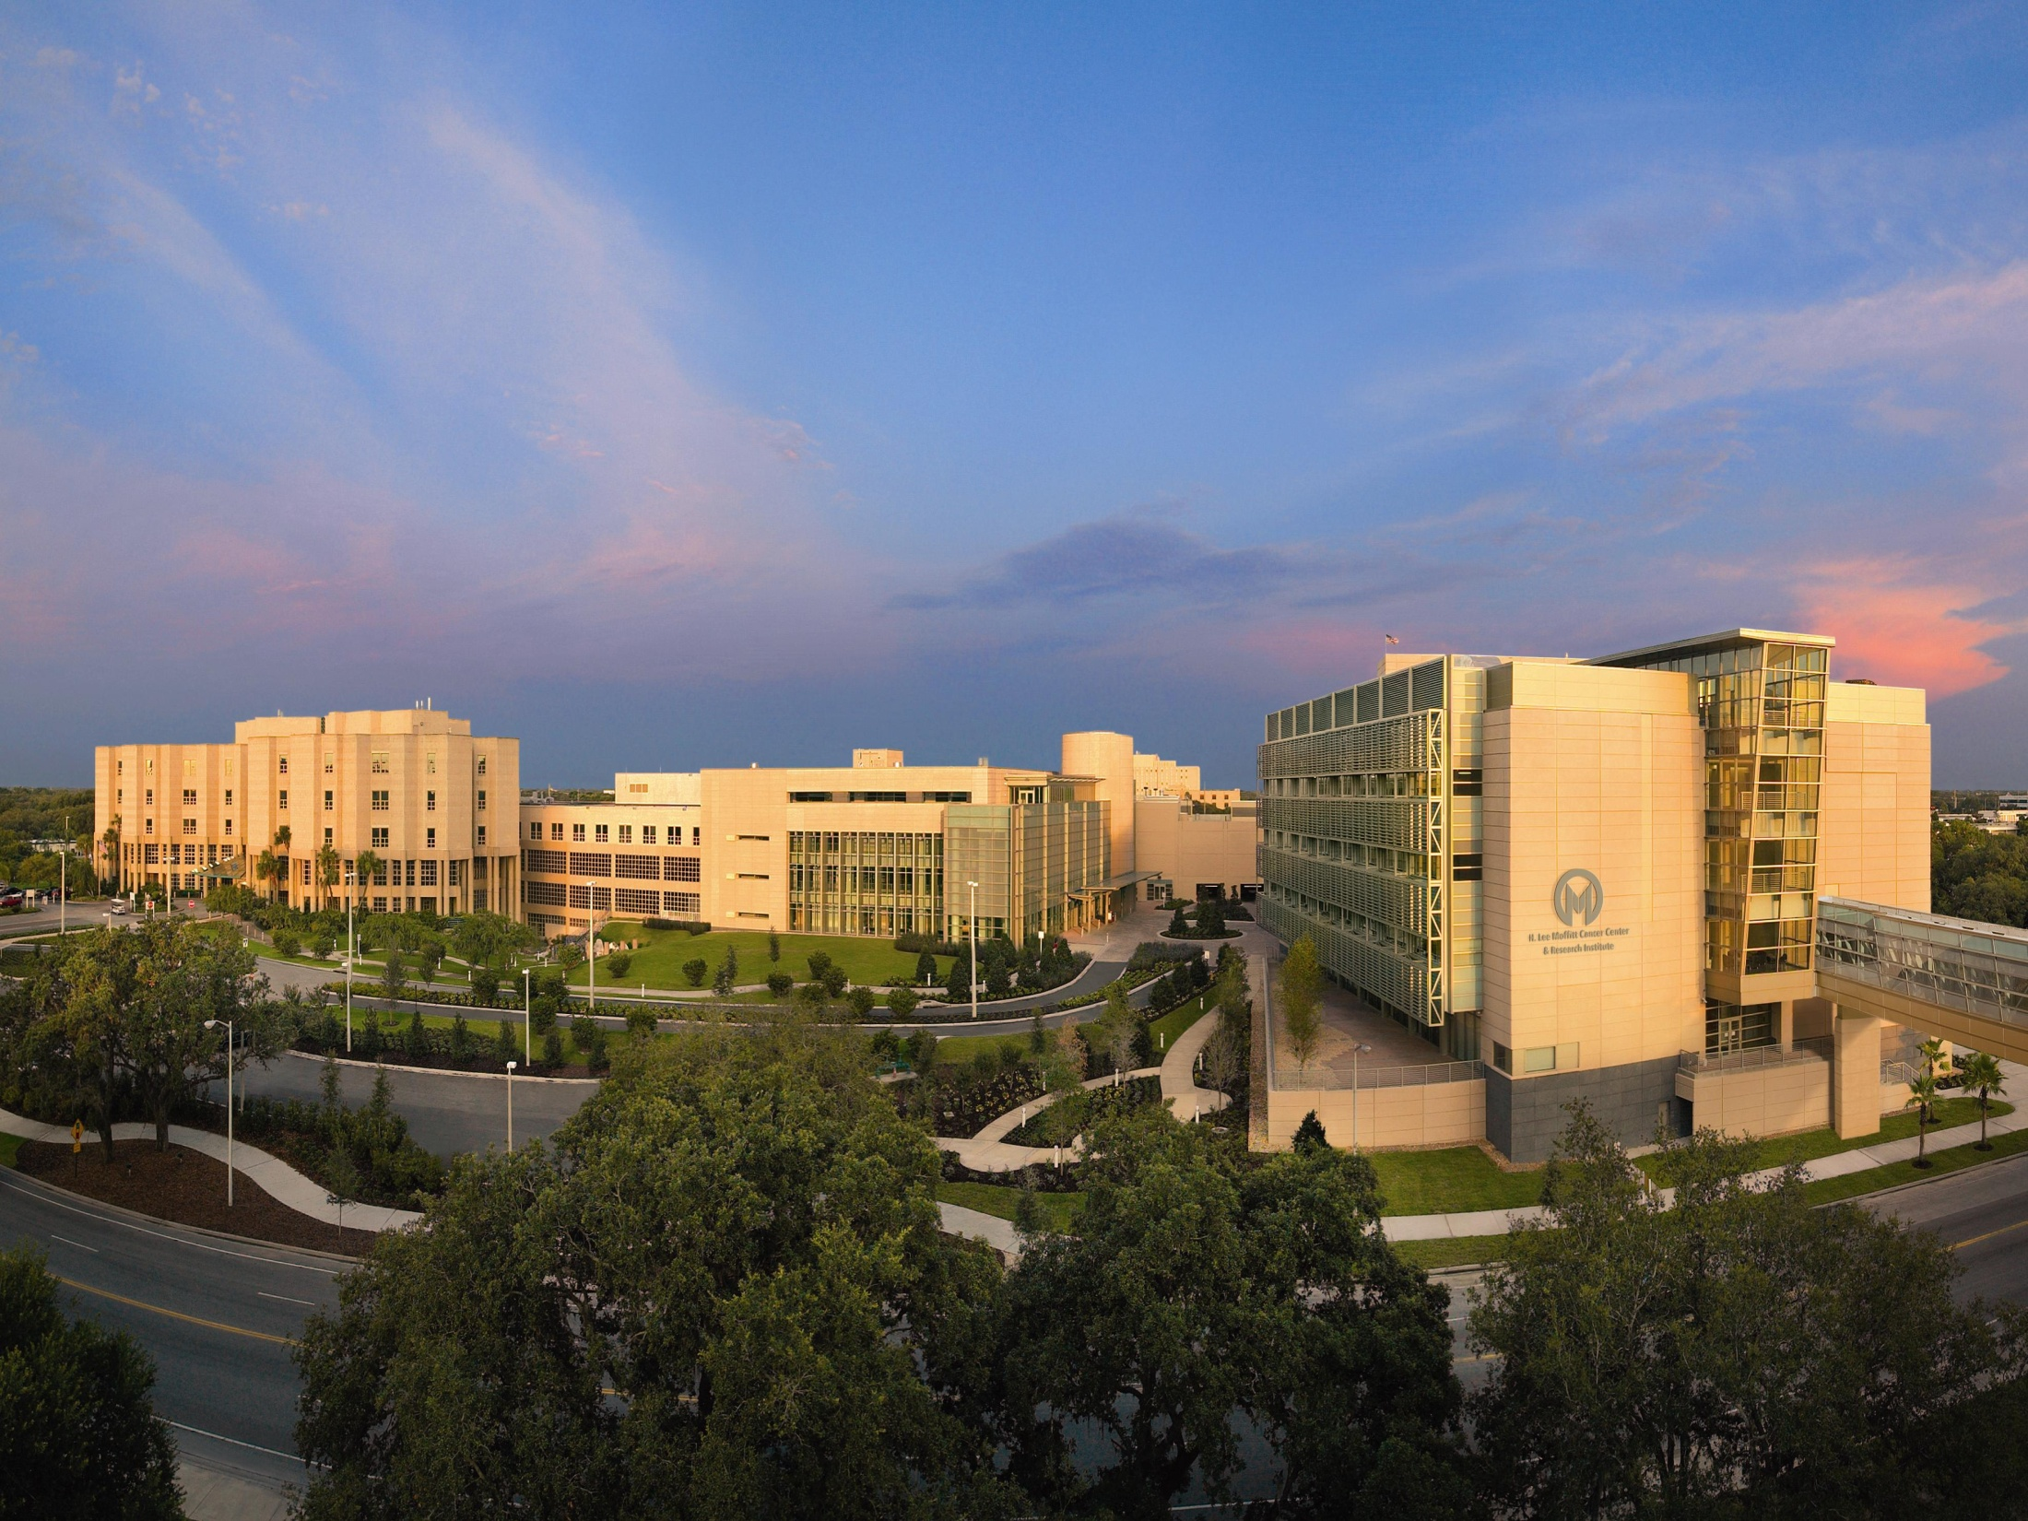



Acknowledgements
Moffitt Cancer Center
Rami Komrokji
Eric Padron
Jeffrey Lancet
Amy McLemore
Amy Aldrich
Kathy McGraw
Lisa Nardelli
Seongsuk Yun
MDACC
Navel Daver
Guillermo Garcia-Manero
Najla Ali
Ling Zhang
Qianxing Mo
Jiqiang Yao
Kendra Sweet
Chetasi Talati
John Puskas
Co-investigators on magro+aza
MDS/AML Study
Notes:
To understand sensitivity and resistance mechanisms to azacitidine as well as novel HMA combo strategies in TP53 mutant AML patients.
To understand mechanisms for poor outcomes to allo-HSCT (solely disease burden issue vs anti-GVL effect vs other)
For TP53 mutant AML, consideration of randomized AZA+APR-246 or AZA+magrolimab versus AZA+venetoclax strategy
Consideration of triplet strategies for TP53 mutant MDS/AML
(including APR-246 or CD47 inhibitor + ven +/- HMA or APR-246 +CD47 combinations); AZA+pevonedistat had 80% response rate in TP53 mutant pts (n=5)

