Slide 1
From normal hematopoiesis to MDS: clonality and inflammation
Uma M Borate MD, MS
Clinical Associate Professor,
Acute Leukemia Clinical Research Director
Division of Hematology
The James Cancer Hospital and OSUCCC
Notes:
Slide master has layouts to accommodate between 1 and 6 faculty. Style all faculty slides.

Slide 2
Conflicts
Consultant for Novartis, Abbvie, Incyte, Daiichi Sankyo
IDMC for Takeda

Slide 3
Normal hematopoiesis-myth ?
Grant A. Challen, Margaret A. Goodell,
Clonal hematopoiesis: mechanisms driving dominance of stem cell clones,
Blood,Volume 136, Issue 14,2020

Slide 4
Contrasting hematopoiesis with clonal hematopoiesis
Leukemia (Leukemia) ISSN 1476-5551 (online) ISSN 0887-6924

Slide 5
Clonal hematopoiesis increases all-cause mortality
Jaiswal S et al N Engl J Med 2014; 371:2488-98

Slide 6
CHIP and Coronary Heart Disease: HR 1.9
CHIP and Early-Onset Myocardial Infarction: HR 4.0

Slide 7
CH is associated with increased risk of hematologic cancer and reduced overall survival
.
Genovese G et al. N Engl J Med 2014;371:2477-2487

Slide 8
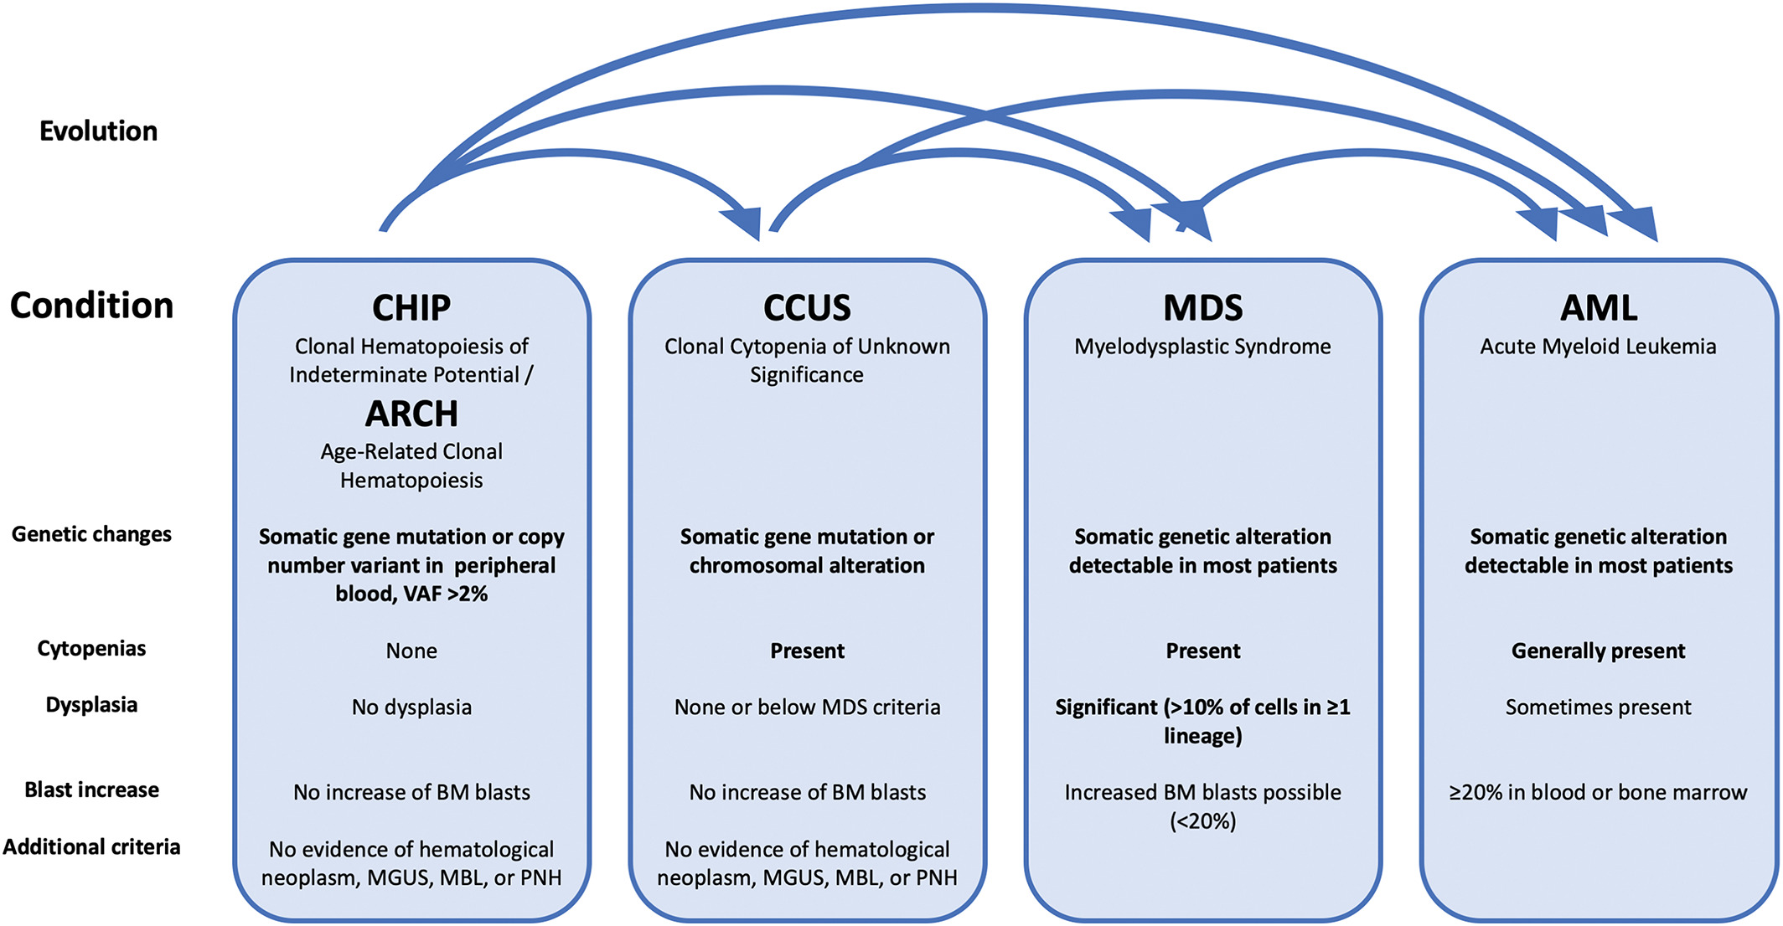
All CH is not created equal
Text
Level 1
Level 2
Level 3
Luise Hartmann and Klaus H. Metzeler Genes Chromosomes Cancer. 2019;58:828–838

Slide 9
Factors that drive Clonal Hematopoiesis
-Age and acquisition of somatic mutations
-Environment : smoking, chemotherapy, radiation
--Inflammation

Slide 10
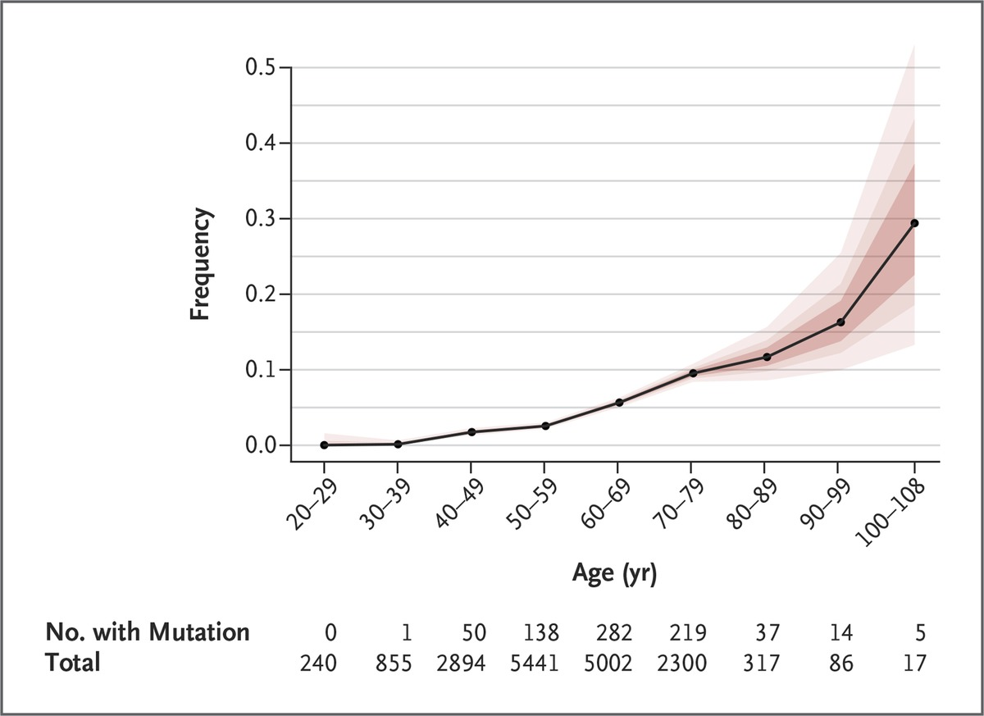
Prevalence of Somatic Mutations, According to Age. Colored bands, in increasingly lighter shades, represent the 50th, 75th, and 95th percentiles
Jaiswal S et al. N Engl J Med 2014;371:2488-2498

Slide 11
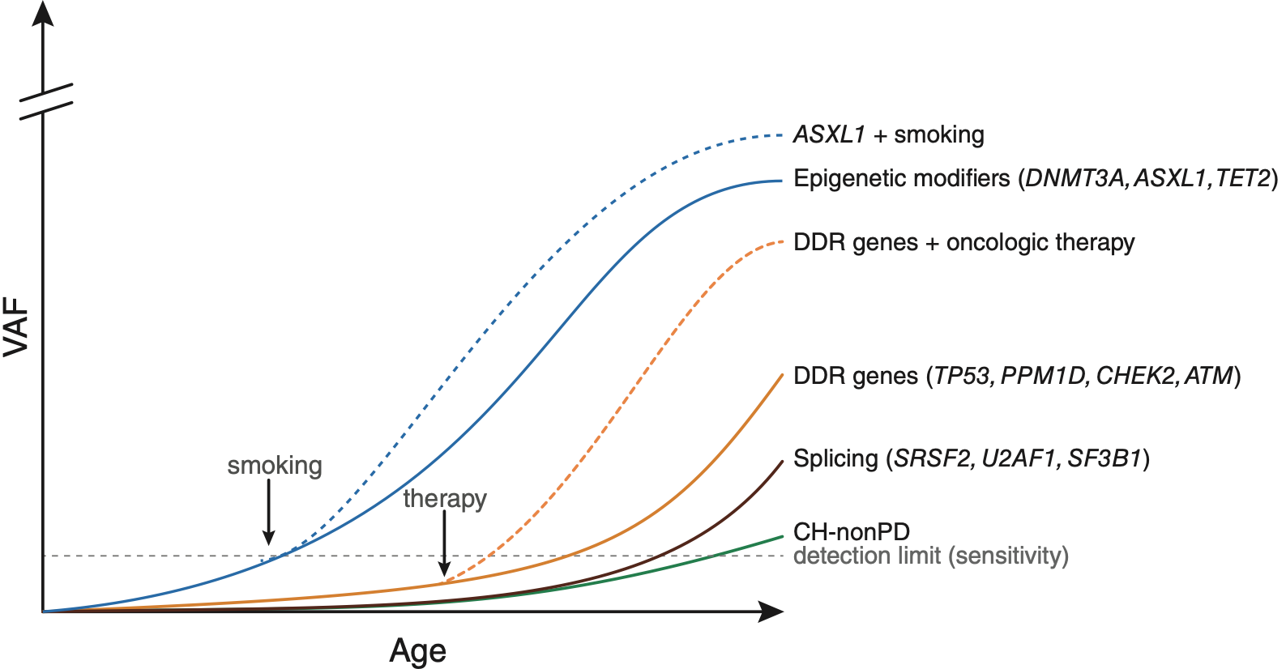
Fitness of mutations dependent on mutation and environmental context
Bolton et al., Nature Genetics 2020
Slide courtesy of Dr. Kelly Bolton, Wash U.

Slide 12
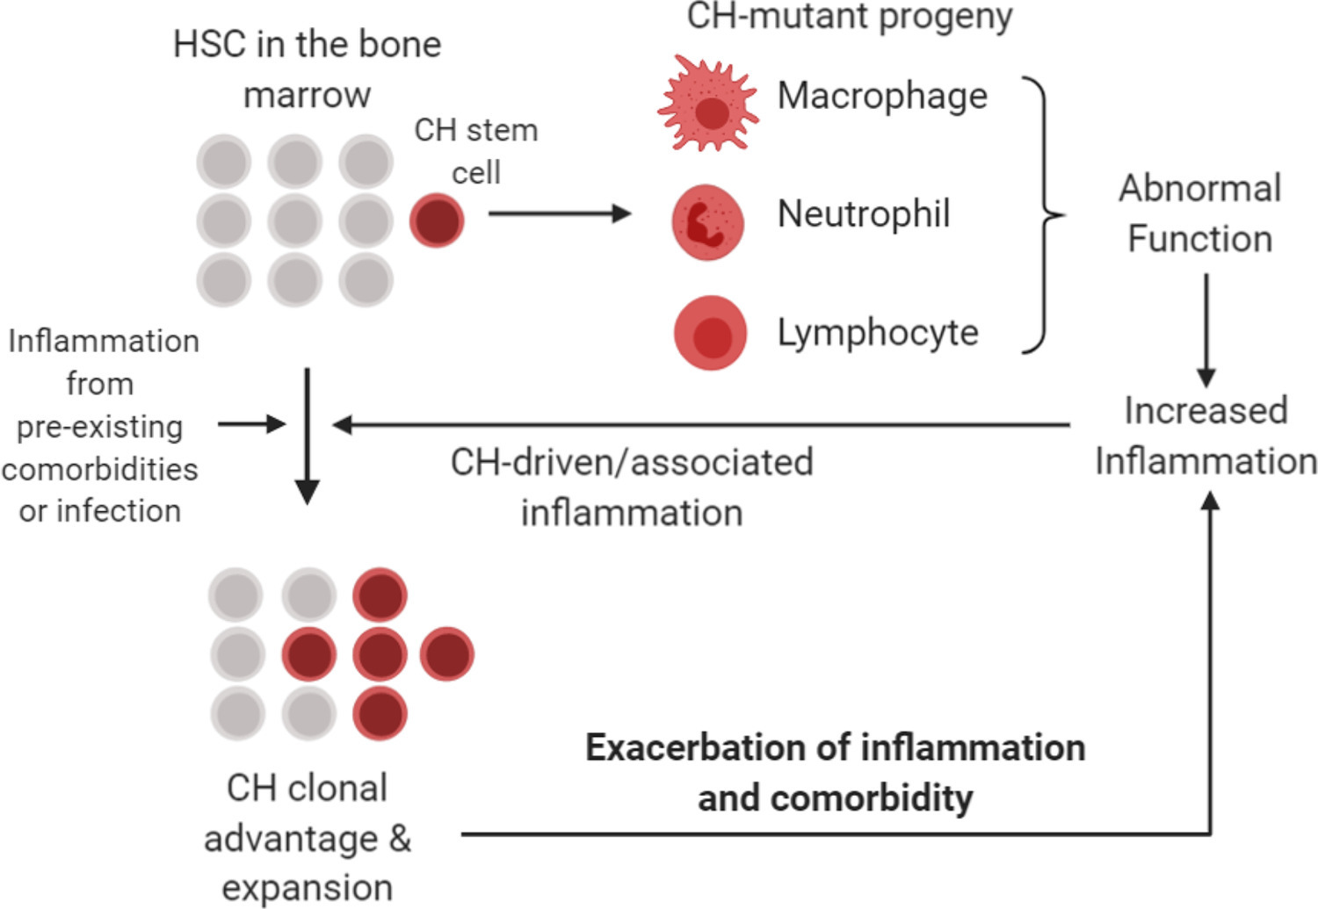
Targeting IL-1Beta Activation through the Inflammasome
https://flipper.diff.org/app/items/info/4713
Elina K. Cook, Michael Luo, Michael J. Rauh, Experimental Hematology, Volume 83, 2020, Pages 85-94,
,

Slide 13
Targeting inflammation-what evidence do we have ? slide courtesy of Dr. David Steensma

Slide 14
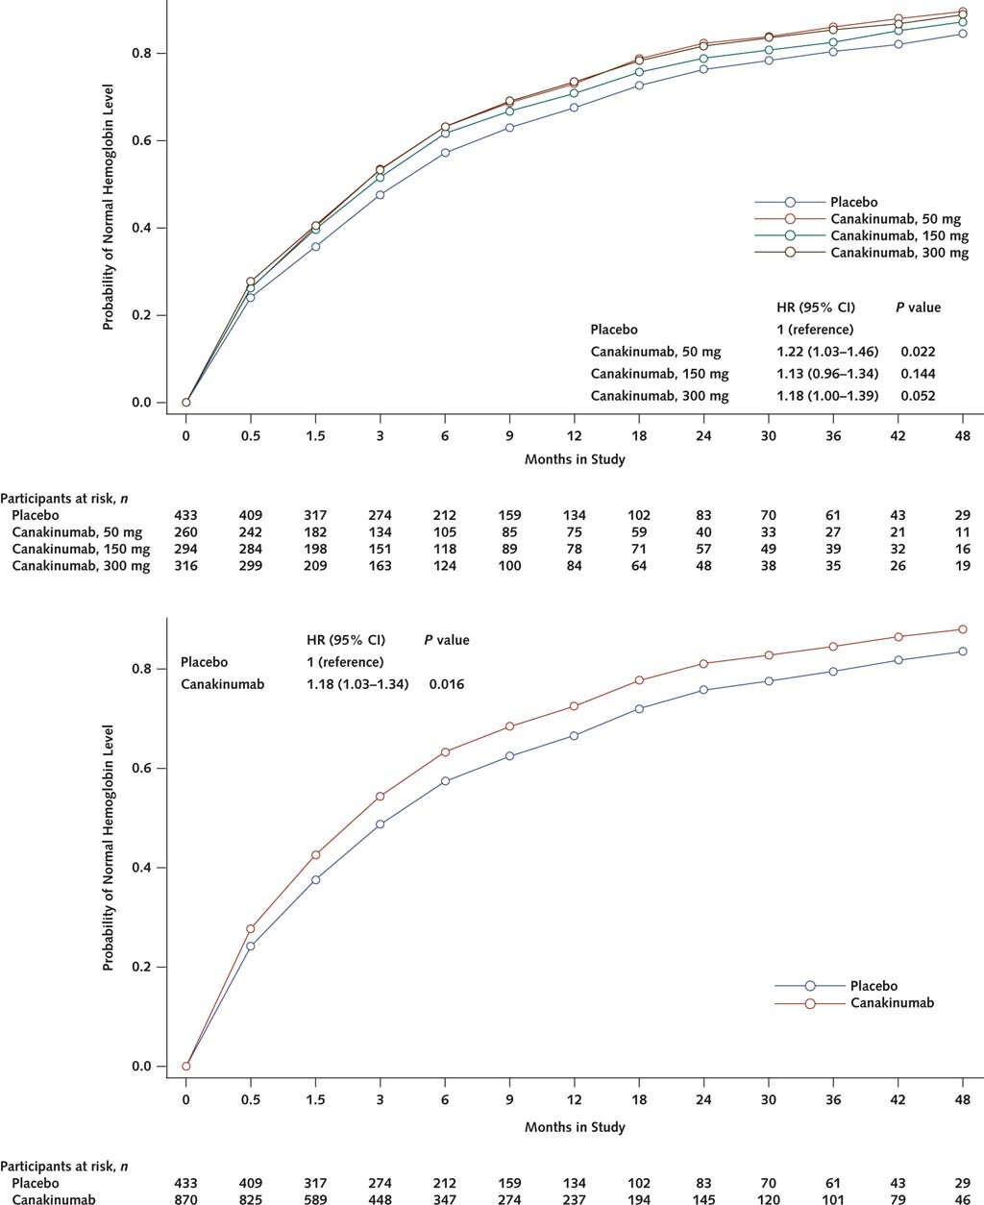
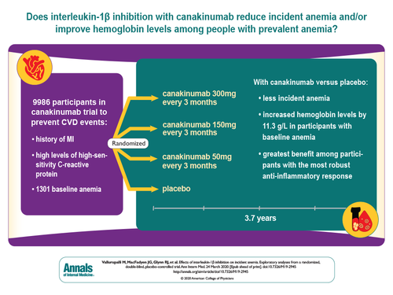
Effects of Interleukin-1β Inhibition on Incident Anemia -Exploratory Analyses From a Randomized Trial
Ann Intern Med. 2020; 172(8):523-532. doi:10.7326/M19-2945
https://www.acponline.org

Slide 15
TET2 mutation and impact of inflammation/immunity

Slide 16
Progressive Cardiovascular
Disease
Tet2-/-
or Tet2+/-
^{HSCs}
TET2-deficient macrophages exhibited an increase in NLRP3 inflammasome–mediated interleukin-1β secretion
LDLr-/-
Tet2-/- HSCs
plus addition of
NLRP3 inhibitor
Fed fatty diet
What is the mechanism of vascular events in CHIP?
Less atherosclerosis
Tet2+/+
Fuster JJ et al Science 2017; 355:842-827
Jaiswal S et al NEJM 2017; 377;111-121

Slide 17
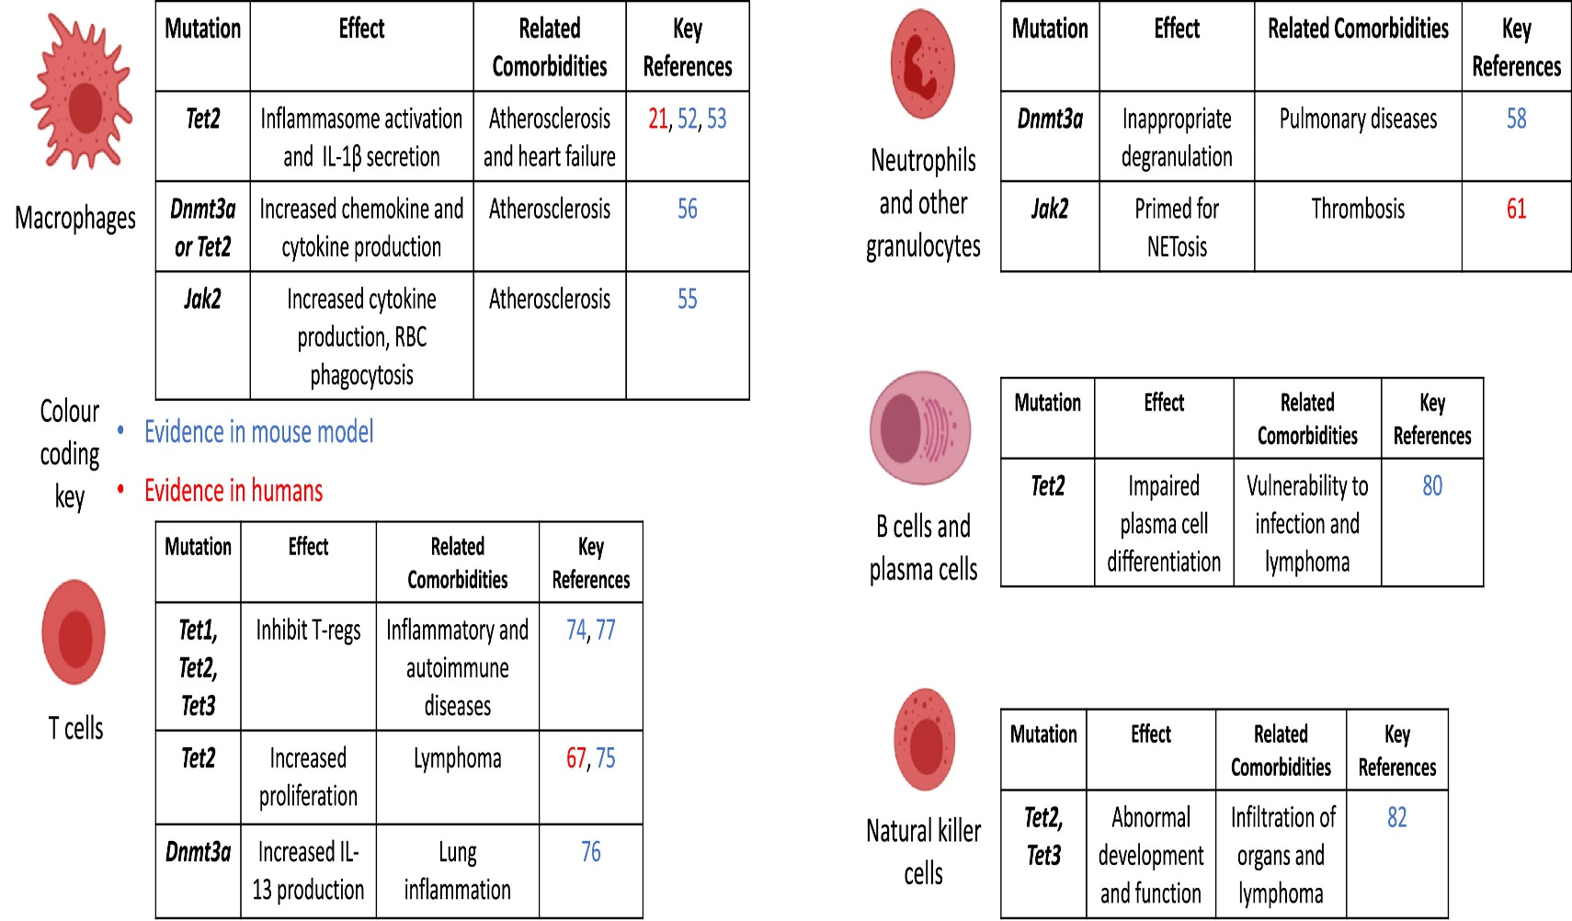
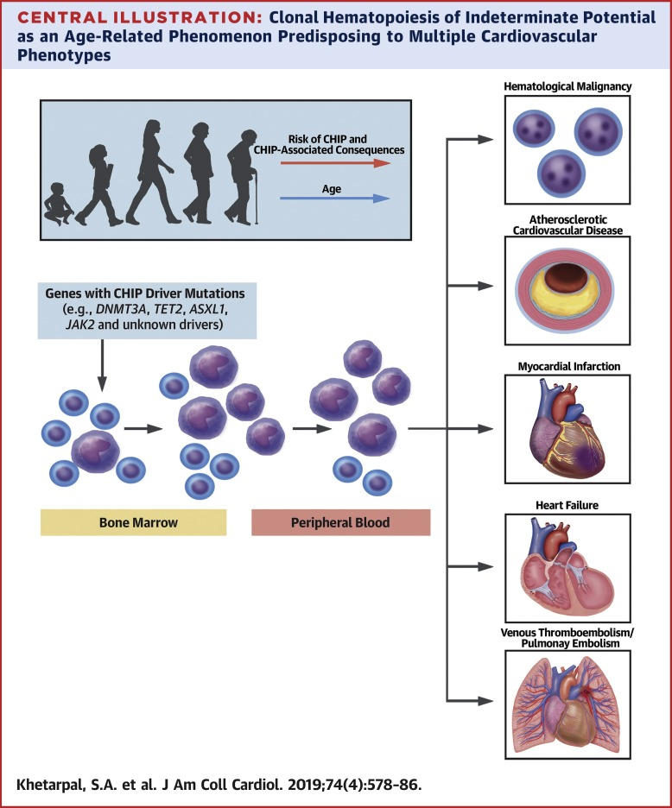

Slide 18
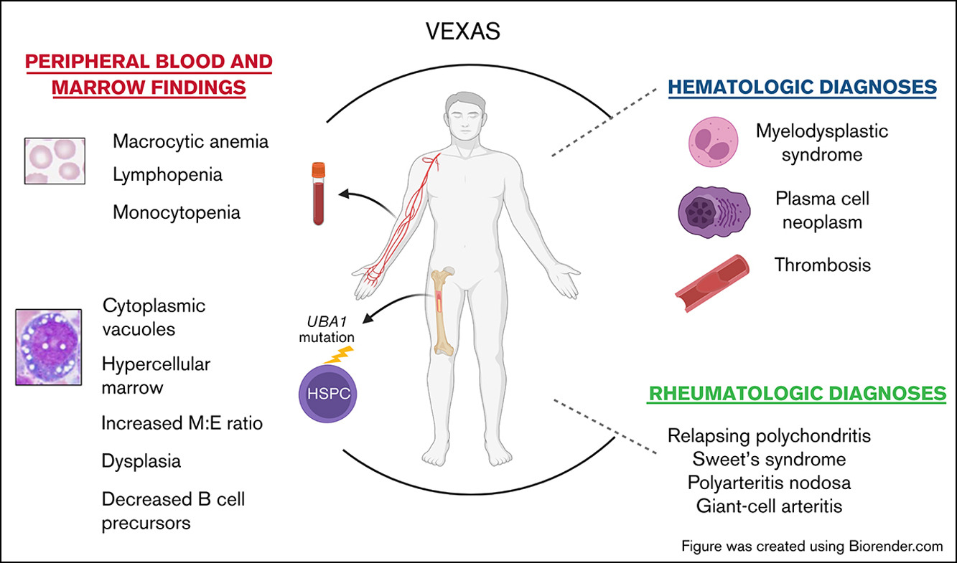
The relationship between CH, Inflammation and Auto-Immunity

Slide 19
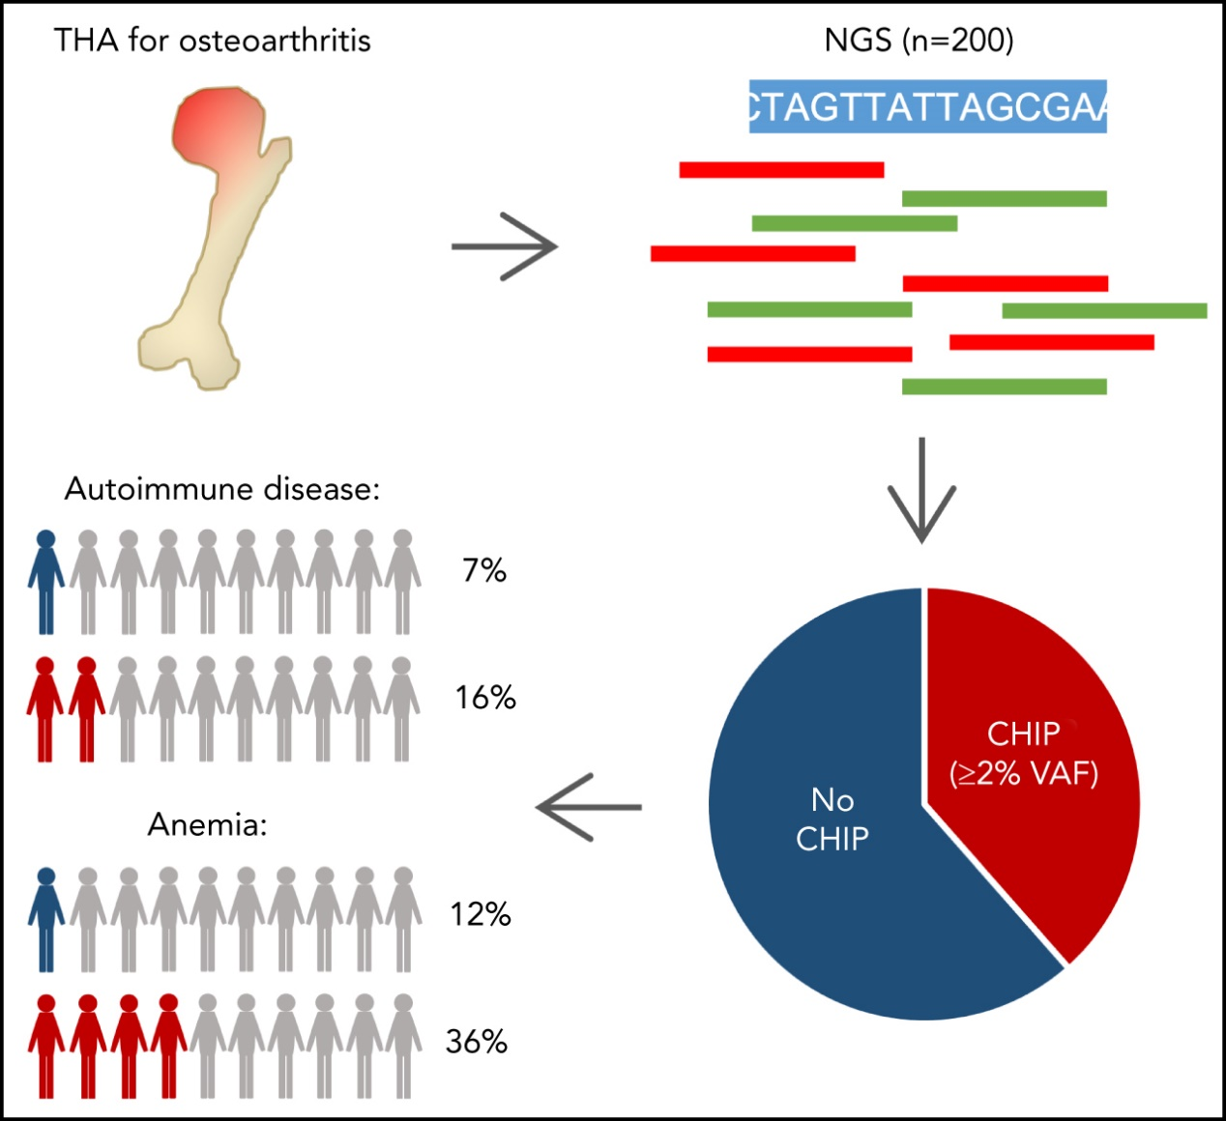
CHIP and hips: clonal hematopoiesis is common in patients undergoing hip arthroplasty and is
associated with autoimmune disease
Judith S. Hecker,Luise Hartmann,Jennifer Rivière,Michèle C. Buck,Mark van der Garde,Maja Rothenberg-Thurley,Luise Fischer,Susann Winter,Bianka Ksienzyk,Frank Ziemann,Maria Solovey,Martina Rauner,Elena Tsourdi,Katja Sockel,Marie Schneider,Anne S. Kubasch,Martin Nolde,Dominikus Hausmann,Alexander C. Paulus,Jörg Lützner,Andreas Roth,Florian Bassermann,Karsten Spiekermann,Carsten Marr,Lorenz C. Hofbauer,Uwe Platzbecker,Klaus H. Metzeler,Katharina S. Götze, CHIP and hips: clonal hematopoiesis is common in patients undergoing hip arthroplasty and is associated with autoimmune disease, Blood, 2021,
Copyright © 2023 American Society of Hematology
Notes:
Figure Legend:

Slide 20
CH and blood counts predict MN development risk
Bolton et al., Nature Genetics 2020
Desai et al., Nature Medicine 2018

Slide 21
Should we intervene early and treat CH ?
Fact: CH mutations can be detected many years before MDS or AML development
Clinical implication: Window for early intervention ?
Fact: We know certain high risk CH mutations are found in dominant clones of MDS and AML patients
Clinical implications: Can we target these mutations, the patient’s environment( make an informed decision on type of chemo) and the inflammasome to prevent clonal evolution ?
Slide courtesy of Dr. Kelly Bolton, Wash Univ

Slide 22
OSU-22091: Inflammation Modification to Prevent Leukemic Progression of Clonal Cytopenias of Unknown Significance (CCUS) Trial (IMPACT) Principal Investigator: Uma Borate, MD, MS
Principal Investigator: Uma Borate, MD, MS

Slide 23
Canakinumab Mechanism of Action
High-affinity human monoclonal anti-human interleukin-1β (IL-1β) antibody of the IgG1/k isotype⁷
IL-1β plays a clinically significant role in auto-inflammatory syndromes (e.g., CAPS, TRAPS, HIDS/MKD, FMF; Still's disease including both SJIA and AOSD, and gouty arthritis)⁷
We suspect clinical benefit of IL-1 inhibition via Canakinumab in patients with high-risk CCUS, as it may reduce downstream activations of other cytokines such as IL-6 (which have been shown to be important factors in CH and malignant transformation)

Slide 24
Eligibility Criteria
INCLUSION
Patients with age ≥18 with high-risk CCUS defined as one or more cytopenia's (> 4 months) with either a somatic spliceosomal mutation or TET2, DMNT3A, or ASXL1 mutation coupled with at least 1 other somatic mutation as determined by next generation sequencing and bone marrow biopsy
Ability to understand and willingness to sign the written informed consent document.
EXCLUSION
Concurrent malignancy requiring active systemic therapy
Diagnosis of MDS or any other myeloid malignancy in the patient’s lifetime
Has received cancer therapy within 12 months of beginning Canakinumab
Patient with an active inflammatory disease requiring anti-inflammatory treatment, specifically TNF-alpha or other biologic agent; those on prednisone (dose less than 20 mg), methotrexate , and azathioprine are allowed
Active infection requiring prompt evaluation and treatment or history of recurrent infections

Slide 25
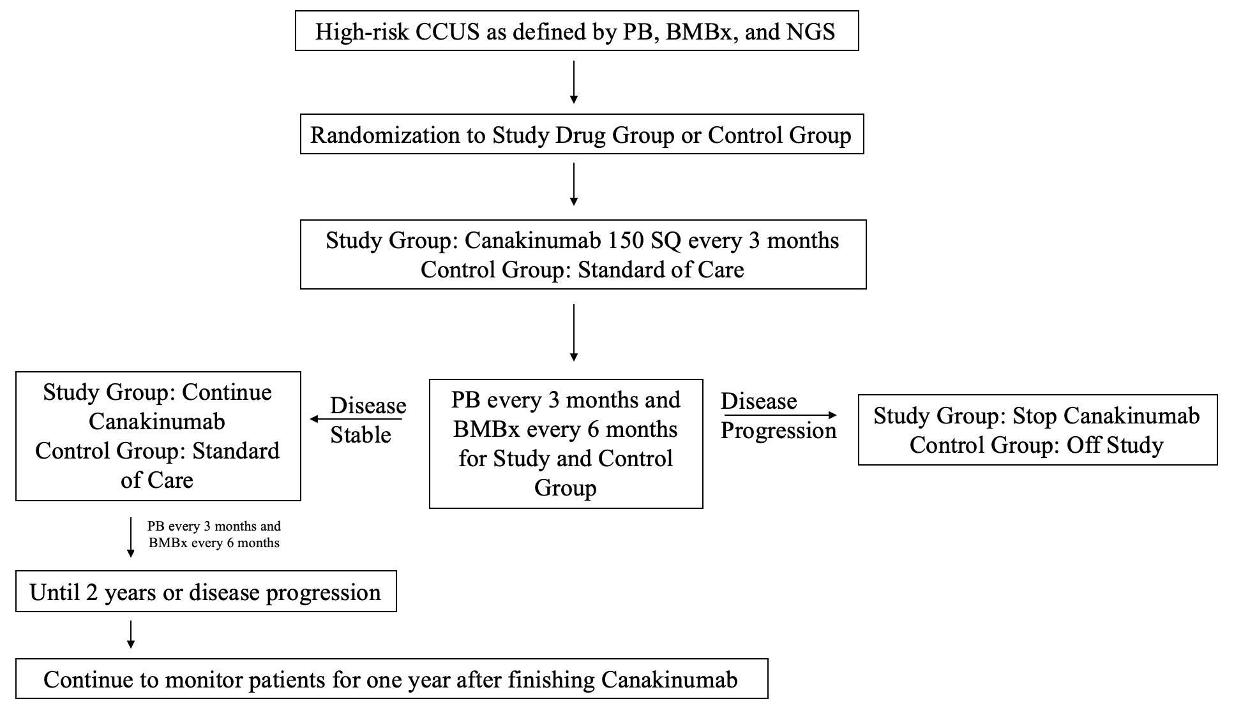
Schema of Proposed Study

Slide 26
Summary
CH also known as CHIP is the presence of ‘early ‘ mutations in the blood that may progress to a myeloid malignancy( MDS or AML) at an average rate of 0.5-1%/yr.
CHIP is seen as early as age 40 and in approx. 10% pts >70 yrs/age
CHIP is associated with increased risk of CVD, MI and HF.
CHIP can progress to CCUS –MDS/AML likely related to a pro-inflammatory state involving the IL-1B and the NLRP3 inflammasome pathway
We are in an exciting time where we can intervene in high risk CCUS patients to potentially prevent progression to MDS

Slide 27
Thank you ! Find me at uma.borate@osumc.edu for any questions /ideas/collaborations !

