Slide 1

Treatment of thrombocytopenia and neutropenia in MDS
Valeria Santini
MDS Unit
Ematologia, Università di Firenze

Slide 2
Incidence of cytopenias in MDS patients
Italian MDS Registry
# 6819 cases
Hb < 10 gr/dl
ANC <800/uL
plt < 100000/uL

Slide 3
+ NGS somatic mutations: IPSS-M
Investigational
TPOmimetics
SF3B1
Perls
ld-HMA
cc-486
HMA
ld-HMA
del5q
MDS- RS
mTP53
biallelic
TD non RS
non del5q
RBC T + ICT
investigational
luspatercept
Investigational
lenalidomide

Slide 4
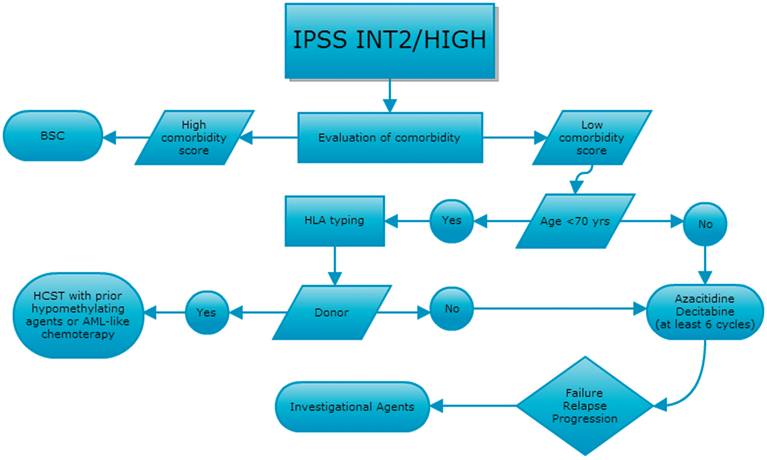
Therapeutic options for HR-MDS
Santini V.
Hematology Am Soc Hematol Educ Program. 2012;2012:65-73.

Slide 5
Thrombocytopenia in MDS
IPSS | % | Platelets median x 10⁹/L (range) | <20 000/μL (%) | <50 000/μL (%) | Bleeding at diagnosis (%) | Platelet transfusion in course of disease (%) | Bleeding as cause of death (%)
Low | 20 | 240 (10-1500) | 2 | 7 | 5 | 12 | 14
Int 1 | 31 | 100 (2-999) | 8 | 21 | 26 | 29 | 14
Int 2 | 21 | 77 (2-701) | 8 | 28 | 27 | 35 | 12
High | 28 | 60 (3-809) | 17 | 40 | 43 | 32 | 13
Neukirchen, et al. Eur J Haematol. 2009.
Notes:
5
A number of therapeutic options has been evaluated in MDS patients with thrombocytopenia. In a trial with romiplostin, a peptibody increasing platelet production, a durable platelet response was achieved by 19 out of 44 patients. Another agent eltrombopag, a non-peptide thrombopoietin receptor agonist, is also being investigated whether it could increase peripheral blood counts in thrombocytopenic MDS patients.

Slide 6
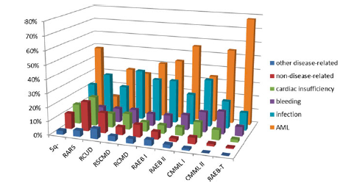
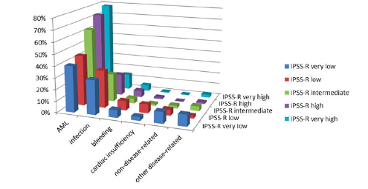
Thrombocytopenia
as a cause of death in MDS
2877 pts
by WHO categories
by IPSS-R risk group
Nachtkamp K, S.
Ann Hematol. 2016 May;95(6):937-44

Slide 7
IPSS-R variables and weighted scores
*
IPSS-R: the international prognostic scoring system acknowledges the depth of cytopenias
Cytogenetics Score | Very good 0 | Good 1 | Intermediate 2 | Poor 3 | Very poor 4
BM blasts, % Score | ≤ 2 0 | > 2–< 5 1 | 5–10 2 | > 10 3
Hb, g/dL Score | ≥ 10 0 | 8–9.9 1 | < 8 1.5
ANC, x 10⁹/L Score | ≥ 0.8 0 | < 0.8 0.5
Platelets, x 10⁹/L Score | ≥ 100 0 | 50–99 0.5 | < 50 1
* Regression analysis for survival and AML evolution.
ANC, absolute neutrophil count; BM bone marrow.
Greenberg PL, et al. Blood. 2012;120:2454-65.

Slide 8
Thrombocytopenia in MDS:
First therapeutic attempts
ITP treatments, including corticosteroids and in exceptional cases splenectomy (15% of peripheral origin ) (Burgeois et al 2001)
Response rates of >40% with high dose androgens, although responses were generally partial and transient (Wattel E et al, 1994)
Treatment with human thrombopoietin (rhTPO) and pegylated recombinant human megakaryocyte growth and development factor (PEG-rHuMGDF) did show some activity, but raised concern regarding antigenicity (Urabe A, et al 2001; Basser R et al, 2002)
IL-6 and IL-11 did not demonstrate sufficient efficacy and/or had excessive toxicity ( Gordon MS et al 1995; Montero AJ et al, 2006)

Slide 9
Clinical studies with thrombomimetics
in MDS
Basood M et al,

Slide 10
Incidence and outcome
of immune thrombocytopenia in LR MDS
Immune cytopenias are present in 17% or LR MDS cases
Seguier J et al. Autoimmun Rev. 2019;18(1):36-42
Jachiet et al.

Slide 11
Jachiet et al.

Slide 12
Incidence and outcome of immune thrombocytopenia in LR MDS
Jachiet et al.

Slide 13
Thrombocytopenia in MDS: thrombomimetic agents in
experimental studies
Eltrombopag- Small molecule TPO receptor agonist
Oral administration
Approved for treatment of immune thrombocytopenic
purpura and aplastic anemia
Romiplostim – peptibody with two single-chain subunits:
Antibody Fc domain and peptide with 2 TPO-R binding domains
Subcutaneous administration
Approved for treatment of immune thrombocytopenic
purpura

Slide 14
Thrombomimetic agents induce platelet increase in LR-MDS patients
(IWG 2006 HI-P)
( 240 cases)
PBO
Eltrombopag
50-300 mg/die
PBO
Romiplostim
750mcg/week
Oliva et al ; 2016 Lancet Hematology 2017
Giagounidis et al, Cancer 2014;120:1838–46

Slide 15
What we know about thrombomimetic agents none approved for MDS
Both eltrombopag and romiplostim are active in inducing platelet increase in severely thrombocytopenic MDS patients
Some MDS patients may achieve improvement in other cytopenias (IWG HI-N and HI-E). Activity on early progenitors?
Romiplostim provokes a transient increase in marrow blasts and investigational studies in MDS had been stopped and restarted later.
Romiplostim and eltrombpag have shown Meg stimulating activity in association with hypomethylating agents in MDS

Slide 16
Eltrombopag vs Placebo in Low- or Intermediate-1–Risk MDS and low PLT count receiving supportive care
Phase II , national, multicentre, prospective, randomized, single blind study
Randomization 2:1
Wk 24
Wk 104
Eltrombopag
+ Standard care
Eltrombopag
+ Standard care
CR and R
Patients
(N = 90)
Placebo
+ Standard care
Standard Care
Dose start: 50 mg with increases every 2 weeks up to 300 mg daily.
Oliva EN et al, Lancet Haematol. 2017 Mar;4(3):e127-e136.

Slide 17
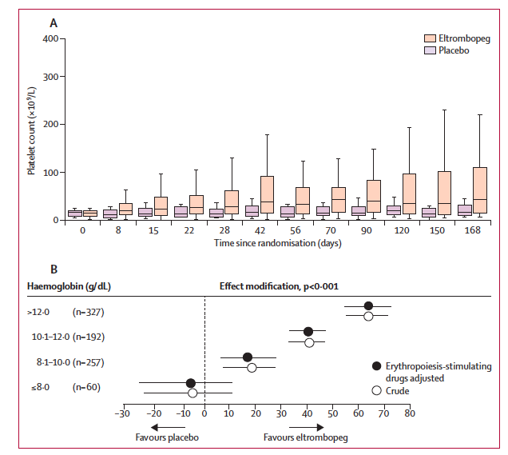
Increase of platelets and hemoglobin
over eltrombopag treatment
At 8 w median PLT counts increased from 18 Gi/L to 44 Gi/L in the eltrombopag arm
Oliva EN et al, Lancet Haematol. 2017 Mar;4(3):e127-e136.

Slide 18
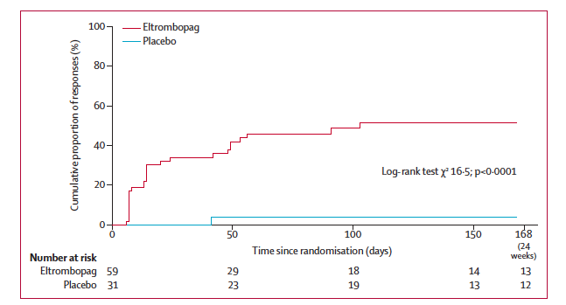
Eltrombopag induces platelet increase
in IPSS low risk MDS patients
Oliva EN et al, Lancet Haematol. 2017 Mar;4(3):e127-e136.

Slide 19
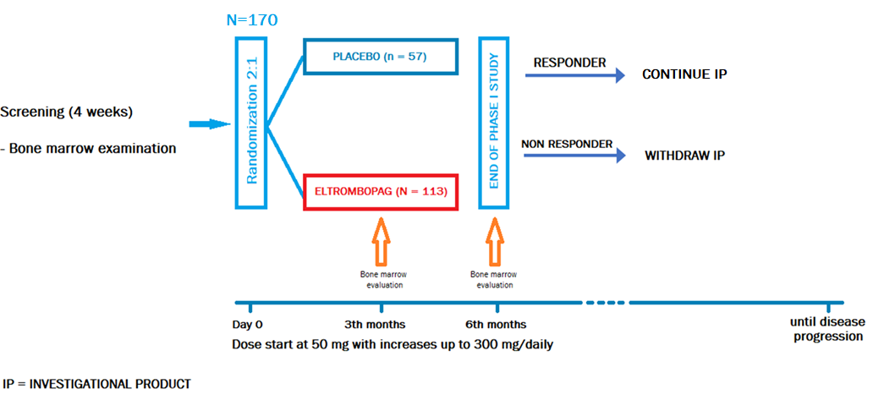
Eltrombopag in MDS: expansion and long term follow up
Oliva EN, et al. Journal of Clinical Oncology, 2023

Slide 20
Study endpoints
The endpoints of the first phase of the EQoL-MDS trial - response rate and safety in the first 24 weeks - have been reached and published (Oliva et al. Lancet Haematol. 2017).
Primary endpoints of 2nd phase
duration of platelet (PLT) response
long-term safety and tolerability
Secondary endpoints
quality of life (QoL) scores
number of monthly PLT transfusions
duration of PLT transfusion independence
time to response
incidence and severity of bleeding
overall survival (OS) at 2 and at 5 years
leukemia-free survival (LFS) at 2 and at 5 years
pharmacokinetics.
Oliva EN, et al. Journal of Clinical Oncology, 2023

Slide 21
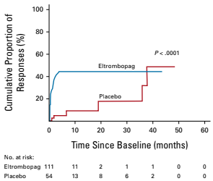
Eltrombopag induces Platelet response
Platelet response
P<0.0001
  Placebo
  6/54
  11%
Eltrombopag
47/111
42%
OR 5.9, 95% CI: 2.3–14.9, p<0.001
Median platelet count change
at best response in the first 24 weeks
eltrombopag arm (31, IQR: 8–10³×10³/mm³)
placebo arm (9.5 (IQR: 1.75–17)×10³/mm³; p<0.0001;
Platelet transfusion independance
  Placebo
  0/8
  0%
Eltrombopag
7/13
54%
Oliva EN, et al. Journal of Clinical Oncology, 2023
Notes:
A response (PLT-R) required an absence of bleeding, with the following increases in PLT count from
baseline levels: for patients with baseline PLTs ≥20000/mm3, an increase of at least 30000/mm3 from baseline; for
patients with baseline PLTs <203103/mm3, the achievement of >20 3 103/mm3 and an increase of at least 100%, not
because of PLT transfusions.

Slide 22
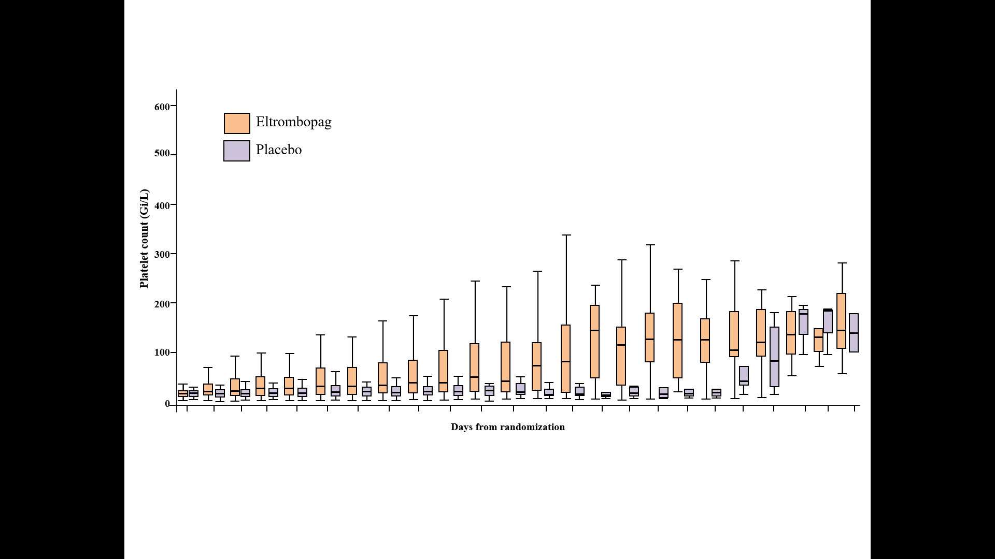
Eltrombopag induces Platelet response
Median time to response
eltrombopag arm (2.1 weeks, 1–6 weeks)
versus the placebo arm (54 weeks, 6–155 weeks; p<0.001).
Median daily dose at response
50 mg (IQR 50-150 mg)
18
16
Between-arms difference (by LMM), P<0.001
14
12
10
Number of cases with
platelet response
8
6
4
2
8 days
22 days
Baseline
15 days
28 days
10 weeks
9 months
15 months
0
4 months
18 months
5 months
8 weeks
3 months
6 months
12 months
21 months
6 weeks
24 months
36 months
30 months
42 months
48 months
54 months
60 months
25
50
100
150
200
250
300
Days from randomization
Daily dose (mg)
LMM, linear-mixed model analysis
Box plot shows median and 75th and 25th percentiles.
The whiskers above and below the box plot mark the 97.5th and 2.5th percentiles, respectively.
Oliva EN, et al. Journal of Clinical Oncology, 2023

Slide 23
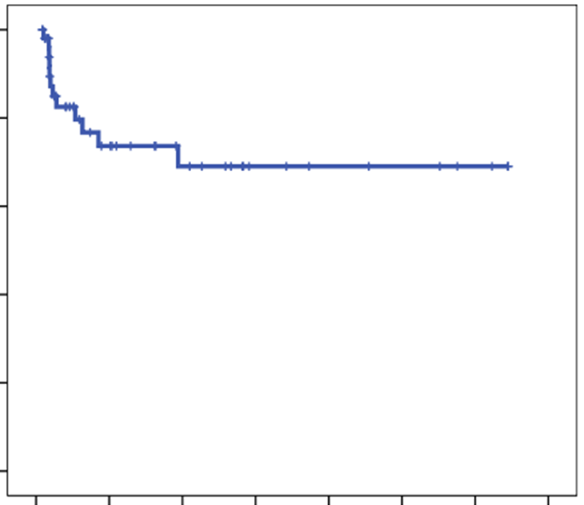
Duration of platelet response with eltrombopag treatment
In the eltrombopag arm (observation period of 13–561 weeks), 12 out of 47 (25.5%) of eltrombopag subjects lost the PLT-R
cumulative thrombocytopenia relapse-free survival at 60 months of 63.6% (95% CI: 46.0–81.2%)
Median duration of PLT transfusion independence was 32 weeks
1.0
0.8
0.6
Cumulative thrombocytopenia
relapse-free survival
0.4
0.2
0.0
0 20 40 60 80 100 120 140
Duration of response (months)
Oliva EN, et al. Journal of Clinical Oncology, 2023

Slide 24
Romiplostim in MDS
Screening
Randomization
26-Week Treatment Period
24-Week Treatment Period
End of treatment
bone marrow biopsy
Long-term follow-up and end of study
Romiplostim 750 μg weekly
n* = 160
Interim
bone marrow biopsy
Romiplostim 750 μg weekly
+ standard of care
n* = 160
Drop-outs
Placebo weekly
n* = 80
Placebo weekly
+ standard of care
n* = 80
Week 1
Week 26
Week 30
Week 54
*n based on study design.
IPSS low/int-1 MDS on supportive care only, with PLTs 1) ≤20x10⁹/L or
2) ≤50x10⁹/L with a history of bleeding. Stratified by baseline IPSS (low, int-1) and PLT count (<20, 20-50x10⁹/L).
Enrollment: July 2008 to March 2011; 250 pts. IP dose adjusted by PLT count. STOPPED Feb 2011
After completing Rx, pts moved to long-term follow-up (LTFU) for 5 years.
Giagounidis A. et al Cancer 2014
Notes:
Key Points:
This phase two placebo controlled trial was designed to examine the affect of romiplostim on clinically significant bleeding events and other endpoints in MDS subjects categorized as low or intermediate-1 per IPSS scoring. The trial consisted of two treatment periods where subjects were given either placebo of romiplostim. There was a 4 week washout after the first treatment period and interim bone marrow biopsies were done.¹
In February 2011, the study-independent safety data monitoring committee (DMC) recommended that the investigational product be discontinued because the risk overweighed the potential benefit:¹
The potential risk for disease progression to AML was not outweighed by the potential benefit of bleeding reduction.¹
Subjects were put at risk for the diagnosis and treatment of AML with the transient increases in blast cell counts in the romiplostim arm.¹
At ASH 2012, 58-week updated data was presented. . And subsequently pre-published in Cancer online 2014
Background:
This study enrolled International Prognostic Scoring System (IPSS) low/int MDS subjects who were receiving supportive care and platelets either ≤ 20 x 10⁹/L, or ≤ 50 x 10⁹/L with a history of bleeding.¹
Dosage of investigational product was adjusted based on the platelet count.¹
The study criteria for AML diagnosis were:²
Persistence of bone marrow or peripheral blasts ≥ 20% in the absence of romiplostim for four weeks, or other hematopoietic growth factors for two weeks.
Confirmed pathology report for chloroma or leukemia cutis.
Initiation of AML treatment.
References:
Kantarjian H, Mufti G, Fenaux P, Sekeres M, Szer J, et al. Treatment with the Thrombopoietin (TPO)-Receptor Agonist Romiplostim in Thrombocytopenic Patients with Low or Int-1 Risk MDS: Follow-up AML and Survival Results of a Randomized, Double-Blind, Placebo (PBO)-Controlled Study. Blood. 2012;120:abstract 421. Presented at: 54th American Society of Hematology Annual Meeting and Exposition; December 8-11, 2012; Atlanta, Georgia.
Fenaux P, Kantarjian H, Muus P, et al. Update of an open-label extension study evaluating the long-term safety and efficacy of romiplostim in thrombocytopenic patients with myelodysplastic syndromes (MDS). Blood. 2011;118:abstract 2272. Presented at: 53rd American Society of Hematology Annual Meeting and Exposition; December 10-13, 2011; San Diego, California.

Slide 25
Romiplostim in MDS
Romiplostim increased platelet responses (P < 0.001) and reduced platelet transfusions (P < 0.001) with a numerical decrease in bleeding (P = 0.13).
Following the decision in 2011 to stop study drug secondary to suspected increased AML HR at that time and transient blasts increases, rates of progression to AML became similar and AML HR subsequently decreased as did blast counts in most (14/16) patients with available follow-up data.
  For romiplostim vs. placebo, final 5-year LTFU HRs for death or progression to AML were 1.03 (95% CI: 0.72−1.47) and 1.06 (95% CI: 0.48−2.33), respectively.

Slide 26
Response to romiplostim : platelets and bleeding events over time
N=60
Fenaux P et al BJH (2017)178:906

Slide 27
Predictive model of response to romiplostim
ORR
Baseline-TPO:
< 500 pg/ml → +2
≥ 500 pg/ml → –3
Prior transfusions
Platelet units
< 6 → +1
≥ 6 → –3
Score +3
65%
Score –1, –2
34%
Score -6
17%
Sekeres MA, et al. Br J Haematol 2014;167:337-45.

Slide 28
Long term follow up on safety and efficacy of romiplostim
Kantarjian H et al, Lancet Hematol 2018

Slide 29
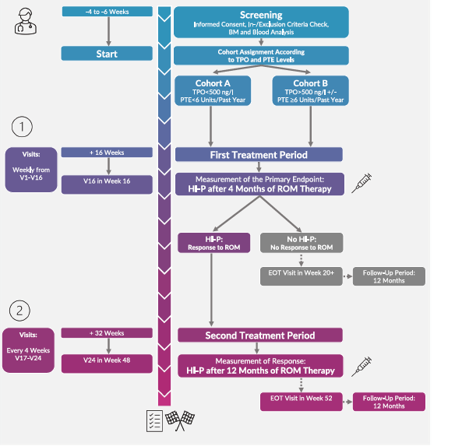
The Europe trial: looking for biomarkers of response
77 pts LR MDS
Int1-Low IPSS
Plt <30 ×10⁹/L or
<50 ×10⁹/L and bleeding
Kubash AS et al

Slide 30
In this Europe study, LR MDS experienced response ( increase in platelets)
in 42% of cases
TPO/PTE predictive moidel was not validated in this study
Multivariate analysis with the follwing variables :
hemoglobin, platelet counts,
combinations of DNMT3a, RUNX1, SRSF2, TET2, ASXL1, U2AF1 and EZH2 yielded
a predictive model :
Kubash AS et al

Slide 31
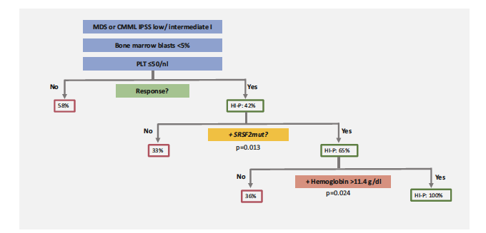
The Europe trial: looking for biomarkers of response
Kubash AS et al

Slide 32
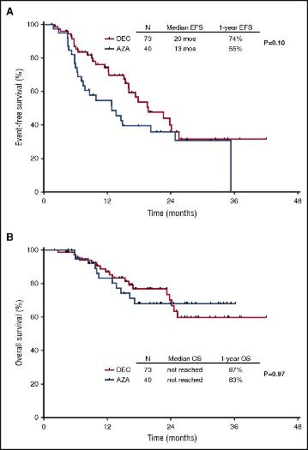

Low-dose decitabine and azacitidine
in LR MDS (3 days)
cc-486 ( oral AZA) is active
in LR-MDS
ORR 62%
High plt
Low plt
Garcia Manero et al; Leuk Res 2018
Jabbour et al, Blood, 2017 .
Garcia Manero et al; Leukemia 2016
Notes:
Figure Legend:
Kaplan-Meier curves for EFS. By treatment group (A) and survival by treatment arm (B).

Slide 33
A Phase III, Randomized, Placebo-Controlled Trial of CC-486
(Oral Azacitidine)
in Patients with Lower-Risk Myelodysplastic Syndromes
Age ≥18 years
IPSS Low or Intermediate-1 MDS
ECOG PS score 0–2
RBC transfusion dependence:
Average of ≥2 RBC units/28 days for ≥56 days
No ≥28-day transfusion-free period in 56 days prior to randomization
Thrombocytopenia:
Platelet count ≤75 ×10⁹/L, confirmed at 2 visits ≥21 days apart
Confirmatory count obtained within 14 days before randomization
+
+
STUDY DESIGN
Screening
Randomization
CC-486 300 mg
QD ×21 days
+ BSC
Cycle 6 Response Assessment:
RBC TI or ≥50% reduction in transfusion requirement
Platelet TI
HI-E, HI-P
No evidence of PD
Positive
Continue Treatment
Patients followed for:
Survival
Progression to AML
Second primary malignancies
MDS treatments
28-day cycles
Placebo
QD×21 days
+ BSC
Negative
Stop Treatment
Garcia Manero G, Santini V et al, J Clin Oncol. 2021 May 1;39(13):1426-1436

Slide 34
Changes in platelets counts during cc-486 and PBO therapy
Garcia Manero G, Santini V et al, J Clin Oncol. 2021 May 1;39(13):1426-1436

Slide 35
CC486 induces platelet increase ( and RBC TI)
in LR-MDS patients
(IWG 2006 HI-P)
PBO
CC-486
Garcia Manero G, Santini V et al, J Clin Oncol. 2021 May 1;39(13):1426-1436

Slide 36
Overall survival in LR-MDS pts treated with cc-486 vs PBO
Garcia Manero G, Santini V et al, J Clin Oncol. 2021 May 1;39(13):1426-1436

Slide 37
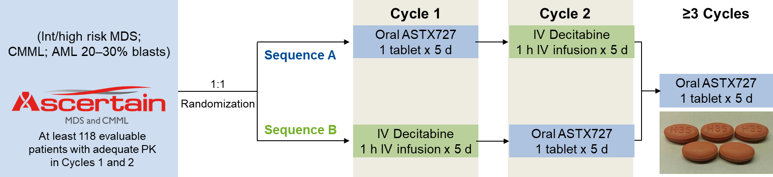
Ascertain study : oral decitabine/cedazuridine
Major entry criteria:
Candidates for IV decitabine
ECOG PS 0-1
Life expectancy of ≥3 months
Adequate organ function
One prior cycle of HMA is allowed
Candidates for decitabine include:
Adult patients with MDS, including previously treated and untreated, de novo and secondary MDS with the following French-American-British subtypes (refractory anemia, refractory anemia with ringed sideroblasts, refractory anemia with excess blasts, and chronic myelomonocytic leukemia[CMML] and intermediate-1, intermediate-2, and high-risk International Prognostic Scoring System groups.
A total of 69 lower-risk (LR/Int-1) subjects were enrolled into ASCERTAIN
³Garcia-Manero, et al, [ASH Abstract 846] Blood. 2019;134 (suppl 1).

Slide 38
Results: Efficacy Response¹
Response Category | Treated Patients (N=66ª), n (%)
Complete response (CR)² | 7 (25.9%)
Partial response (PR) | 0
Marrow CR (mCR)² | 11 (40.7%)
mCR with hematologic improvement | 5 (19.2%)
Hematologic improvement (HI) | 17 (42.5%)
HI-erythroid³ | 9 (22.5%)³
HI-neutrophils³ | 3 (7.5%)³
HI-platelet³ | 13 (32.5%)³
HI- multiple lineages³ | 5 (12.5%) ³
Overall response (CR + PR + mCR + HI) | 35 (53.0)
Median CR duration was 15.3 months.
Median duration of best response was 13.4 months.
Median time to first and best response were 3.0 months and 4.3 months, respectively.
18 (26.0%) of subjects proceeded to HCT.
¹Responses adjudicated by independent review committee
²Percent is of 26 subjects with ≥ 5% bone marrow blasts
³Percentages based on 40 subjects with < 5% bone marrow blasts
ªExcludes 3 subjects who did not receive ASTX727

Slide 39
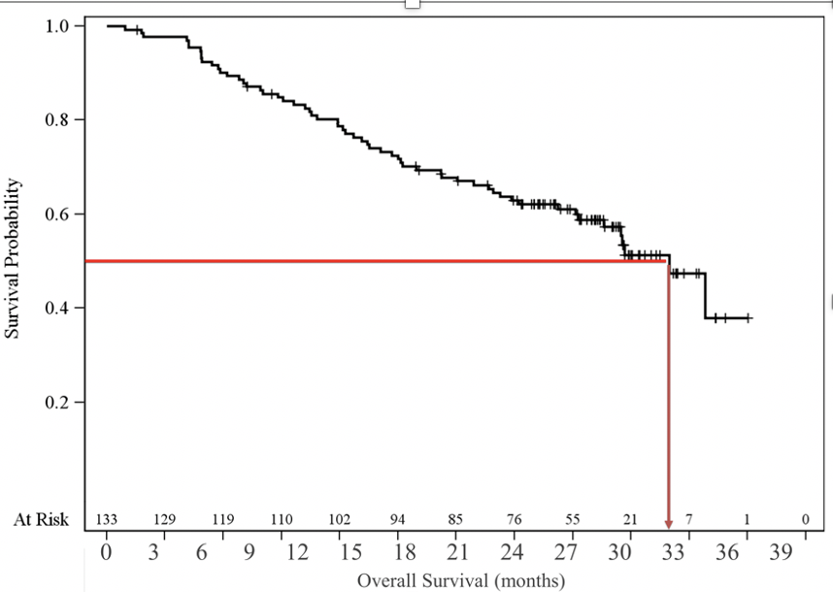
The era of oral therapy in MDS :
ASTX-727 (dac+ cedazuridine) induces responses
in MDS ( phase 3)
Response category | Treated Patients (N=133), n (%) | 95% CI
Complete response (CR) | 29 (22) | (15.1,29.8)
Partial response (PR) | 0
Marrow CR (mCR) | 43 (32.3%) | (24.5,41.0)
mCR with hematologic improvement | 22 (16.5%) | (10.7,24.0)
Hematologic improvement (HI) | 10 (7.5%) | (3.7,13.4)
HI-erythroid | 2 (1.5%) | (0.2,5.3)
HI-neutrophils | 1 (0.8%) | (0.0,4.1)
HI-platelet | 7 (5.3%) | (2.1,10.5)
Overall response (CR + PR + mCR + HI) | 82 (61.7) | (52.8,69.9)
Progressive Disease | 6 (4.5%) | (1.7,9.6)
Median CR duration was 14.0 months
Median duration of best response was 12.7 months
34 (26%) of subjects proceeded to HSCT
Savona et al. [ASH Abstract 1230] Blood. 2020;135.
os
Median follow up 32 months
mOS for 133 patients is 31.7 months (95% CI: 28, NE)
LFS is 29.1 months (95% CI: 22.1, NE)
Savona et al. [Abstract MDSF 2021]

Slide 40
New avenues of treatment

Slide 41
Neutrophil and platelet increase during luspatercept treatment
Garcia Manero et al. Blood
2022 Jan 27;139(4):624-629.
Garcia Manero et al , Blood 2022

Slide 42
Incidence of cytopenias in MDS patients
Italian MDS Registry
# 6819 cases
Hb < 10 gr/dl
ANC <800/uL
plt < 100000/uL

Slide 43
IPSS-M patient-specific risk score & risk categories
Continuous risk score
Patient-specific score
Reproducible and Interpretable
Bernard e et al, NEJM Evid 2022; 1 (7) June 12

Slide 44
The model consisted of
hemoglobin, platelets and bone marrow blasts ( neutrophil number not significant)
2) IPSS-R cytogenetic category
3) 17 binary features derived from the presence of mutations in 16 predictive genes
4) one feature representing the number of mutations from a group of 15 genes.
Molecular International Prognostic scoring system
for myelodysplastic syndromes IPSS-M
Bernard e et al, NEJM Evid 2022; 1 (7) June 12

Slide 45
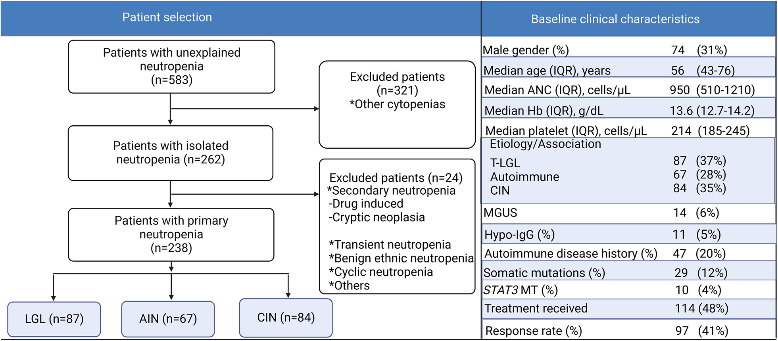
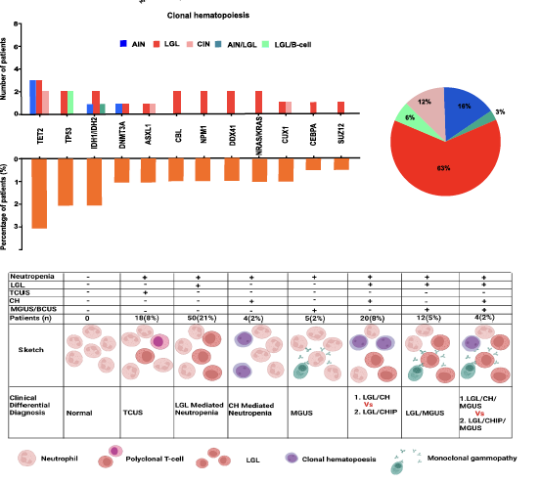

Isolated neutropenia: a difficult diagnosis

Slide 46
+ NGS somatic mutations:IPSS-M ??
Investigational
TPOmimetics
SF3B1
Perls
ld-HMA
cc-486
HMA
ld-HMA
del5q
MDS- RS
mTP53
biallelic
TD non RS
non del5q
RBC T + ICT
investigational
luspatercept
Investigational
lenalidomide

Slide 47
No impact on outcome
Myeloid growth factors in MDS:
GM-CSF
Sagramostim
used in the ‘80s
G-CSF =
filgrastim –
recommended
in febrile
neutropenia
Hutzschenreuter F, et al Cochrane Database of Systematic Reviews 2016, Issue 2. Art. No.: CD009310

Slide 48
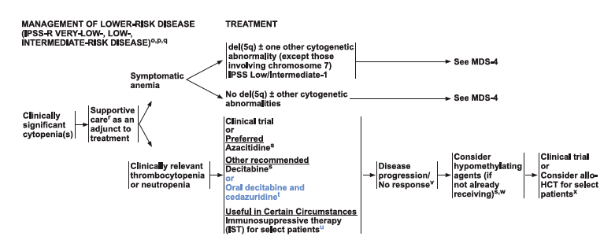
NCCN guidelines for MDS 2022

Slide 49
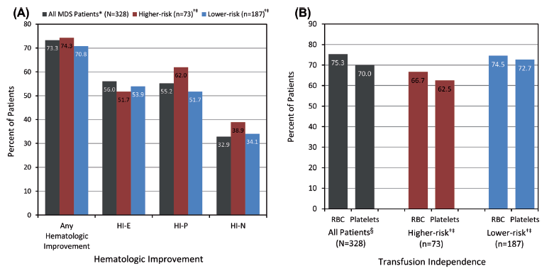
Azacitidine induces HI in LR-MDS patients ( 187 cases)
Grinblatt DL et al , Leukemia & Lymphoma, 2014

Slide 50

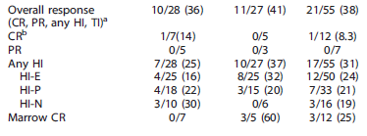
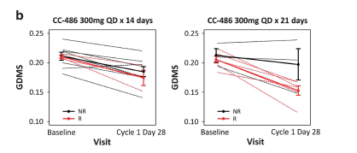
Oral azacitidine is effective in
LR-MDS patients
DNA methylation
After treatment
Garcia Manero G et al. Leukemia 2016; 30:889

Slide 51
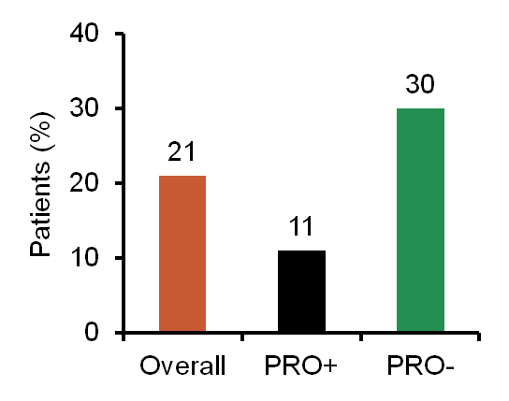
Prophylaxis may be protective, particularly in patients with low baseline absolute neutrophil count
Retrospective analysis of 144 patients with MDS
Impact of baseline ANC
Death from sepsis in patients with ANC <1g/L
 | ANC <1G/L | ANC >1G/L | p value
Hospitalisation for sepsis | 39% | 29.3% | 0.15
Severe sepsis | 15.2% | 8.8% | 0.18
Death from sepsis | 21% | 9.9% | 0.06
Prophylaxis* | 47.5% | 31.7% | 0.04
p=0.076
Median ANC
Patients with fatal infection: 0.7g/L
Other patients: 1.9g/L
p=0.0348
ANC is a prognostic factor for fatal infection in patients with MDS treated with azacytidine, not so for LR MDS without HMA therapy
*levofloxacin (500mg/day); posaconazole (200mg t.i.d.)
PRO: prophylaxis
Vidal V, et al. ASH 2012 meeting poster 3812

Slide 52
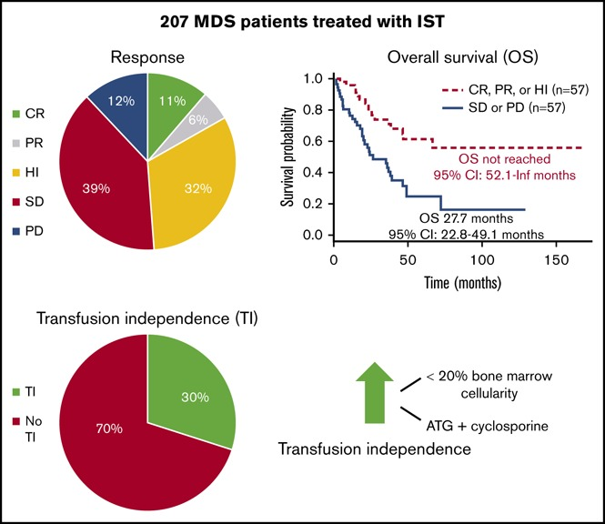
Immunosuppressive therapy( IST) in LR-MDS
207 pts (mainly ATG based)
Stahl et al; Blood Adv 2018 :2 , 1765

Slide 53
Immunosuppressive therapy in MDS
An underutilized therapy?
hATG and CSA inconsistent results
33% response (Komrokji 2016)
Response rate | 68% | 56% | 56% | 35% | 30% | 27% | 25% | 16%
Pts/study | 22/1 | 95/8 | 25/1 | 53/3 | 20/1 | /2 | 76/2 | 19/1
BIAS in interpretation of results:
Scattered studies, few pts, not selected for LR IPSS, different endpoints
Parikh et al, Semin Hematol 2012; 49(4):304-11.

Slide 54
Neutrophil and platelet increase during luspatercept treatment
Garcia Manero et al. Blood
2022 Jan 27;139(4):624-629.
Garcia Manero et al , Blood 2022

Slide 55




MDS UNIT

